Slide 1
Vehicle Tracking Management Solution
(VTMS)

Slide 2
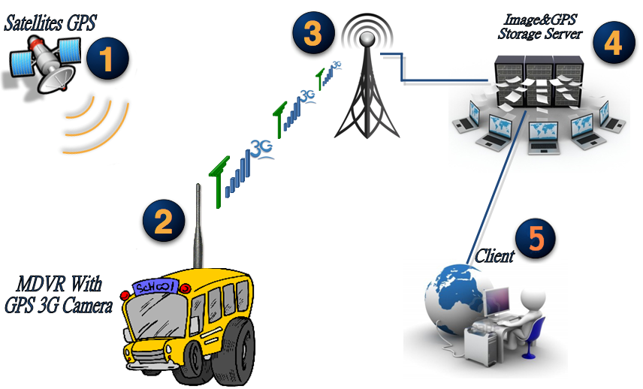
How does VTMS work?

Slide 3

Industries and service may need VTMS
Bus Lines
Shuttle services
Taxi Industries
Garbage Truck Services
Tank Truck Services
Delivery Services
Fire Engine Services
Ambulance Services
Limousine Services
Armored Truck Transportation
Sightseeing Services
Towing Services
Construction Industries
Private Vehicle
And more…..

Slide 4
Why should I install VTMS?
Insurance fraud prevention
Self protection in accident
Increase productivity
Monitor driver behavior
Deterrence
Emergency notification from driver
Reduce the cost of fleet maintenance, such as insurance premiums, fuel cost, traffic ticket.
Fleet management
Powerful evidence in court of law

Slide 5
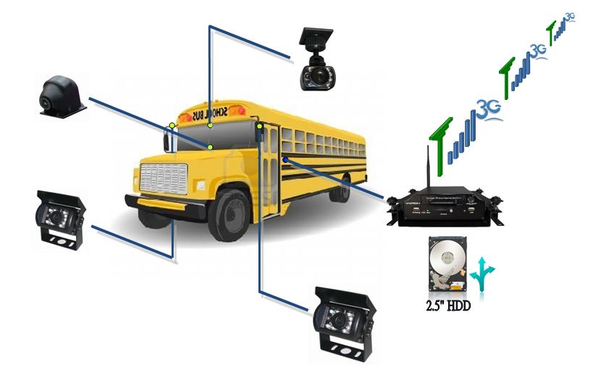
Hardware Installation Schematic Diagram

Slide 6
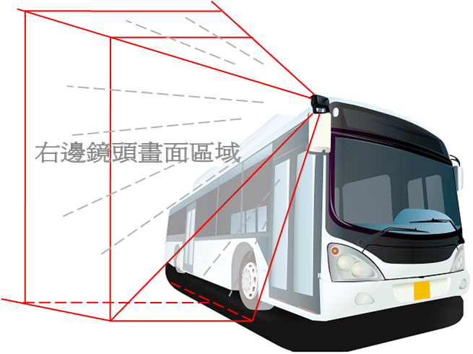
Schematic Diagram － Right Angle

Slide 7
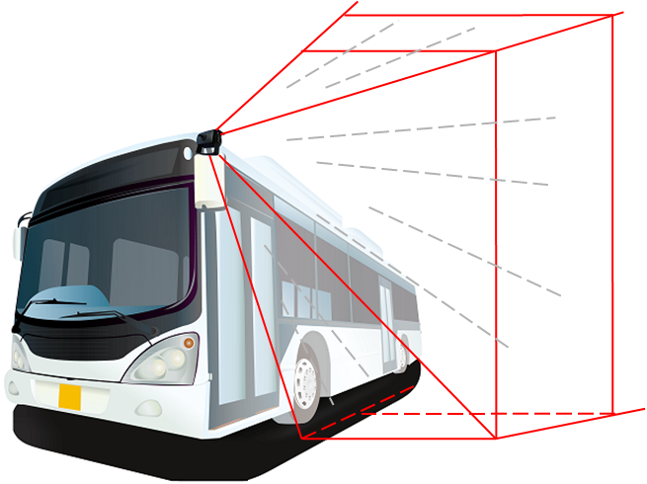
Schematic Diagram － Left Angle

Slide 8
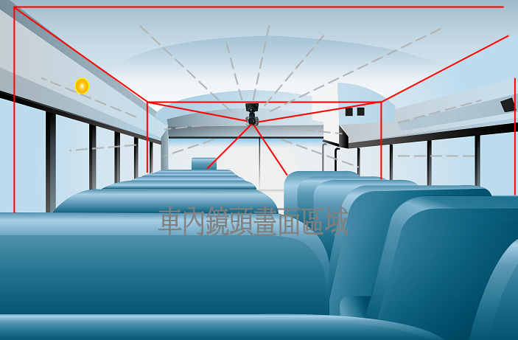
Schematic Diagram － Interior

Slide 9
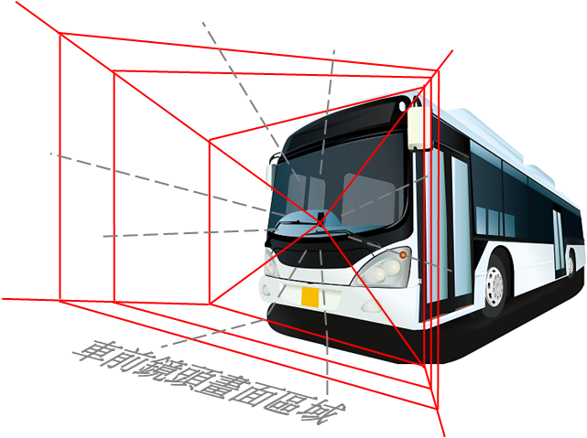
Schematic Diagram － Front

Slide 10
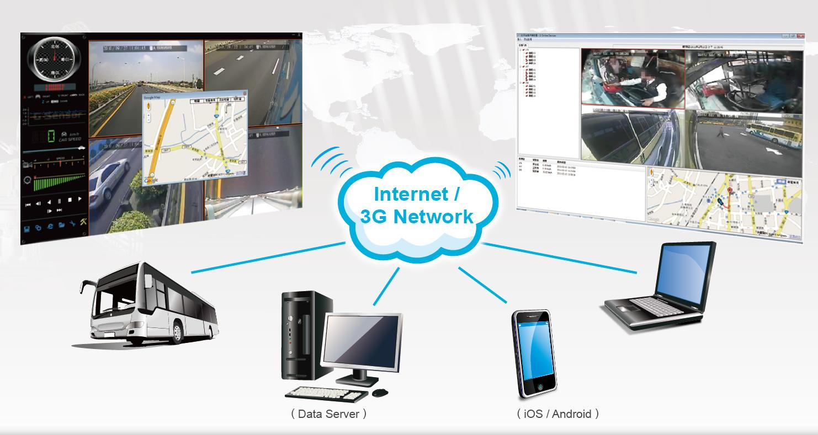
3G Client / CMS Application / APP

Slide 11
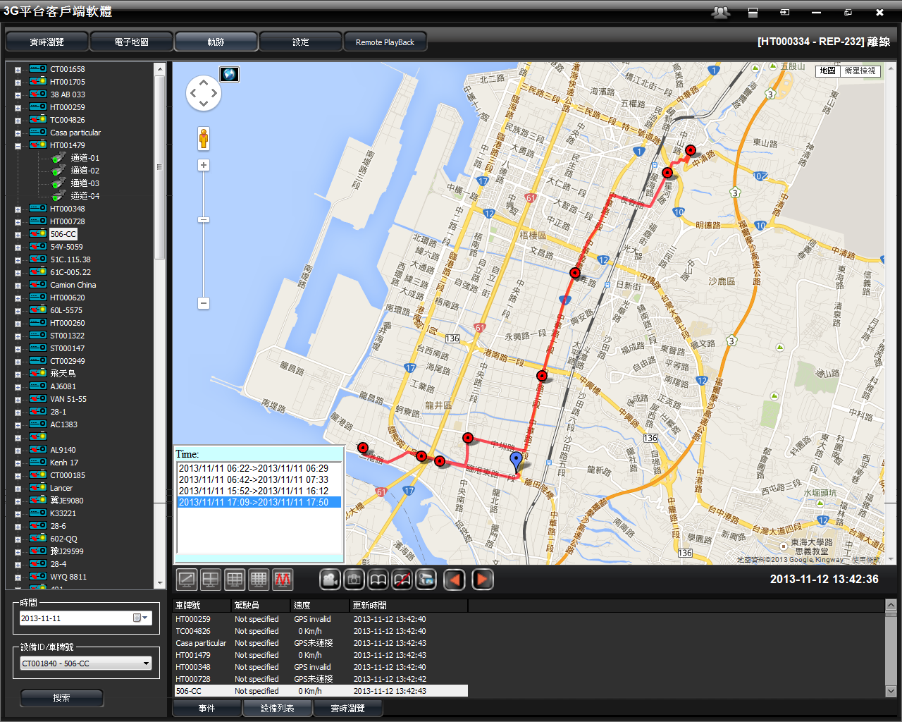
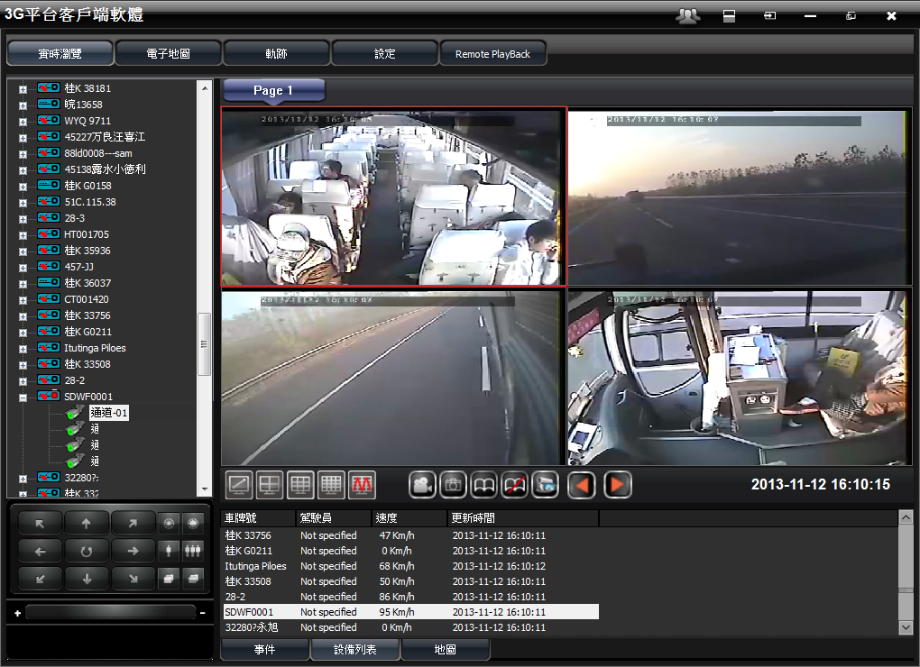
3G Client / CMS Application / APP
3G Client
3GClient is the application software connected to 3G server to manage all MDVR devices which connect to same server.
Features includes live monitoring/Google map tracking/GPS routing/two-way voice communication and more…… please see more new features in appendix.

Slide 12
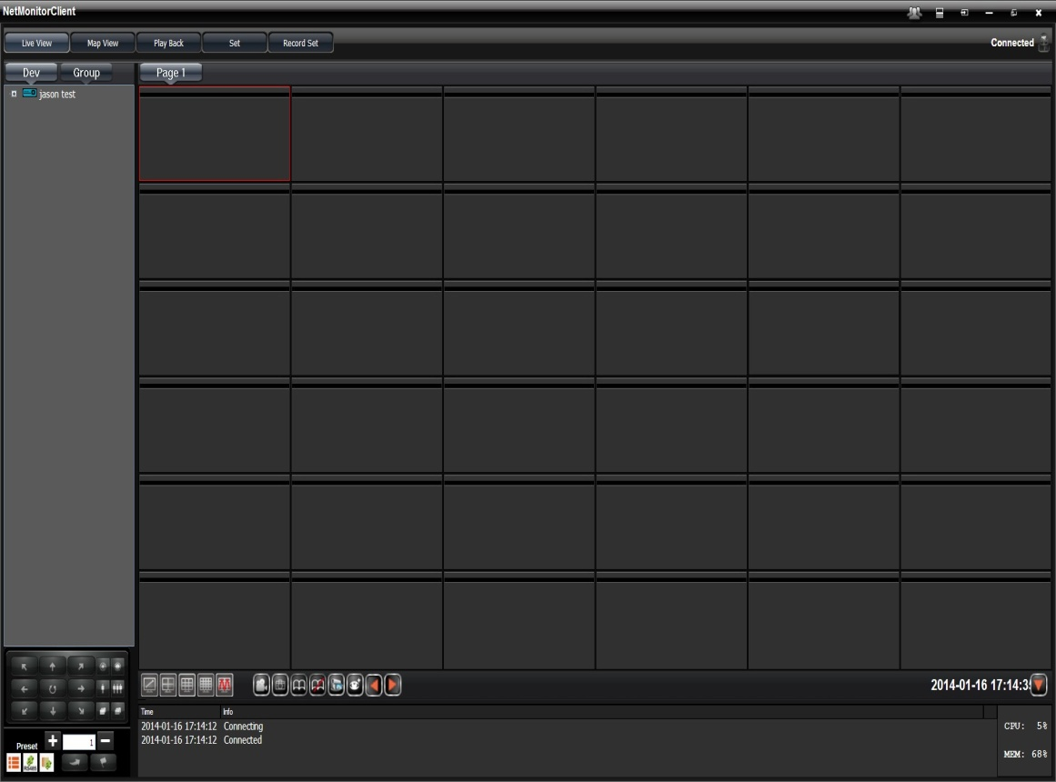
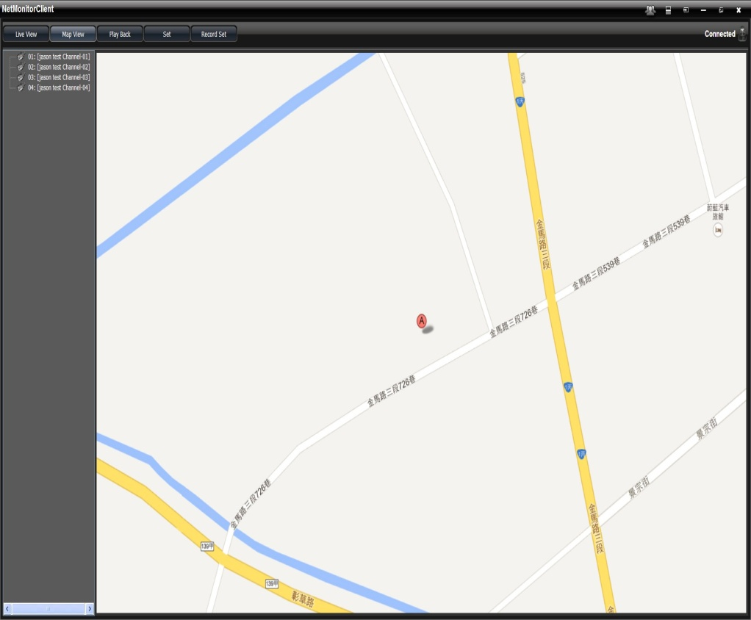
3G Client / CMS Application / APP
64ch CMS Application
Vacron 64ch CMS is the software application to connect with multiple 3G server to monitor different MDVR device.

Slide 13

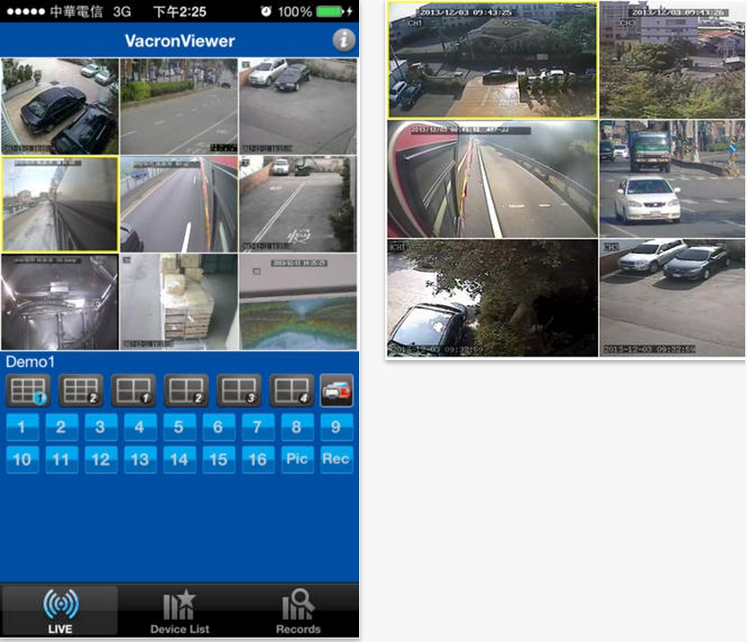
3G Client / CMS Application / APP
Smart Phone APP
Vacronviewer @ iOS APP
https://itunes.apple.com/us/app/vacronviewer/id780070117?mt=8
Features:
  Support live viewer
  Support landscape mode
  Vehicle DVR support LBS service
  Support multi windows monitoring
  MDVR server device multi list support

Slide 14
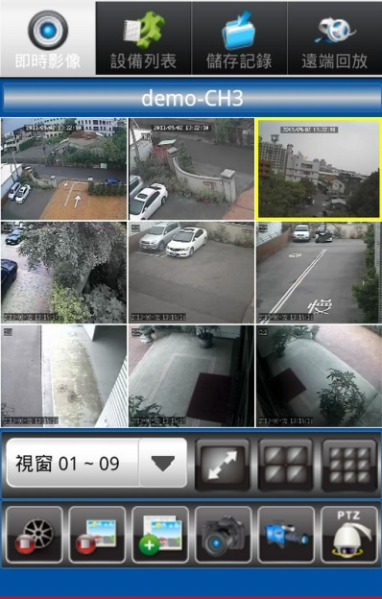
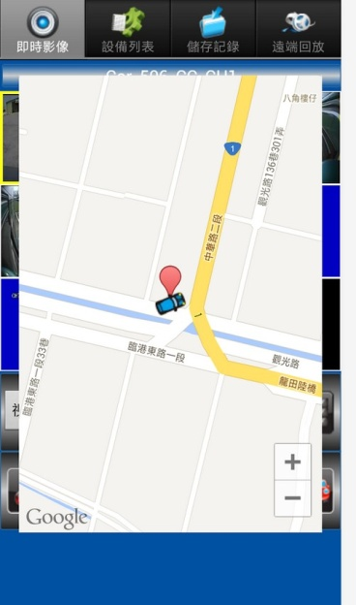
3G Client / CMS Application / APP
Smart Phone APP
Vacronviewer @ Android APP
https://play.google.com/store/apps/details?id=com.fuho.vacronviewer
Features:
  Support live viewer
  Support landscape mode
  Vehicle DVR support LBS service
  Support multi windows monitoring
  MDVR server device multi list support

Slide 15
Main Features of VTMS
Multiple account management
Panic Button
GPS map route tracking
Speed and location display on the central monitoring platform.
Real time live viewing through 3G network
Recording / playback
Two-way voice communication between driver and monitoring center
Idling notification for under 5Kmh over 3 mins
Over speeding notification
SQL data can be outputted for other platform usage

Slide 16
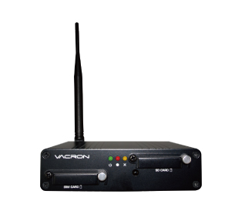
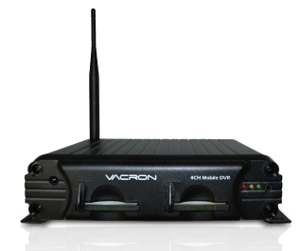
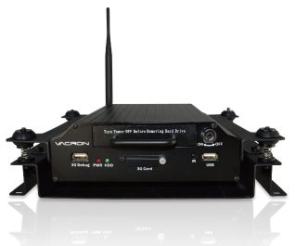
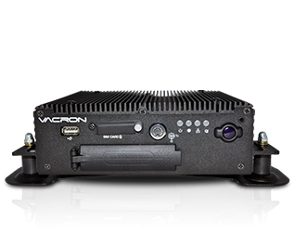
What MDVR model do we have?
CDR-E10-3GA | SA-650CF-3GA | SA-650HD-3GA | VVH-MD80D
4CH / CIF 120FPS SD CARD S Connector Alarm I/O DC 12V | 4CH / CIF 120FPS CF CARD S / BNC Connector Alarm I/O RS485 DC 8V~28V | 4CH / CIF 120FPS 2.5’ HDD / SSD S / BNC Connector Alarm I/O RS485 DC 8V~28V | 8CH / CIF 240FPS 2.5’ HDD / SSD S Connector Alarm I/O RS485 DC 8V~36V

Slide 17
FAQ
Q: Does it need a public IP to communicate between each MDVR and 3G server?
A: Yes, it needs the public IP for the communication between each MDVR and the 3G server. But it is better for you to get a fixed IP address from local ISP for 3G server.
Q: What do I need to build a 3G server?
A: You can build up any of PC with i7 CPU/4G ram and win7 pro OS PC if you are thinking to handle small project of fleet management. And we will offer you the software and instruction as it requested. But if you are thinking to handle a big project with over 100pcs MDVR and stable maintain in long time running, a professional server in the market requested, such as IBM or HP server.
Q: What Internet bandwidth do I require for my server?
A:it depends on how many MDVR would you like to attach in the server. 100MB/100MB bandwidth can have capability to handle about 200~250 MDVR to live viewing and downloading in the same time.

Slide 18
FAQ
Q: What is the price of the server software?
  A: The server software is free, but the client needs to pay for license fee per unit. We normally will give client one free demo license key to try, and each free demo key allows 5 units to be attached in server at the same time.
Q: What size of HDD can be supported?
  A: So far our MDVR does support the 2.5” HDD/SSD up to 1TB.
Q: How can I set 3G network of MDVR after I apply sim card from ISP?
  A: After the user insert the sim card into the 3G module, then use our 3G configuration tool from CD on PC and fill up the all of 3G network information provided from ISP. After that, output the config file to USB driver, then insert the USB driver to MDVR. All of 3G setting will be set after MDVR reboot.

Slide 19
FAQ
Q: What brands of HDD support MDVR?
  A: Most of Western Digital and Seagate HDD does support.
Q: If I can not see the video image in 3G client software, what do I do?
  A: Please check APN and Dial-up numbers information from local 3G provider and use 3G configure tool to configure the setting.
Q: Why MDVR keep restart when it’s powered on?
  A: Please apply 2.5” HDD, CF card, or SDHC card properly before providing the power to MDVR; it’s designed to let customers know if the video image is recorded in MDVR

Slide 20
FAQ
Q: Can I make our own private account with specific user name and password?
  A: Yes, please provide your designated user name and password for your sales representative.
Q: When I saw DC 12V power Jack and provide it with the power on MDVR, why MDVR can not be powered on
  A: Because normally MDVR is designed to be powered on with ACC in the vehicle, it’s our friendly design for customers who would like to test the device locally; please use the provided cable inside the package, and connect the blue and yellow wires together to make it short circuit, then provide DC12V power to start MDVR.
Q: When I build up my own 3G server, why I can not change the video frame rate and resolution on 3G web server
  A: Because it’s our friendly design to let the user who use 3G client server can change the setting easily.

Slide 21
YouTube Link
Insurance fraud http://www.youtube.com/watch?v=2QCTTWsYGXY

Slide 22




Successful Case Study
ChangHua Bus (Taiwan)
  http://www.changhuabus.com.tw/
Court of Sao Paulo (Brazil)
  http://www.tjsp.jus.br/
International Police Association (Brazil)
  http://ipa-brasil.org.br/
ChangHua County Police Department (Taiwan)
  http://www.chpb.gov.tw/english/

Slide 23
Appendix
3G Server New Features Update

Slide 24
3G Server New Features Update
Dec. 2013

Slide 25
Update on Management Platform
Non-Admin can logon to 3G management platform
Stream settings
Report and log of ACC state
Online status (on/off/idle/speeding)
Fleet management (underdeveloped – travel time / distance)
Web video display (late December)
Data flow check

Slide 26
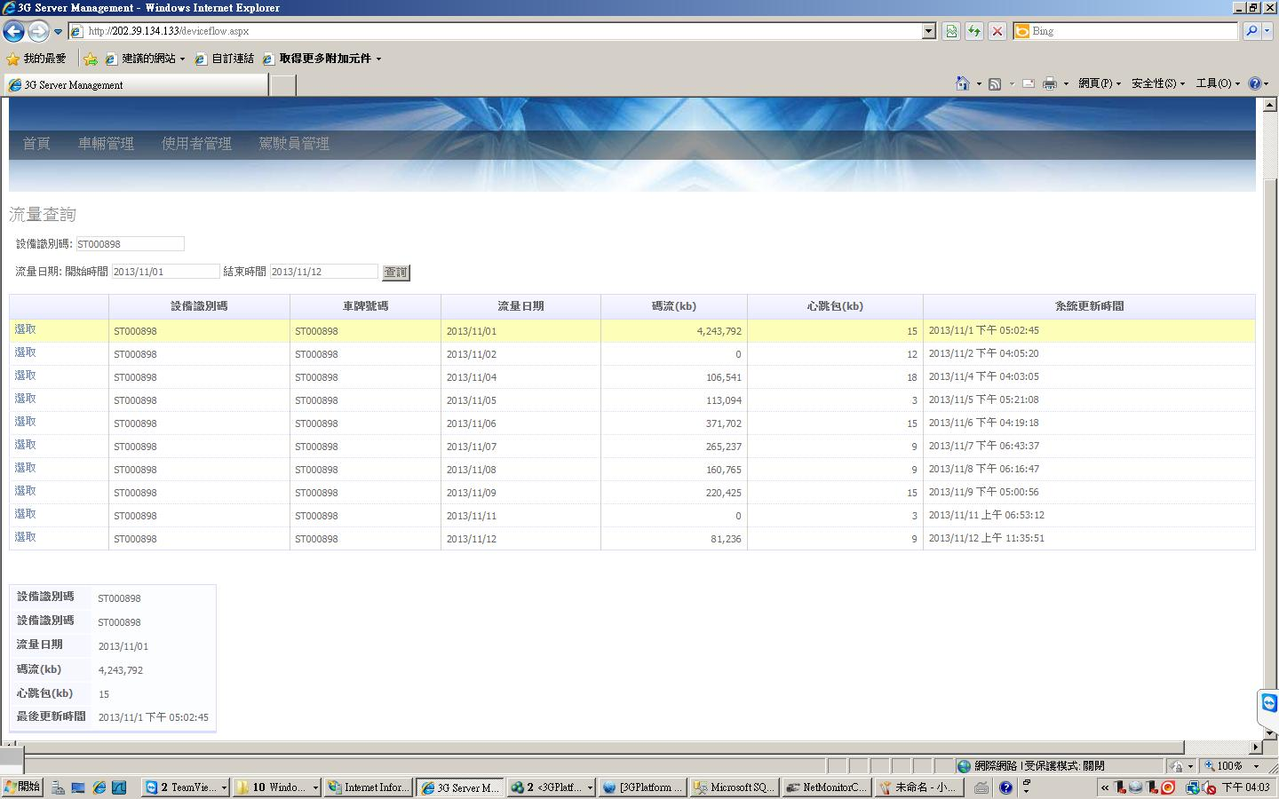
Data Flow Chart wwwroot (Version after 102/11/12)

Slide 27
New Features on 3G client
(Server Version 4.12, 3G Client version .20)
Pros: the continuation of the previous user interface, easy-to-use.
Cons: certain degree of difficulty on system integration.
Features planning to be added in the future:
a. change the server IP address on the MDVR remotely.
b. Audio (broadcasting, auto cut off)
c . Duplex remote playback.
d. Google Maps (coordinate & address)

Slide 28
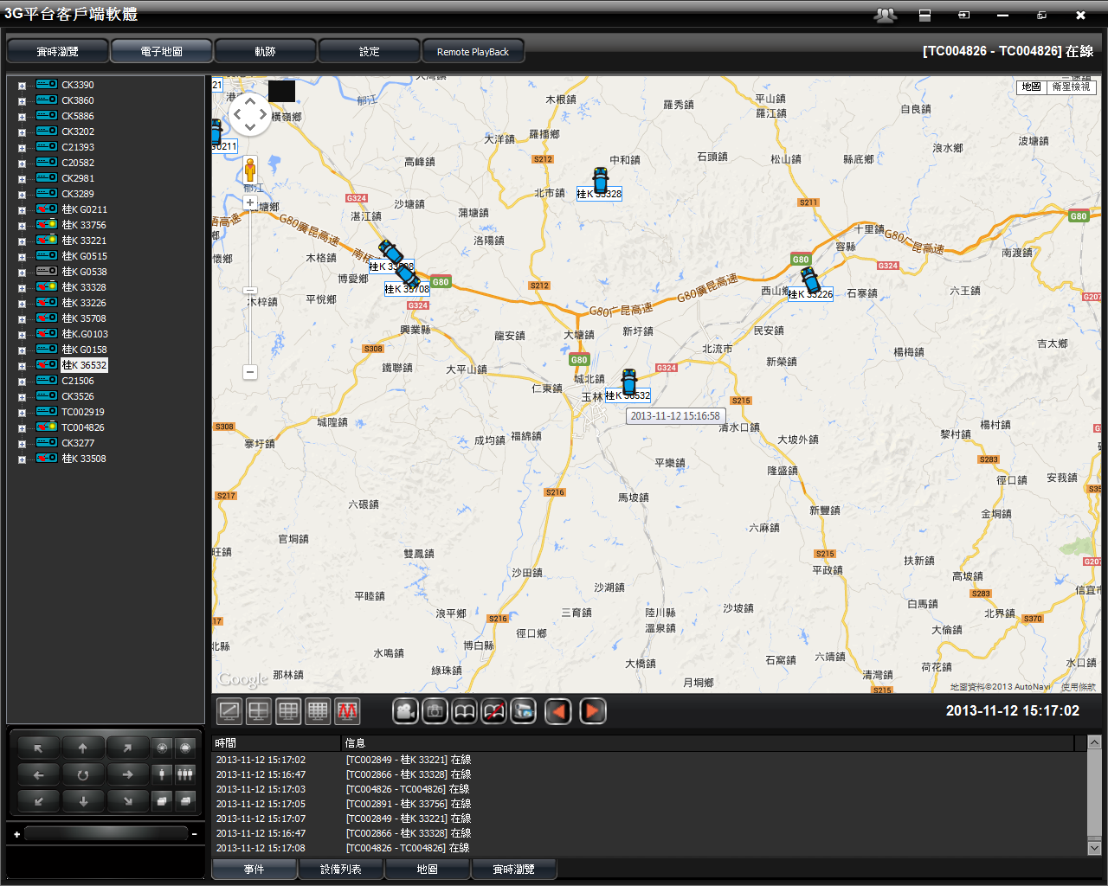
All vehicles’ position & time before logoff. (Electronic Map)

Slide 29
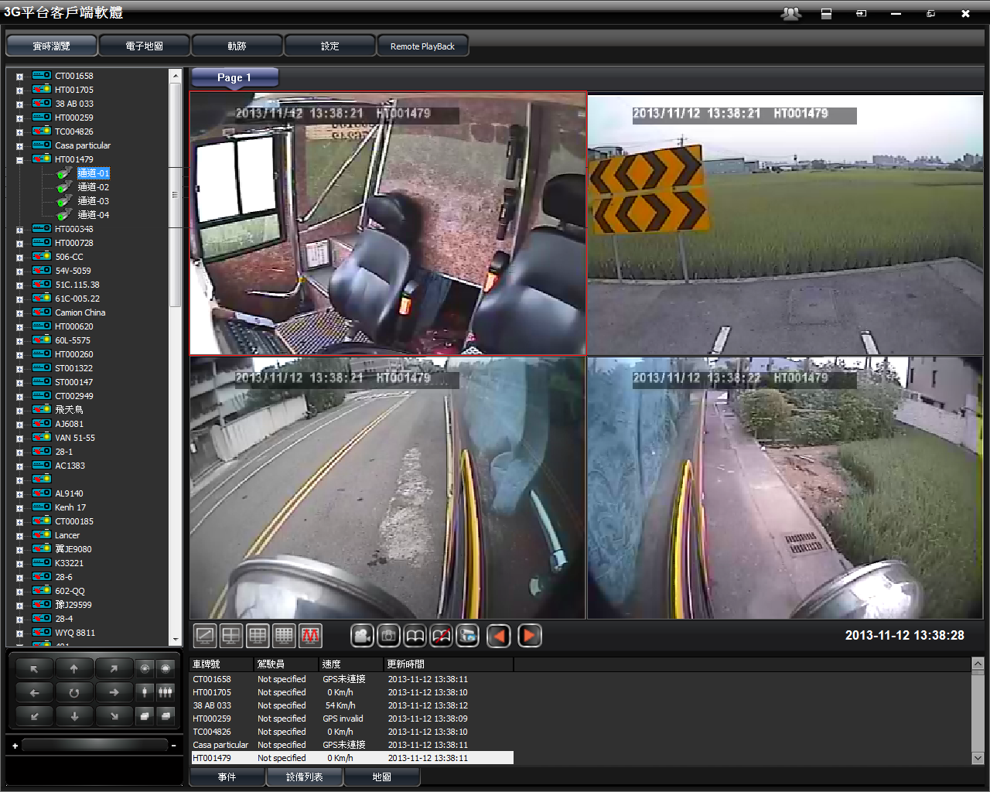
Idling indicator (yellow dot)
(Speed under 5kph, or 3mph for over 3min)

Slide 30
Over speed Limit indicator(red dot)
(Suitable for public transportation)

Slide 31
Check points – on a specifitying route. One minute traveling time between two red points.

Slide 32
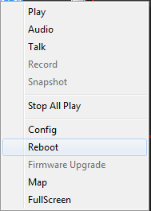
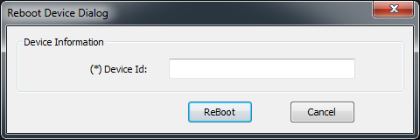
Reboot MDVR Remotely
Firmware V4439 and later
Right click on the vehicle, then click reboot, then enter its ID number (not license plate number)

Slide 33
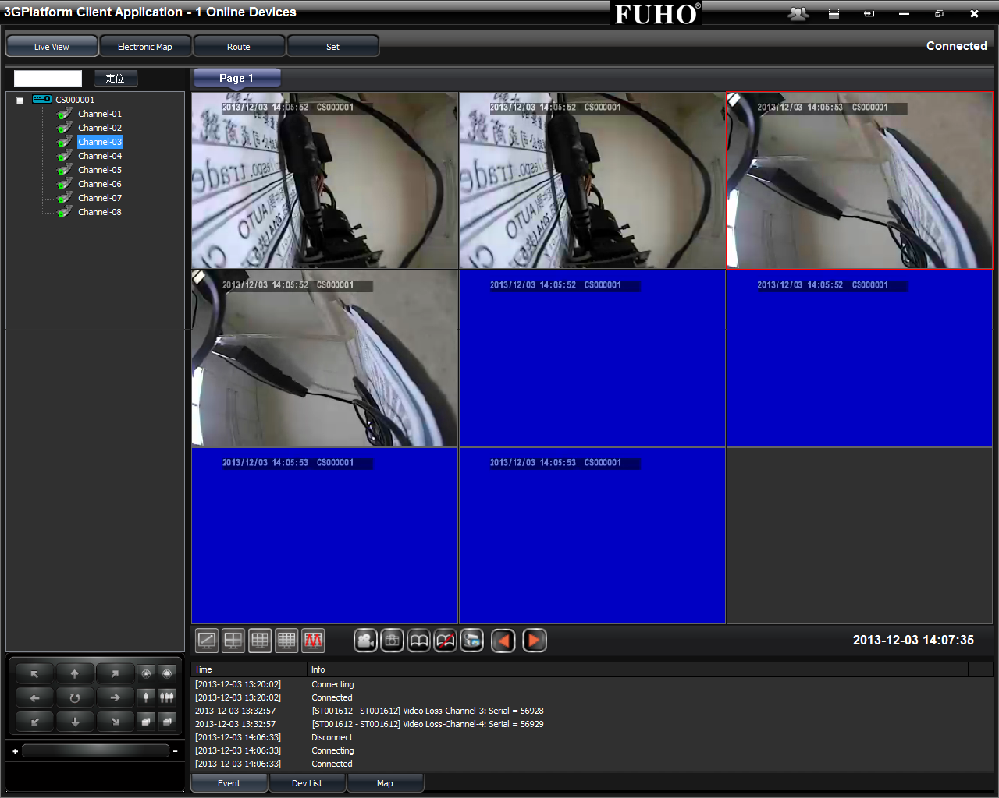
Support MD80D 8-channel Images

Slide 34
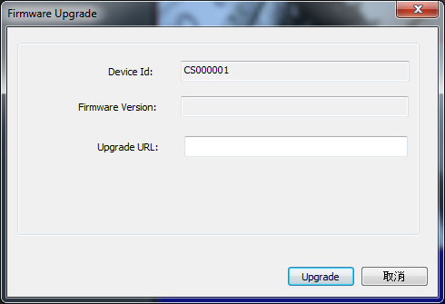
Firmware Update Remotely (80D)

Slide 35
Quick View on 3G Alarm Feature
Transmit one heartbeat every 5 seconds.
Continuous alarm warning in 5 minutes (such as door open) would count as one time.
Video lost: send warning every 30 minutes.
Send warning to server when hard drive failed and MDVR auto reboot.
Video Pop-Up/Record/E-Mail

Slide 36
Other Alarm Features
(General Use)
Single channel viewing during signal light or reverse.
Emergency button
Current status report, e.g. door open, gasoline cap open.

Slide 37
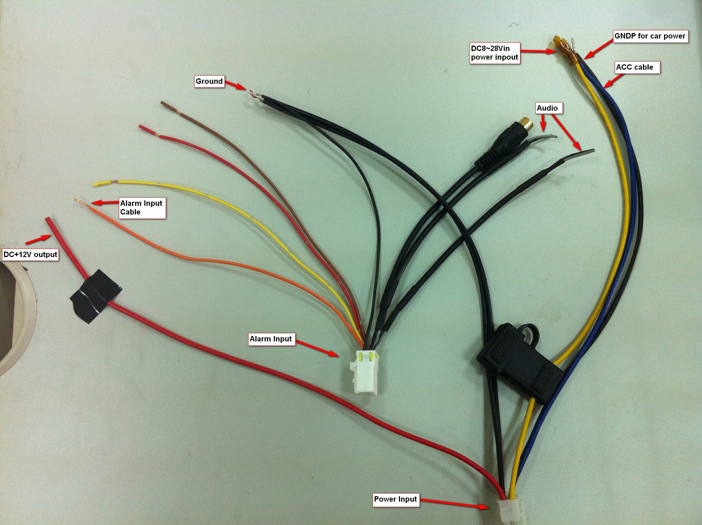
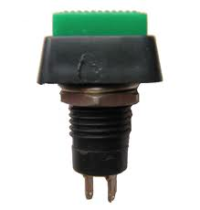
Alarm (Wire Connection Diagram)Alarm
DC-12V connection (for signal light)
Use pulse button as the emergency button: press the button for immediate power connection for at least one second. Release the button to stop.
http://www.allaboutcircuits.com/vol_4/chpt_4/1.html

Slide 38
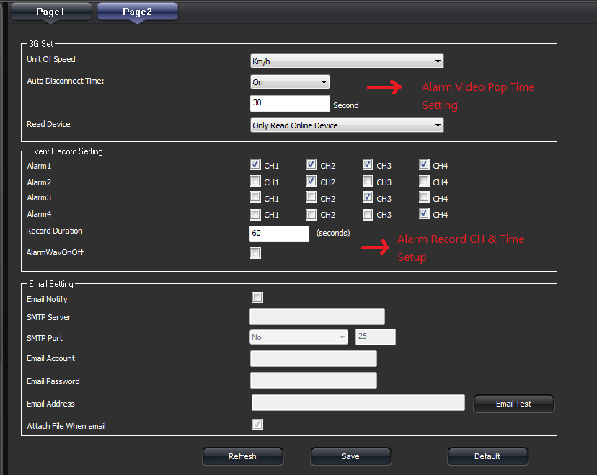
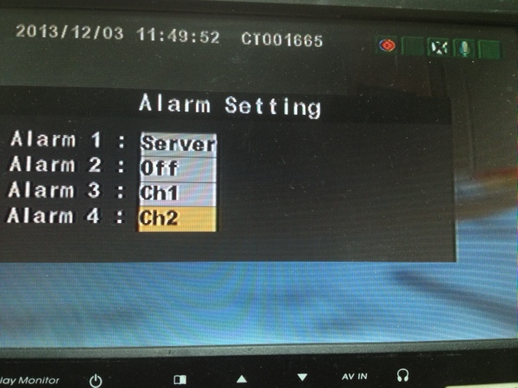
Software Setting
3G Client Setting
MDVR OSD Setting
（select server)

