Slide 1


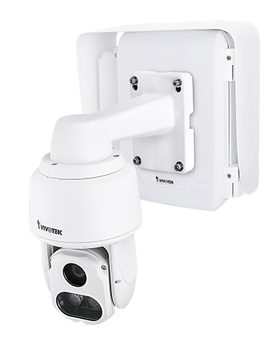
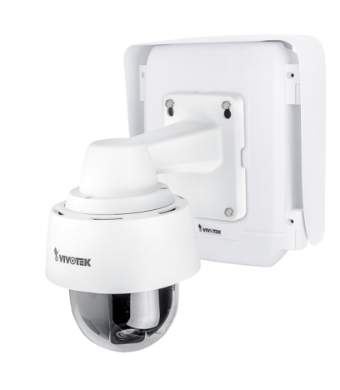
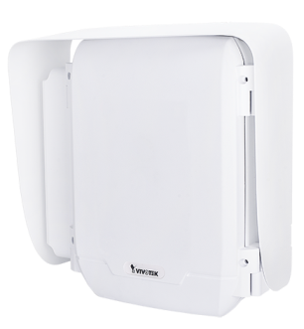
VIVOTEK Surveillance Cabinet Solution
Notes:
1

Slide 2
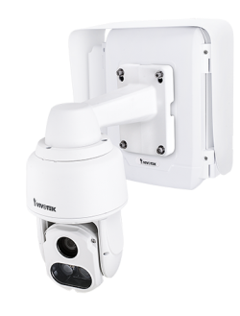
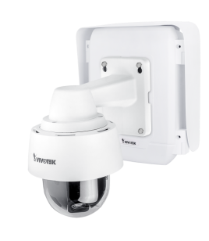
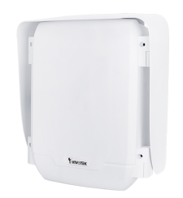
Agenda
• Challenge of outdoor camera installation?
• Why VIVOTEK?
• Application via local power and PoE
•Mounting Accessory
• Advanced Solutions

Slide 3
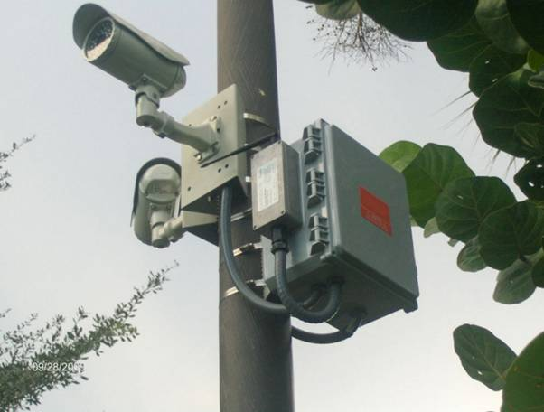
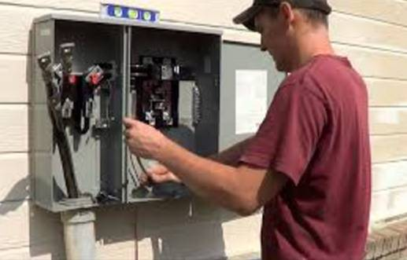
Outdoor camera installation
Requirement:
Power supply issue
Wide temperature range
Data transmission
Dust and rain protection
Surge protection

Slide 4
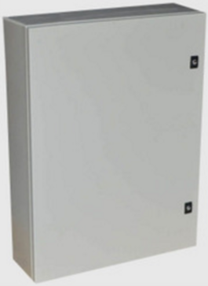
100~240VAC Power supply
Network Device
VIVOTEK Cabinet

Slide 5


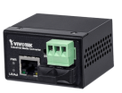
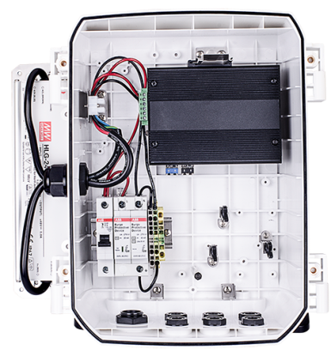

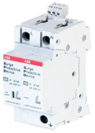
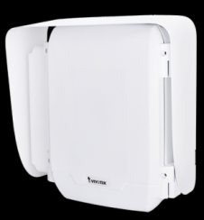

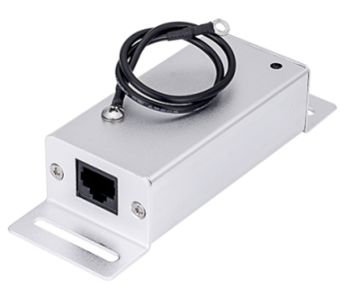
VIVOTEK Cabinet solution
PoE Injector
PoE Switches
2/30/80KM
Media Converter
MCB Fuse
AC Surge Protector
IK10, IP66
-40 °C to 75 °C
80/120/240W
Power Supply
PoE Surge
Protector
All –in-one to fit your need

Slide 6
Key Features
• Compatible with VIVOTEK speed dome(SD936x Series), Bullet, Dome, Enclosure and Daisy-Chain PoE camera.
• Single and multiple camera applications
• Weather-proof IP66-rated, vandal-proof IK10-rated
• Integrate with IP cameras, fiber converter, industrial PoE solution, surge protector, power supply, MCB Fuse to be installed in a single cabinet
• Temperature : -40~75 °C

Slide 7
Why VIVOTEK Cabinet?
Customization
Reduce total ownership cost
Safety
Notes:
7

Slide 8
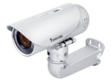
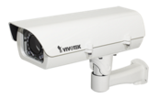
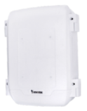
Selling Points : One-Stop Power Box
One-stop shop: integrate industrial PoE switch/injector, power supply, and surge protector kit in a single box
Easy installation and save maintenance cost
One box can support multiple cameras application
PoE Injector
2/30/80KM
Media Converter
PoE Switches
MCB
Fuse
AC Surge
Protector
PoE Surge
Protector
80/120/240W
Power Supply

Slide 9

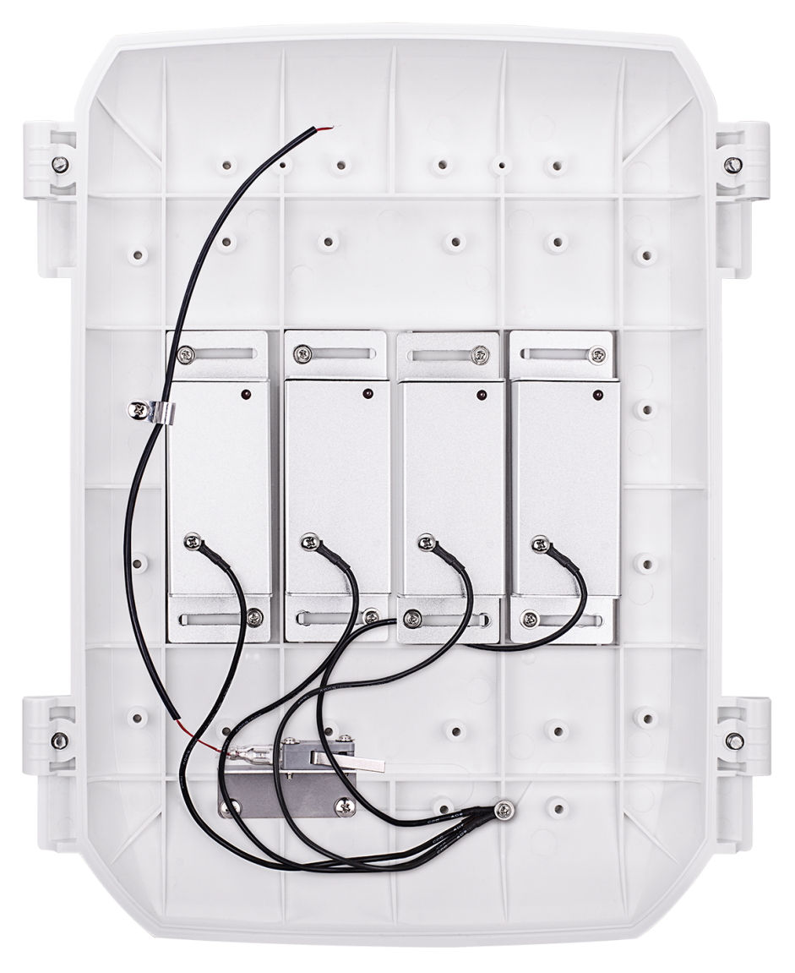

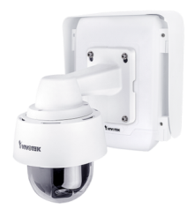
Selling Points-Safety
➔Safety issue
Integrate AC/PoE surge protector
Door open/close detection switch
PoE Surge
Door Switch
AC Surge

Slide 10
Application via Camera Power Type
Set A
DC power for Speed Dome
Set B
PoE for Single Camera
Set C
PoE for Multiple Camera

Slide 11
Application
Set A
DC power for Speed Dome
Set A-1
for SD9361/62 Speed Dome Need 24VDC
Set A-2
for SD9364 Speed Dome Need 48VDC

Slide 12
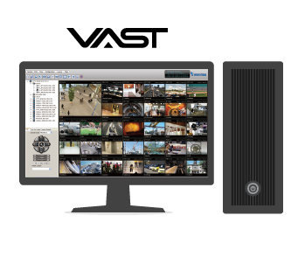
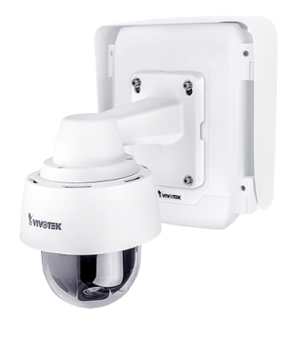
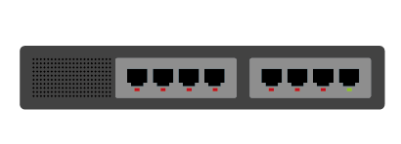
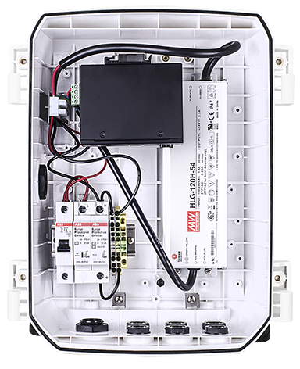
Set A-1 for SD9361/62 Speed Dome
VMS
Switch
Power
Fiber
PoE
LAN
LAN up to 100m
Fiber up to 80km(option)
100~240VAC POWER
AW-IHS-0203
HLG-80H-24
Ordering Information
100145000G | AT-CAS-001 | Cabinet for Speed Dome SD936x Series
900032000G | AT-SUN-001 | Sunshield for AT-CAx series cabinet
100145300G | AT-SWH-000 | Power Safety Kit
900033700G | HLG-80H-24 | 90~305VAC In ,24VDC/80W Out ,IP67, - 40 ℃ ~ 70 ℃
100133200G | AW-IHS-0203 | Industrial Gigabit SFP Fiber Media Convert(option)
AT-SWH-000

Slide 13
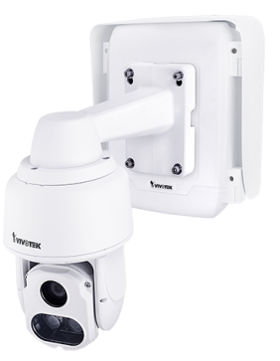
Set A-2 for SD9364 Speed Dome
VMS
Switch
Power
Fiber
PoE
LAN
LAN up to 100m
Fiber up to 80km(option)
100~240VAC POWER
AW-IHS-0203
HLG-120H-48
Ordering Information
100145000G | AT-CAS-001 | Cabinet for Speed Dome SD936x Series
900032000G | AT-SUN-001 | Sunshield for AT-CAx series cabinet
100145300G | AT-SWH-000 | Power Safety Kit
900033400G | HLG-120H-48 | 90~305VAC In ,48VDC/120W Out ,IP67, - 40 ℃ ~ 70 ℃
100133200G | AW-IHS-0203 | Industrial Gigabit SFP Fiber Media Convert(option)
AT-SWH-000

Slide 14
Application
Set B
PoE for Single Camera
Set B-1
15.4W/30W at/af Camera
Set B-2
60W UPoE Camera
Set C-3
95W PoH/PoE Camera

Slide 15
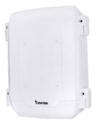
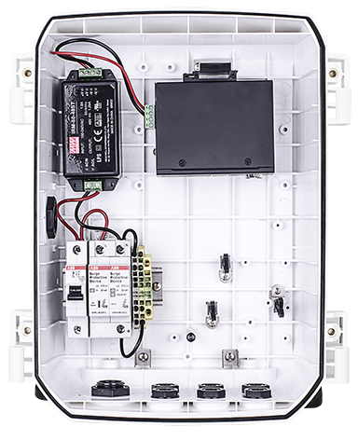
Set B-1 for Single camera(15.4W/30W)
VMS
PoE
Switch
Power
Fiber
PoE
LAN
Fiber up to 80km
100~240VAC POWER
AW-IHT-0200
Ordering Information
IRM-60-48ST
100145100G | AT-CAB-001 | Cabinet
900032000G | AT-SUN-001 | Sunshield for AT-CAx series cabinet
100145300G | AT-SWH-000 | Power Safety Kit
900033600G | IRM-60-48ST | 85~264VAC In , 48VDC/60W Out , -30 ℃ ~ 70 ℃
100142300G | AW-IHT-0200 | Industrial 1xGE 30W PoE + 1xGE SFP Switch
AT-SWH-000
Optional PoE Surge Device
900034000G | AT-PSP-001 | 8~10KV PoE surge protector

Slide 16
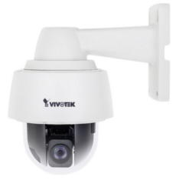
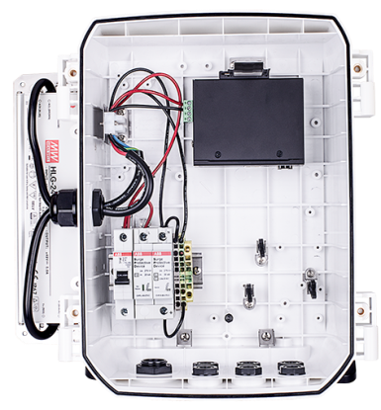
Set B-2 for Single camera(60W UPoE )
VMS
PoE
Switch
Power
Fiber
PoE
LAN
Fiber up to 80km
100~240VAC POWER
AW-IHU-0200
Ordering Information
100145100G | AT-CAB-001 | Cabinet
900031900G | AT-CAB-002 | Side-mount bracket for HLG series power supply
900032100G | AT-SUN-002 | Sunshield for AT-CAx + AT-CAB-002 cabinet
100145300G | AT-SWH-000 | Power Safety Kit
900030400G | HLG-120H-54 | 90~305VAC In ,54VDC/120W Out ,IP67, - 40 ℃ ~ 70 ℃
100142800G | AW-IHU-0200 | Industrial 1xGE 60W UPoE + 1xGE SFP Switch
HLG-120H-54
AT-SWH-000
Optional PoE Surge Device
900034000G | AT-PSP-001 | 8~10KV PoE surge protector

Slide 17
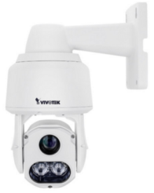
Set B-3 for Single 95W PoH/PoE Camera
VMS
Switch
PoE
Power
Fiber
PoE
LAN
Fiber up to 80km
100~240VAC POWER
AW-IHH-0200
Ordering Information
100145100G | AT-CAB-001 | Cabinet
900031900G | AT-CAB-002 | Side-mount bracket for HLG series power supply
900032100G | AT-SUN-002 | Sunshield for AT-CAx + AT-CAB-002 cabinet
100145300G | AT-SWH-000 | Power Safety Kit
900030400G | HLG-120H-54 | 90~305VAC In ,54VDC/120W Out ,IP67, - 40 ℃ ~ 70 ℃
100146000G | AW-IHH-0200 | Industrial 1xGE 95W PoH/PoE + 1xGE SFP Switch
HLG-120H-54
AT-SWH-000
Optional PoE Surge Device
900034000G | AT-PSP-001 | 8~10KV PoE surge protector

Slide 18
Application
Set C
PoE for Multiple Camera
Set C-1
Multiple 15.4W/30W Cameras
Set C-2
Multiple 60W UPoE cameras

Slide 19

Set C-1 for Multi cameras(15.4W/30W)
VMS
Switch
PoE
Power
Fiber
PoE
LAN
LAN up to 100m
Fiber up to 80km(option)
100~240VAC POWER
AW-IHT-0600
Ordering Information
100145100G | AT-CAB-001 | Cabinet
900031900G | AT-CAB-002 | Side-mount bracket for HLG series power supply
900032100G | AT-SUN-002 | Sunshield for AT-CAx + AT-CAB-002 cabinet
100145300G | AT-SWH-000 | Power Safety Kit
900030400G | HLG-120H-54 | 90~305VAC In ,54VDC/120W Out ,IP67, - 40 ℃ ~ 70 ℃
100128500G | AW-IHT-0500 | Industrial 4xFE 30W PoE + 1xFE Switch
100129000G | AW-IHT-0600 | Industrial 4xGE 30W PoE + 2xGE SFP Switch(option)
HLG-120H-54
AT-SWH-000
Optional PoE Surge Device
900034000G | AT-PSP-001 | 8~10KV PoE surge protector

Slide 20





Set C-2 for Multi cameras(60W UPOE)
VMS
Switch
PoE
Power
Fiber
PoE
LAN
Fiber up to 80km
100~240VAC POWER
AW-IHU-0600
Ordering Information
100145100G | AT-CAB-001 | Cabinet
900031900G | AT-CAB-002 | Side-mount bracket for HLG series power supply
900032100G | AT-SUN-002 | Sunshield for AT-CAx + AT-CAB-002 cabinet
100145300G | AT-SWH-000 | Power Safety Kit
900030500G | HLG-240H-54 | 90~305VAC In ,54VDC/240W Out ,IP67, - 40 ℃ ~ 70 ℃
100142600G | AW-IHU-0600 | Industrial 4xGE 60W UPoE + 2xGE SFP Switch
HLG-240H-54
AT-SWH-000
Optional PoE Surge Device
900034000G | AT-PSP-001 | 8~10KV PoE surge protector

Slide 21
Cabinet Ordering Information
Notes:
21

Slide 22
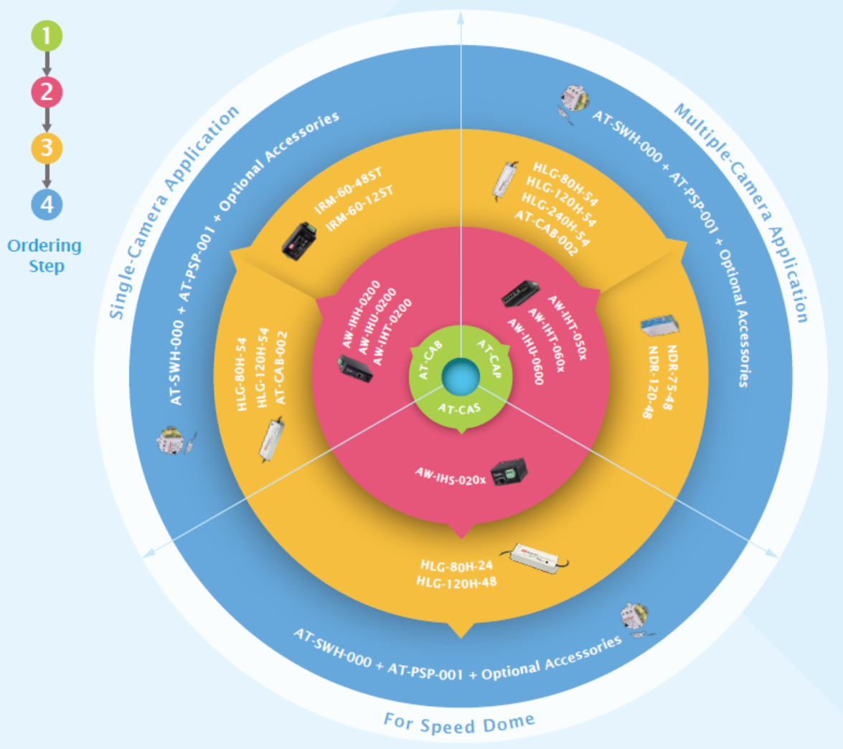
Ordering Information

Slide 23
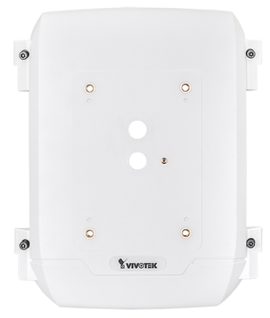
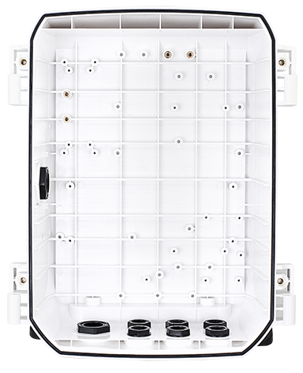
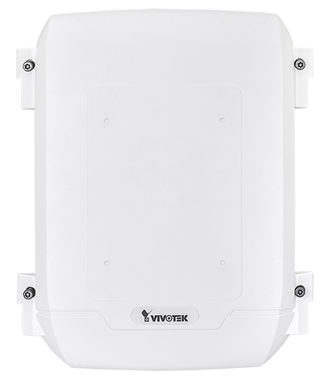
Cabinet Parts
  AT-CAS-001 for SD936x Series Speed Dome
  AT-CAB-001 for PoE Solution

Slide 24
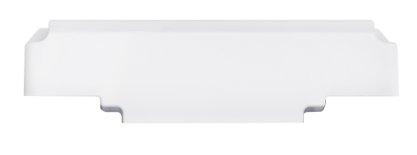
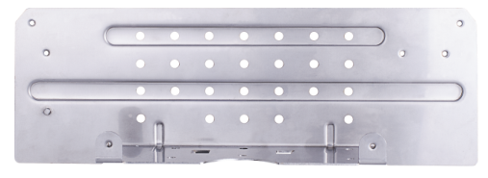
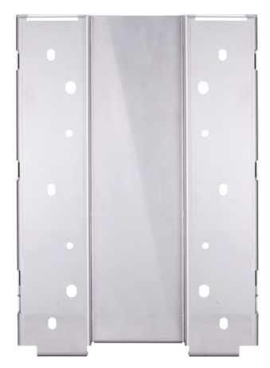
Cabinet Parts
AT-CAB-002 : Side-mount bracket for HLG series power supply
Wall Mount (Standard Accessory)

Slide 25
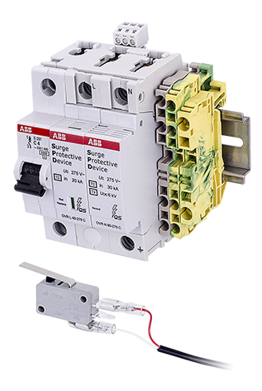
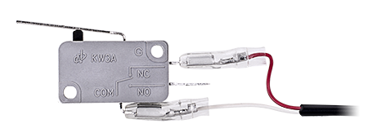
Cabinet Parts
AT-SWH-000 : Power Safety Kit
AT-SWH-002 : Door open/close detection switch
Include:
MCB fuse : 4A , 100~230VAC
AC Surge protector : 110V~230VAC, Uc: 275VAC, 40KA with DO
Terminal block 4x2.5 mm2 (L),
Terminal block 4x2.5 mm2 (GND)
Terminal block 2x4 mm2 (GND)
AT-SWH-002 : Door open/close detection switch Kit
Include:
Door switch
Screw

Slide 26
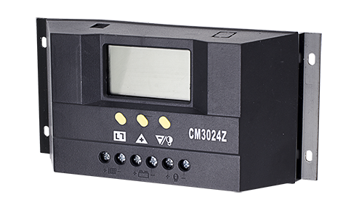
Cabinet Parts
AT-PSP-001: PoE Surge Protection
◆ Gigabit PoE (802.3af / 802.3at)
◆ Protect all 8 lines (CAT5 / CAT6)
◆ Failure Indicator
◆ IEC 61643-21
◆ IEC 61000-4-5
◆ ITU-T K-Series
◆ Surge Handling Capability: 20kv, 10kA to ground in 8/20 μs,600v
◆ Operation Temperature : -40~85°C
AT-SPC-001 : 30A Solar Power Control(Coming soon)
◆ Rated Current : 30A
◆ Rated Voltage : 12V/24V
◆ Intelligent PWM charge mode
◆ Overload, Short Circuit Protection
◆ Battery reverse-discharge protection
◆ Battery Low Voltage Disconnection (LVD)
◆ Battery reverse connection protection
◆ Open Circuit Voltage of solar panel : ≤50V
◆ Operation Temperature : -10~60°C

Slide 27
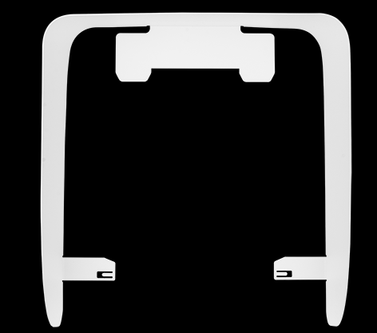
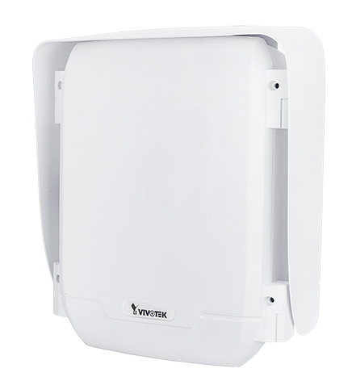
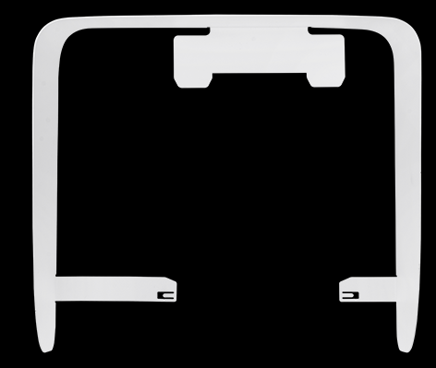
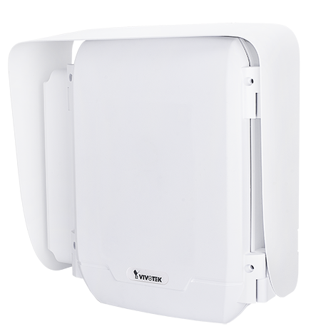
Cabinet Parts
AT-SUN-001 : Sunshield for AT-CAx series cabinet
AT-SUN-002 : Sunshield for AT-CAx + AT-CAB-002 cabinet
For AT-CAB-001 / AT-CAS-001
cabinet use
For AT-CAB-001 / AT-CAS-001
+ AT-CAB-002 cabinet use

Slide 28
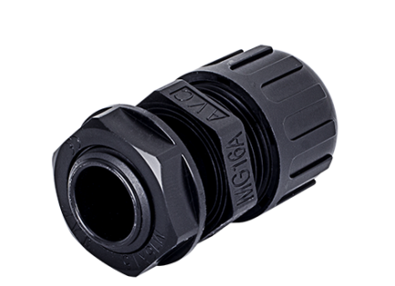
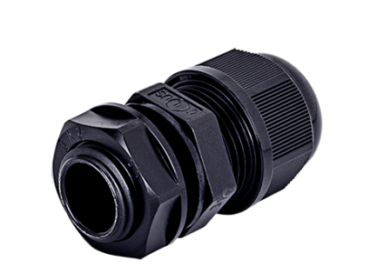
Cabinet Parts
AT-WPC-001 : M16 Cable Gland for 4~7mm AWG
AT-WPC-002 : M16 Cable Gland for Corrugated Tubing : 5/16 "
Cable Range : 4-7mm
Corrugated Tubing : 5/16 "

Slide 29
Mounting Accessory
Notes:
29

Slide 30
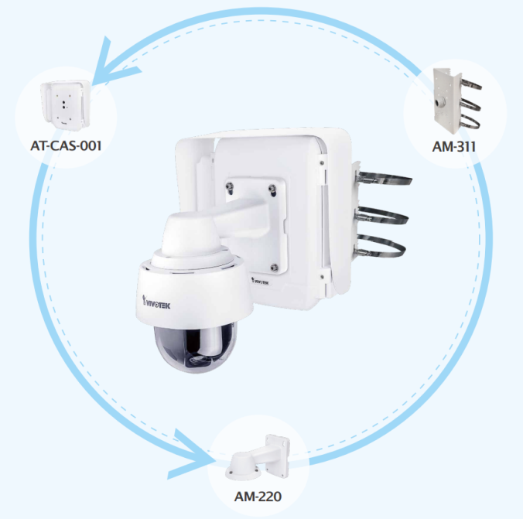
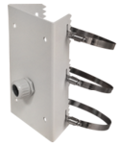
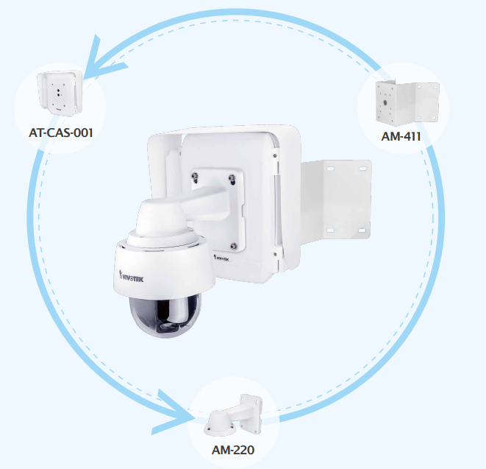
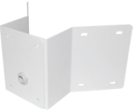
Mounting Accessory
Pole Mount AM-311
Corner Mount AM-411

Slide 31
LTE
Solar
Wifi AP
Advanced Solutions
Notes:
31

Slide 32







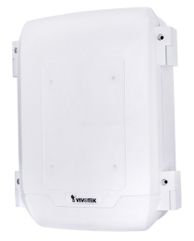
Advanced Solution : 4G LTE AP + Camera
VPN Tunnel
VPN Server
4G LTE AP
Outdoor
Camera
4G BS
100~240VAC POWER

Slide 33

Advanced Solution : WiFi AP + Camera
PoE Switch
WiFi AP
WiFi AP
Outdoor
Camera
100~240VAC POWER

Slide 34




Advanced Solution : Solar Power + Camera
VPN Tunnel
VPN Server
4G LTE AP
Outdoor
Camera
4G BS

Slide 35

Advanced Solution : Solar Power + Camera
PoE Switch
WiFi AP
WiFi AP
Outdoor
Camera

Slide 36

Thank you
for your attention
The End

