Slide 1
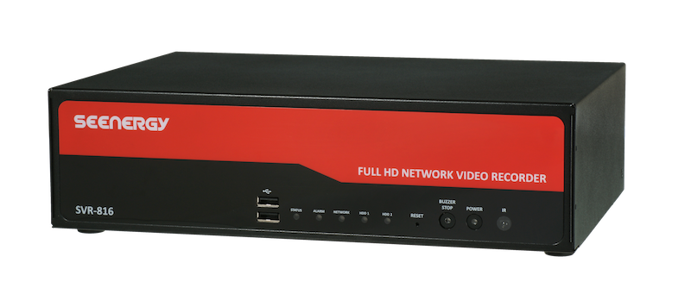
Training Course
SVR800
2014/3/15
Mariame

Slide 2
SVR 800
SVR800
SVR 800 is a Network Video Recorder (NVR) made by SEEnergy Corp.
An external device that helps to monitor the IP cameras of the users.
It can display and manage simultaneously channels up to 16 and have multiple function.

Slide 3
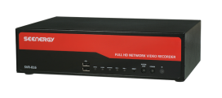
PLAN
Training Course SVR800
SVR800
Installation
Configuration
Main View
System Options

Slide 4
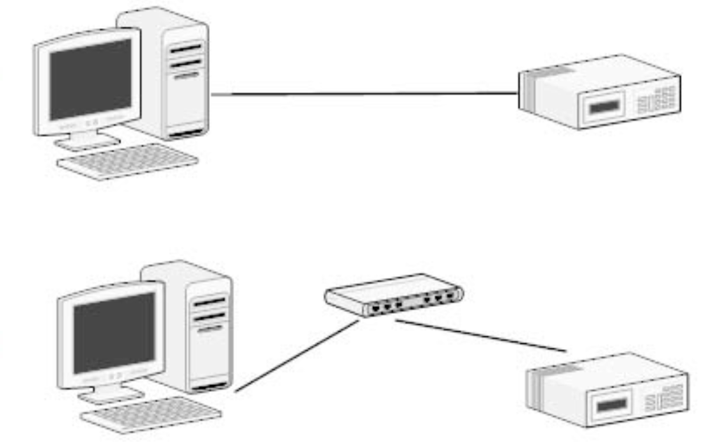
Installation
SVR800
  To connect to the NVR, use a PC that is on the same network (LAN) over a switch or hub, or connect the PC directly to the NVR using a crossover CAT5 Ethernet cable.

Slide 5
Installation
SVR800
SVR 800 Default network configuration
The NVR comes with a pre-configured static IP “192.168.101.50”. However, it is only used when there is no DHCP server presented in the network.
The NVR will turn on its DHCP server function and act as the DHCP server in the network.
Or it will get automatically an IP Address from the pre existing DHCP server.

Slide 6
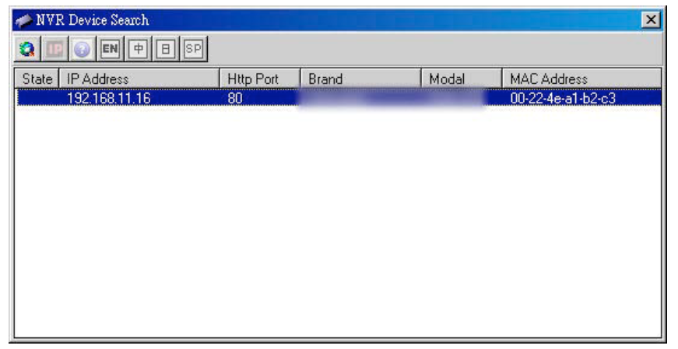
Installation
SVR800
How to find the IP address of the SVR?
Install first “NVR device Search” utility software.
Then find the IP address of the SVR that matches the SVR’s MAC address on the displayed list.
P.S If there is no DHCP server available on the Network.
SVR’s IP address will be “192.168.101.50”

Slide 7

Installation
SVR800
Two ways to display the NVR’s User Interface (UI)
Web UI => Internet Explorer
Or
Local UI => Connect a Monitor directly to the NVR through VGA or HMDI port

Slide 8
PLAN
Training Course SVR800
SVR800
Installation
Configuration
Main View
System Options

Slide 9
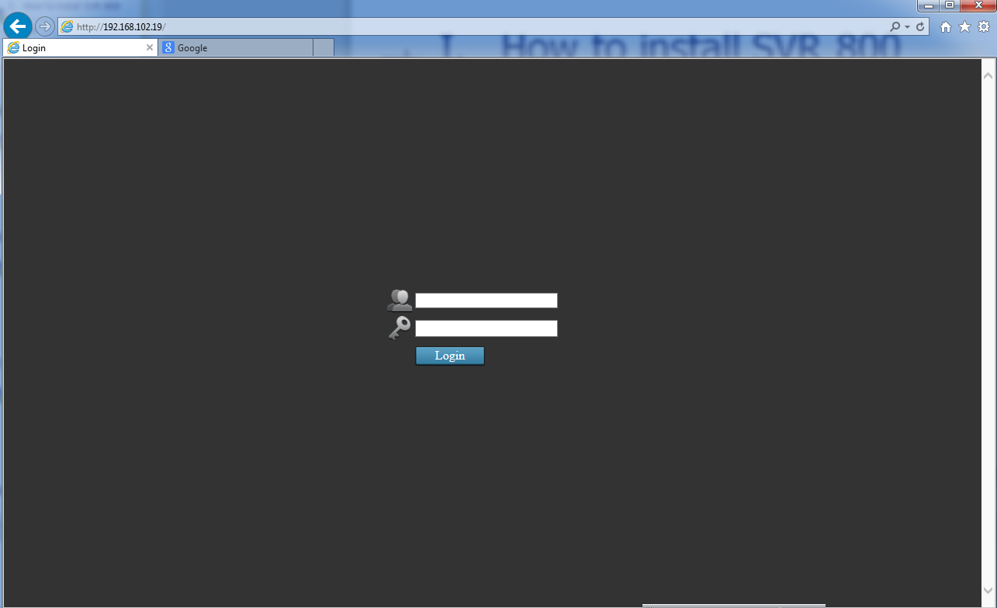
Configuration
SVR800
Access to the NVR through Web UI
  Open Internet Explorer (IE) with administrator privileges
  Type the SVR’s IP address on the address bar
  Log in with default settings:
  Username: Admin / Password: Admin
1
2

Slide 10
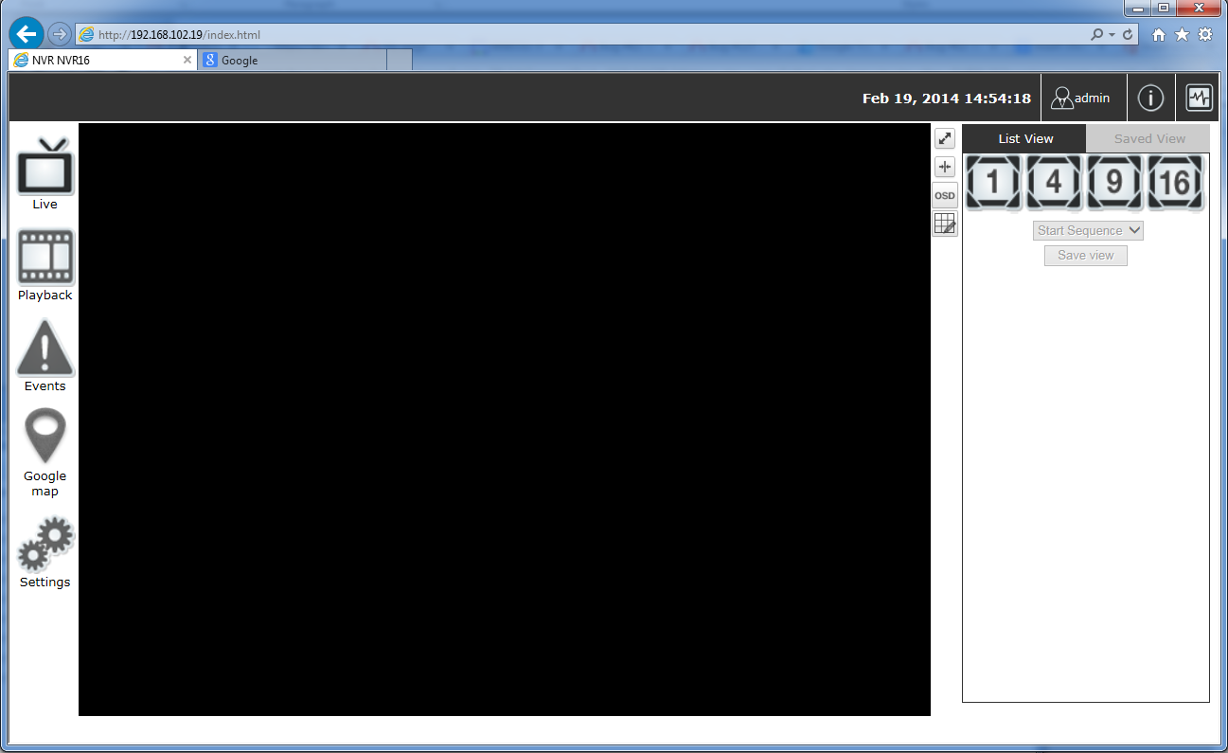
Configuration
SVR800
Access to the NVR through Web UI: Main View
Go to settings page
Notes:
After login in in the web UI, the Main view will be displayed.
Click on « Settings » to start configuration

Slide 11

PLAN
Training Course SVR800
SVR800
Installation
System Configuration
Configuration
Channel Configuration
Main View
Event Configuration
Maintenance
Recording Configuration

Slide 12
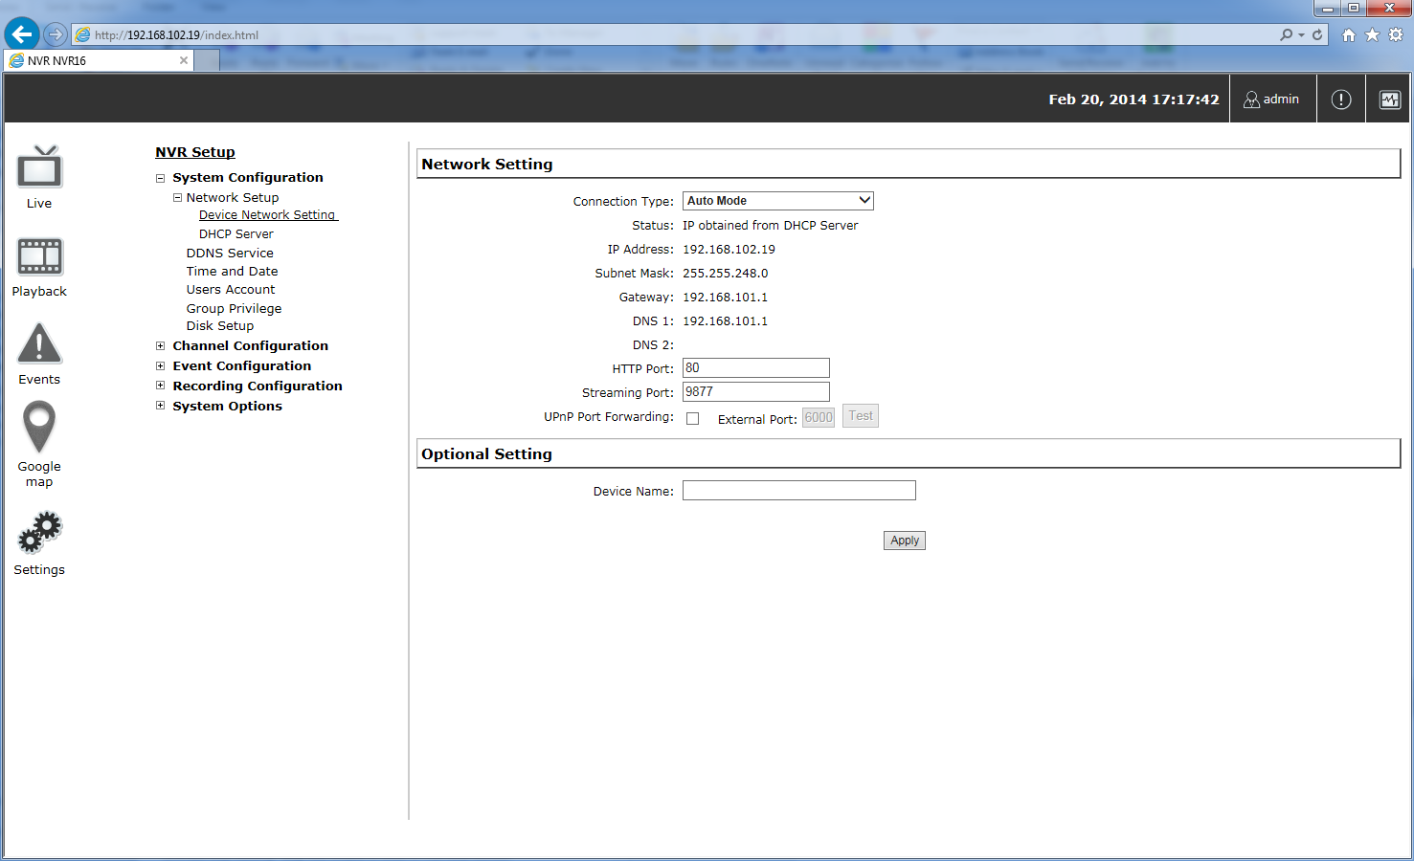
Configuration
SVR800
Network Configuration
Edit NVR’s network configuration

Slide 13
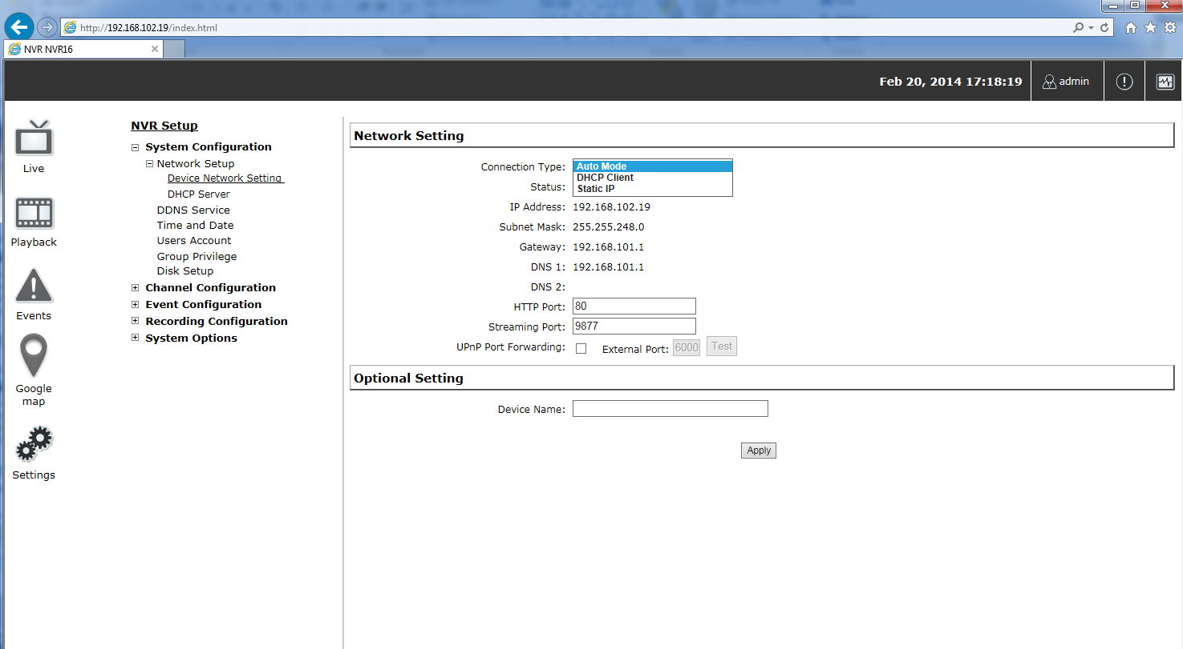
Configuration
SVR800
Network Configuration
Choose the “Auto Mode” or “DHCP Client” if there is already a DHCP server on the LAN.
Notes:
It has 3 types of connection : Auto Mode, DHCP Client, Static IP

Slide 14
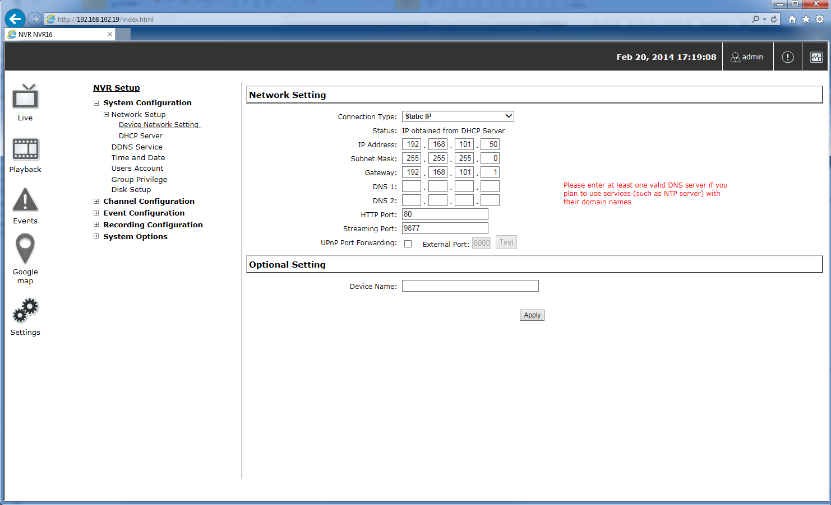
Configuration
SVR800
Network Configuration
Choose the “static IP” mode if you want to set static IP address for the NVR.

Slide 15
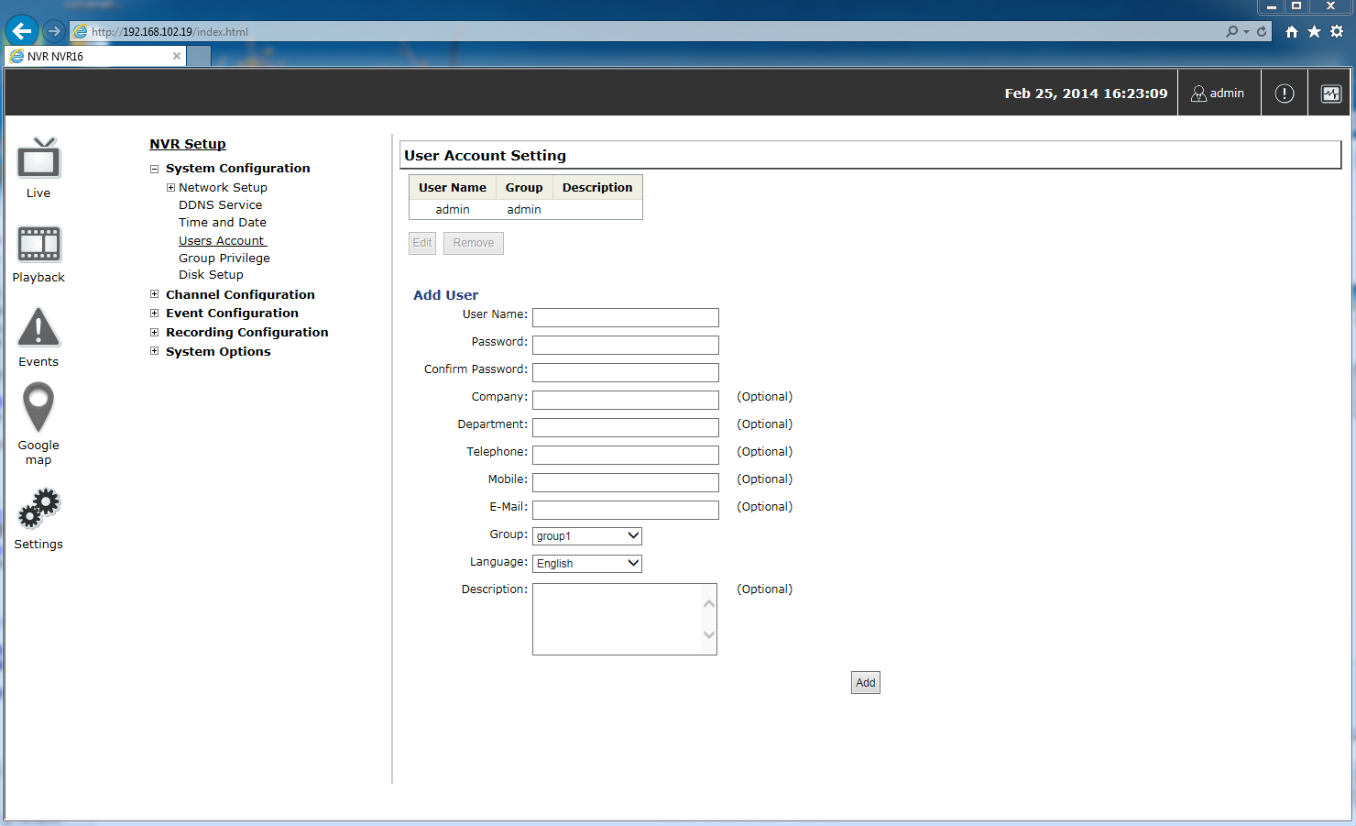
Configuration
SVR800
Users Account
Default account’s username is “admin” with password “admin”.
Notes:
Multiple users can access the recorder simultaneously. You can add, remove and edit users.
It is highly recommended to change the password upon your initial login.

Slide 16
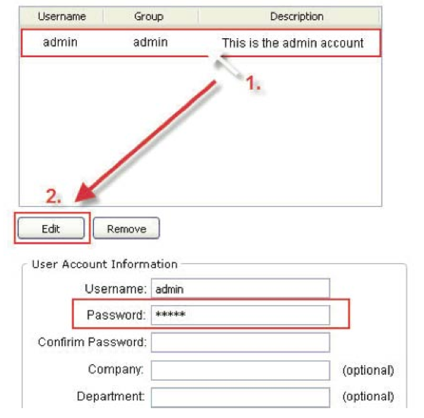
Configuration
SVR800
Users Account : Change user’s password
Notes:
We highly recommend to change the default password of “admin” account.

Slide 17
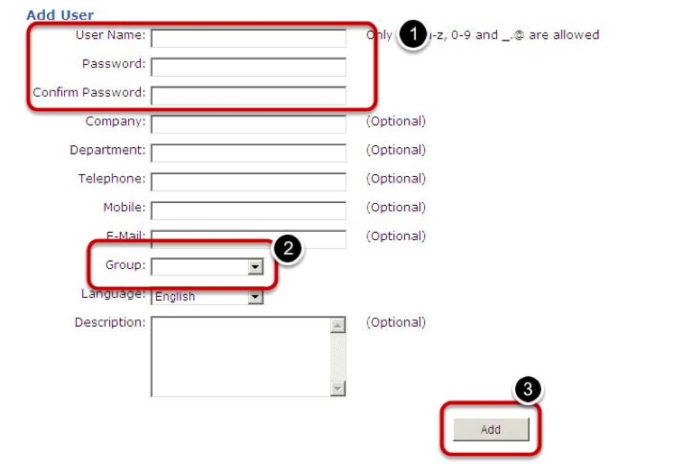
Configuration
SVR800
Users Account : Add a User
Notes:
• Enter a username and password in “User Account Information”. All other fields are optional for your own reference.
• Select a group from the “Group” drop-down menu to assign the new user to a particular group
• Enter a short description for the account if you wish
• Click “Add” to finish configuration

Slide 18
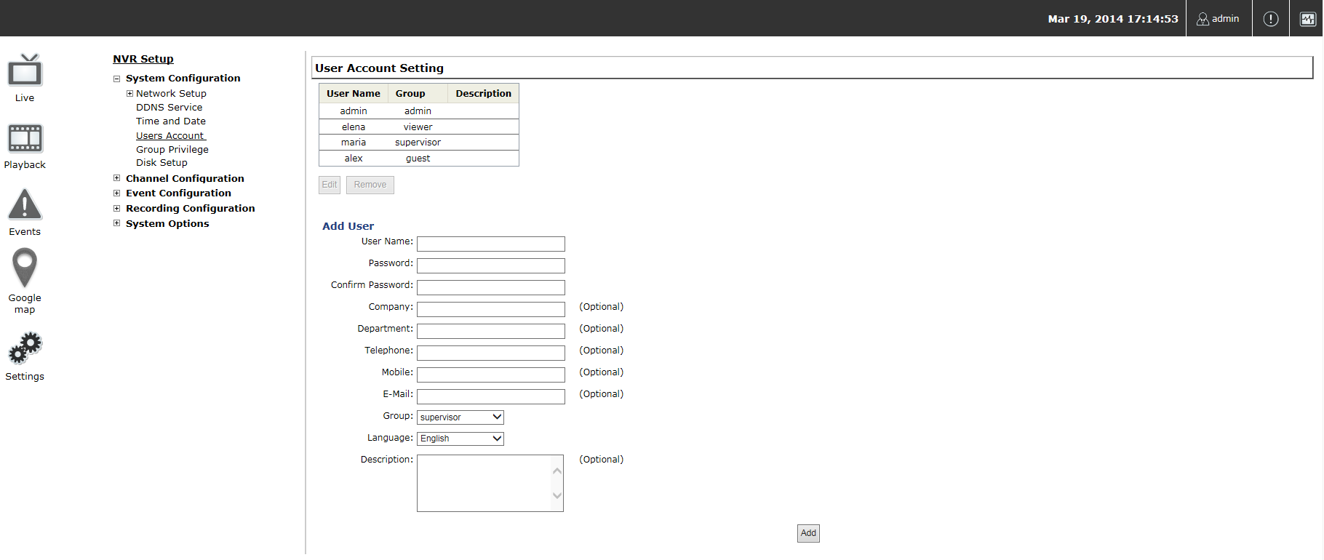
Configuration
SVR800
Users Account
View of added users to the system
Notes:
Multiple users can access the recorder simultaneously. You can add, remove and edit users.
It is highly recommended to change the password upon your initial login.

Slide 19
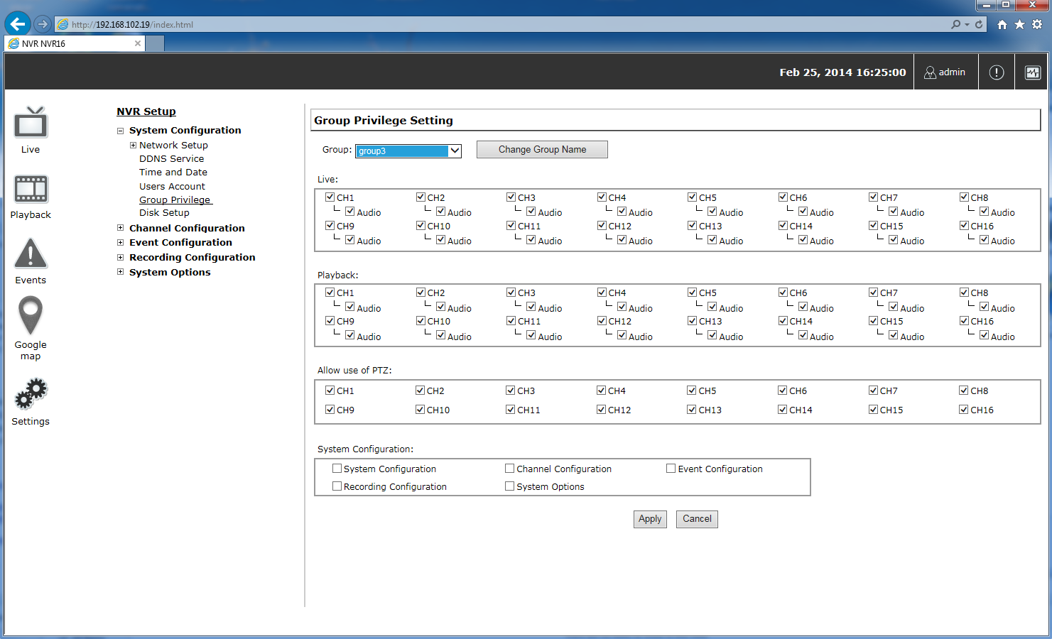
Configuration
SVR800
Group Privileges : Customize access policies for each group

Slide 20
Configuration
SVR800
Group Privileges : Customize access policies for each group
7 available Groups :
Group 1 to Group 5 are customizable + Admin Group+ Guest Group
“Guest” group privilege: “view-only” privilege in the “Live View” page. Users in this group don’t have the rights to make any changes in the “Live View” page. Guest group cannot access to other pages.
User can alter settings by checking or unchecking the checkbox
Group’s Name can be changed.

Slide 21
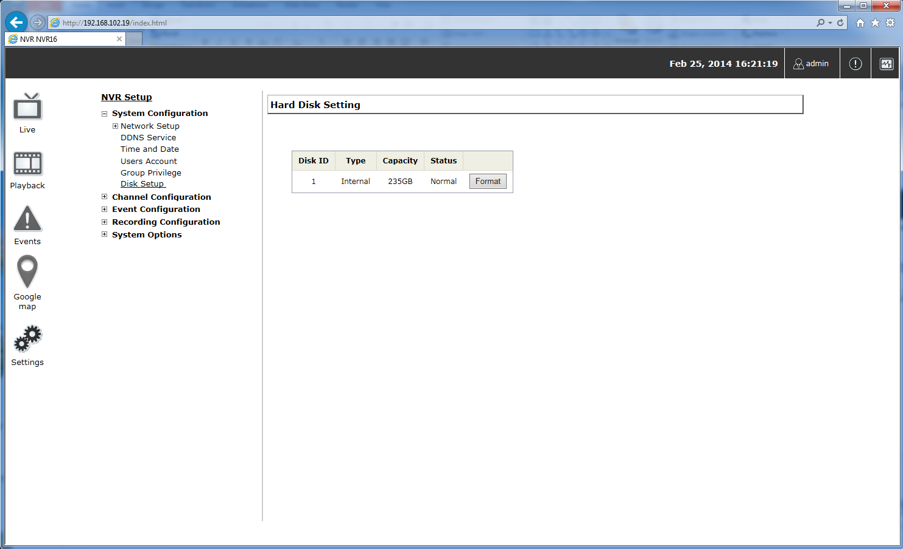
Configuration
SVR800
Disk setup
Notes:
The disk setup displays the number of HDDs plugged in the NVR.

Slide 22
Configuration
SVR800
Disk setup
First, install a hard disk in the SVR,
Then, Initialize it to be ready for recording => click on the “Format” button.
P.S
Plug in the HDD when the NVR is OFF.
The external HDDs will only be listed in the "USB Backup”

Slide 23
PLAN
Training Course SVR800
SVR800
Installation
Configuration
System Configuration
Channel Configuration
Main View
Event Configuration
System Options
Recording Configuration

Slide 24
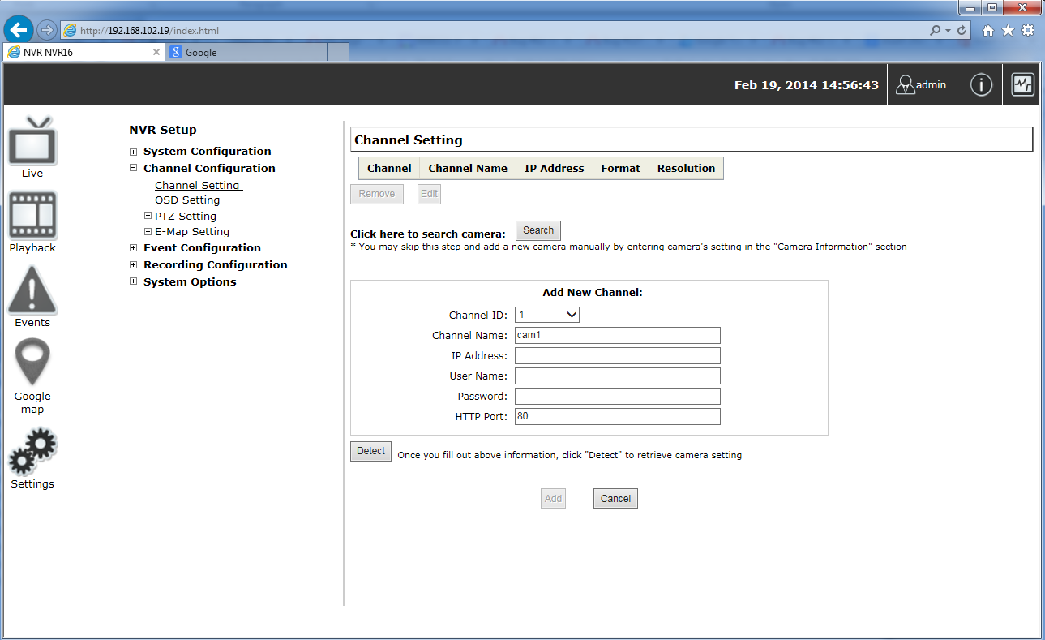
Configuration
SVR800
Channel Setting: Add a channel

Slide 25
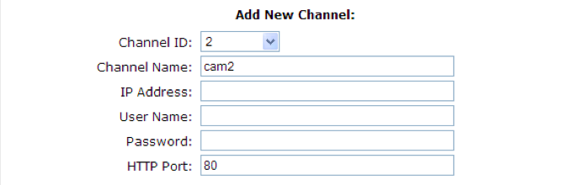
Configuration
SVR800
Channel Setting : Add a Channel
Two options for adding a new camera :
Option1: Automatic search of the cameras by the NVR on the same LAN.
Option2: Enter camera’s information and add it manually to the channel.

Slide 26
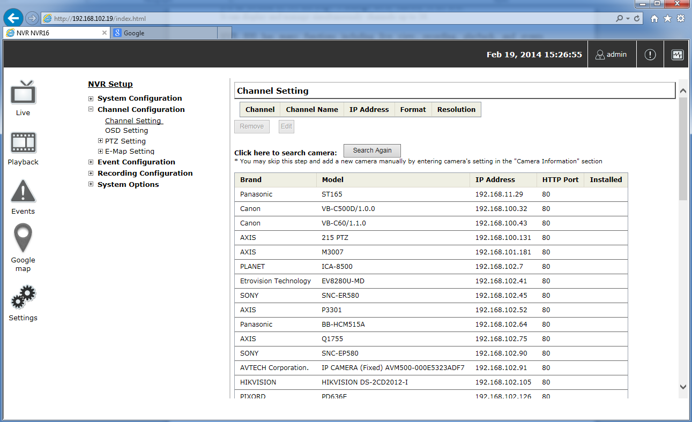
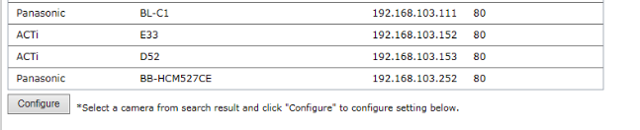
Configuration
SVR800
Channel Setting:
Option1 Add a camera with automatic search function
List of cameras available on the same LAN as the NVR.
Select the camera from the list then press « Configure »
Notes:
Simply select a camera from the list and press “Configure”

Slide 27
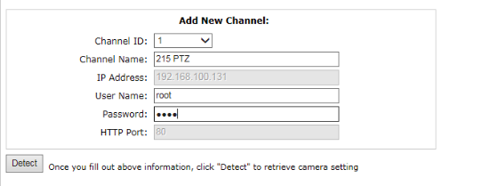
Configuration
SVR800
Channel Setting
Option1 Add a camera with automatic search function
1
2
Type in the username and password then press « Detect » button

Slide 28
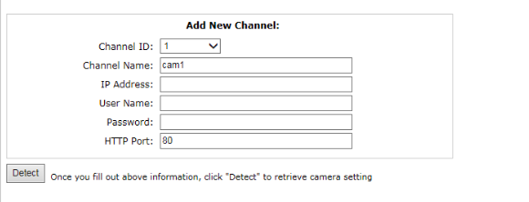
Configuration
SVR800
Channel Setting
Option2 Add manually a camera
1
2

Slide 29
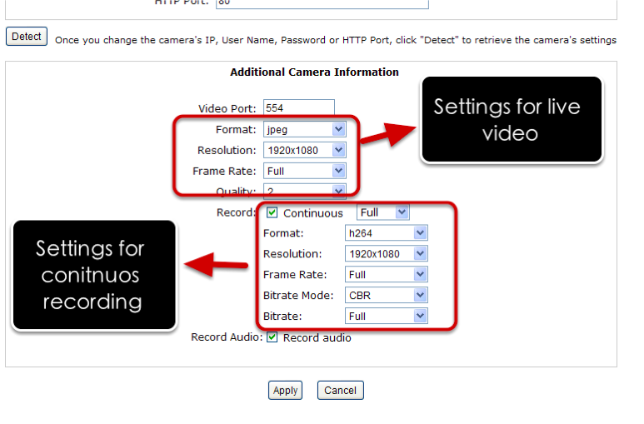
Configuration
SVR800
Channel Setting
Configure the channel

Slide 30
Configuration
SVR800
Things to consider before setting the channel’s configuration!
The max throughput of the SVR
SVR800 max throughput: 94 Mbps <=> 16CH*30 fps at Full HD and H.264 codec

Slide 31
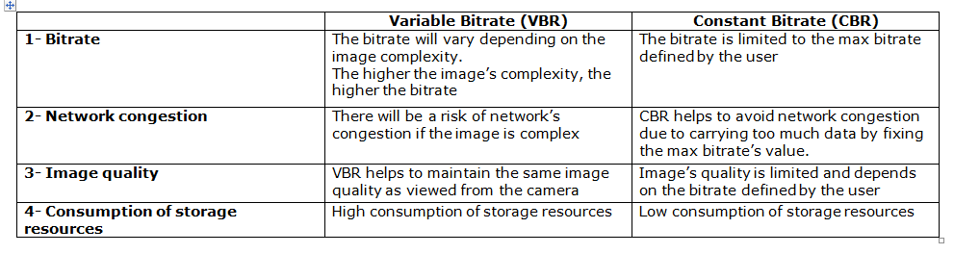
Configuration
SVR800
Things to consider before setting the channel’s configuration!
VBR or CBR configuration
It depends on users requirements. User can either prioritise the image quality or the network’s flow stability. User needs to choose the VBR (Variable bitrate) or CBR (Constant bitrate).

Slide 32
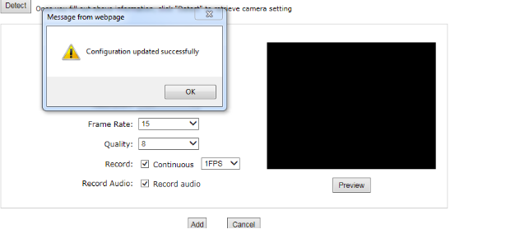
Configuration
SVR800
Channel setting
Add the camera after setting the right configuration
Notes:
The camera is successfully added to the channel

Slide 33
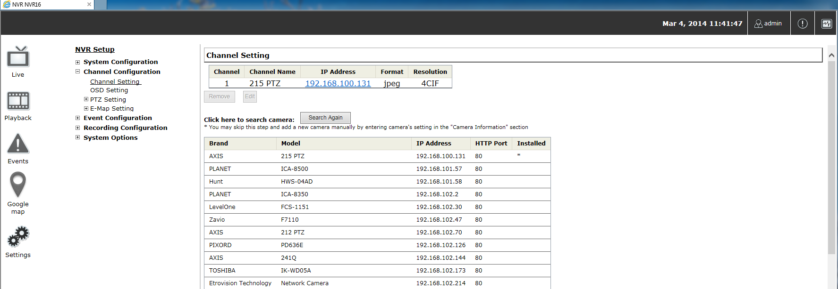
Configuration
SVR800
Channel Setting
Add the camera after setting the right configuration
The new channel appears on the list
Notes:
The new channel appears on the list

Slide 34
PLAN
Training Course SVR800
SVR800
Installation
System Configuration
Configuration
Channel Configuration
Main View
Event Configuration
System Options
Recording Configuration

Slide 35
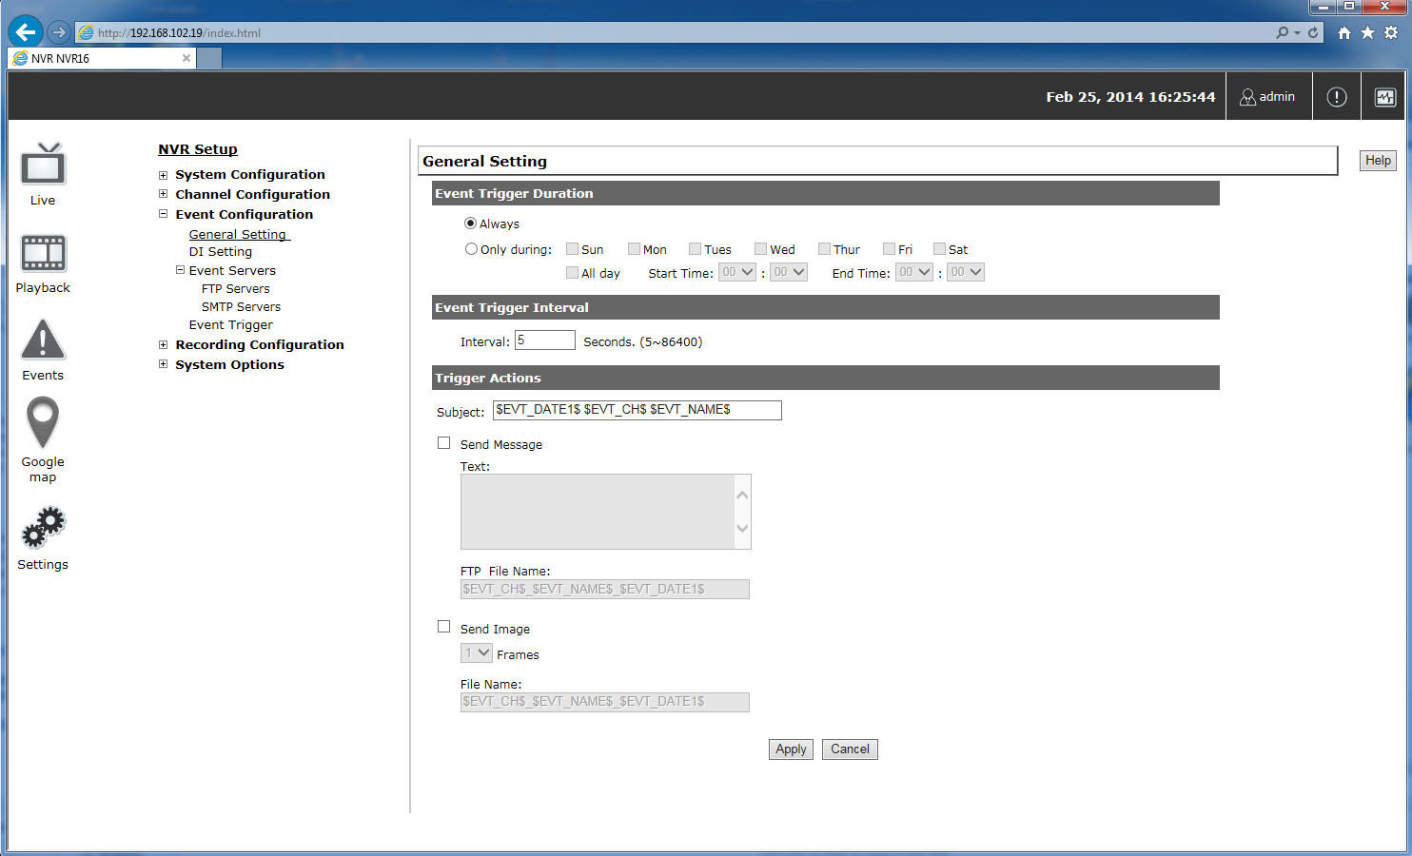
Configuration
SVR800
Event Configuration
General settings
When event is triggered?
How often is the event triggered?
What to do when event is triggered?
Notes:
General Settings:
It can help :
Quickly configure when an event is triggered.
How often events are triggered
Corresponding actions when events are triggered

Slide 36
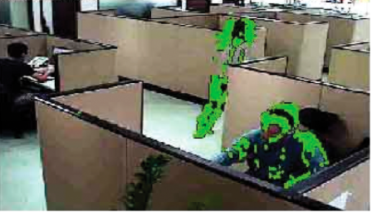
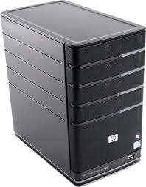

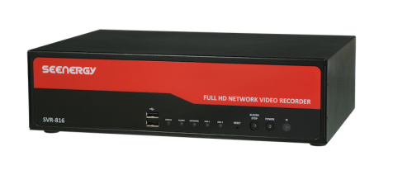
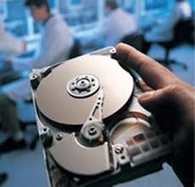
Configuration
SVR800
Event Configuration:
Event Servers are used as media to send alerts when NVR is triggered.
Triggers
Send Alerts
Detects
Motion detection
SMTP server
Administrators
Detects
Triggers
Send Alerts
Disk Failure
FTP server

Slide 37
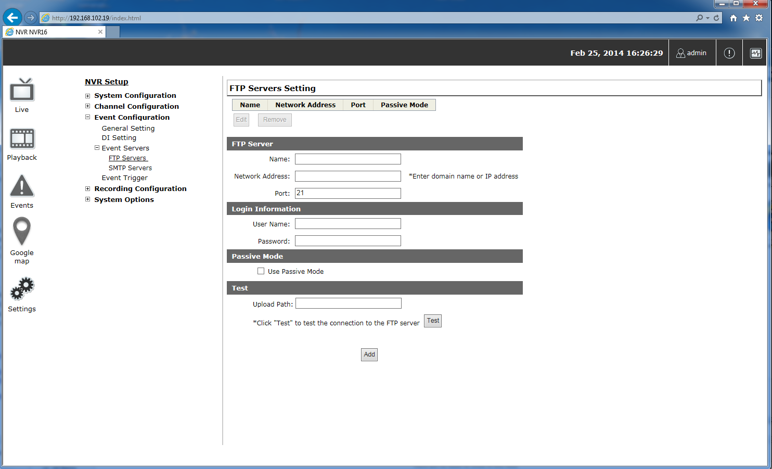
Configuration
SVR800
Event Configuration
FTP Server Settings
1
2
3

Slide 38
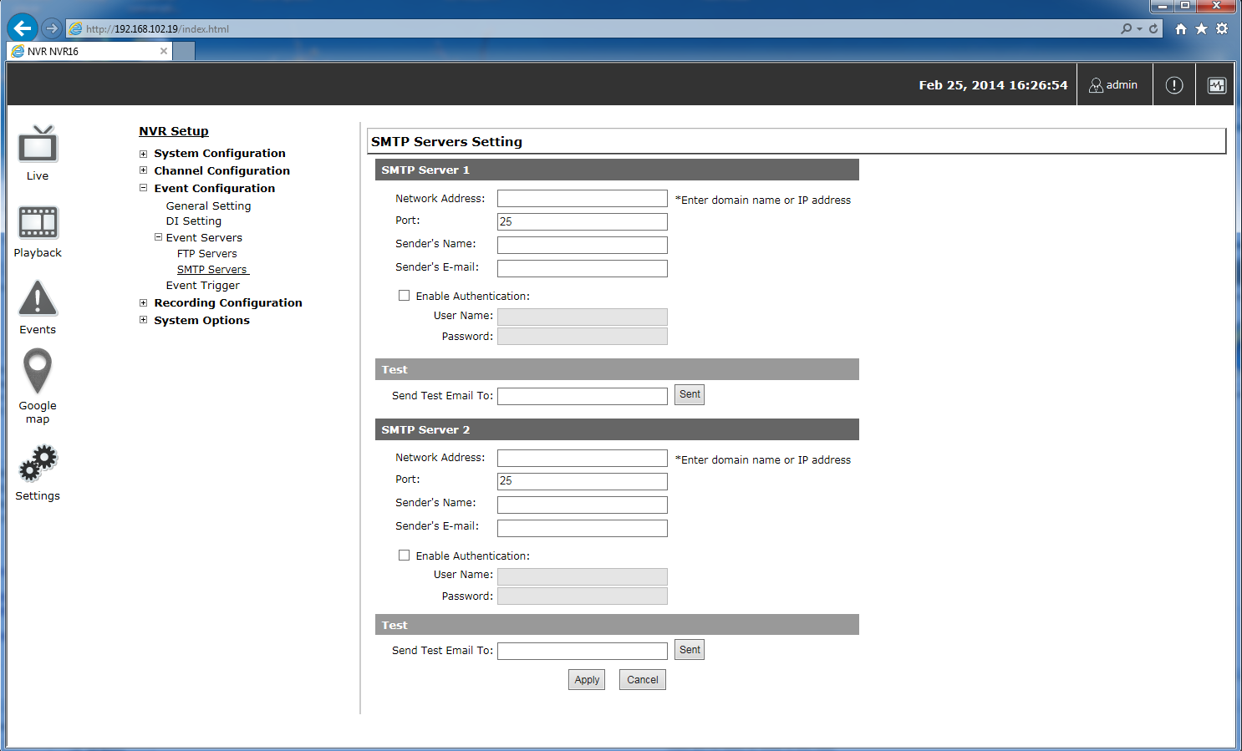
Configuration
SVR800
Event Configuration
SMTP Server Settings
Supported authentication methods of the SMTP server:
PLAIN
LOGIN
CRAM-MD5
DiGEST-MD5
Notes:
It does not support GMAIL, Hotmail, Yahoo

Slide 39
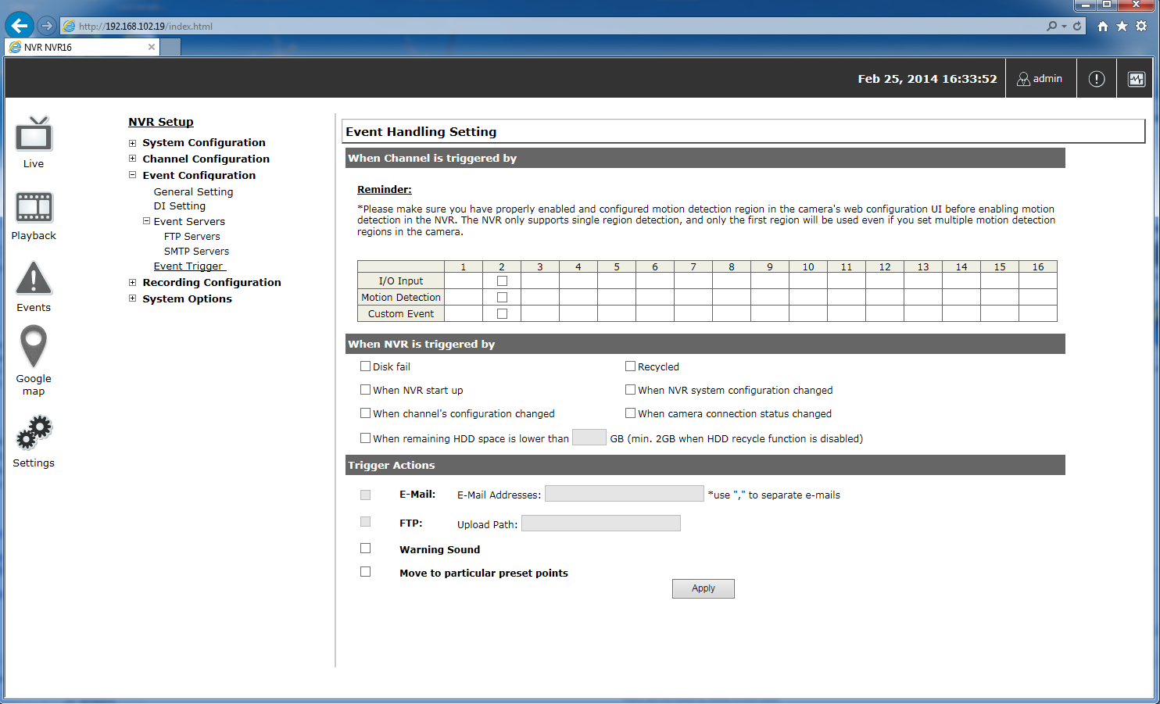
Configuration
SVR800
Event Configuration
Event trigger
Notes:
•Which channels will have event trigger function enabled
•What is considered to be an event
•Where the warnings will be sent to and how they will be sent

Slide 40
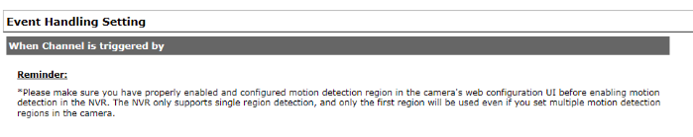

Configuration
SVR800
Event Configuration
Event trigger
Event trigger can be enabled for each Channel .
“ custom event ” option allows the NVR to receive events from the CMS software and start recording; events such as the intelligent video detection in the CMS.
Notes:
•Which channels will have event trigger function enabled ?

Slide 41
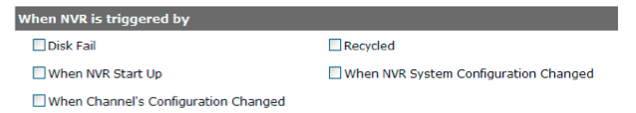
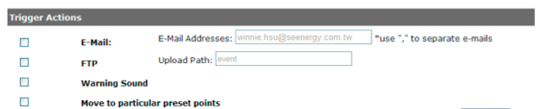
Configuration
SVR800
Event Configuration
Event trigger
Define what is considered to be an event
Define how and where the notifications will be sent
Notes:
What is considered to be an event?
Where the warnings will be sent to and how they will be sent ?

Slide 42
PLAN
Training Course SVR800
SVR800
Installation
System Configuration
Configuration
Channel Configuration
Main View
Event Configuration
System Options
Recording Configuration

Slide 43
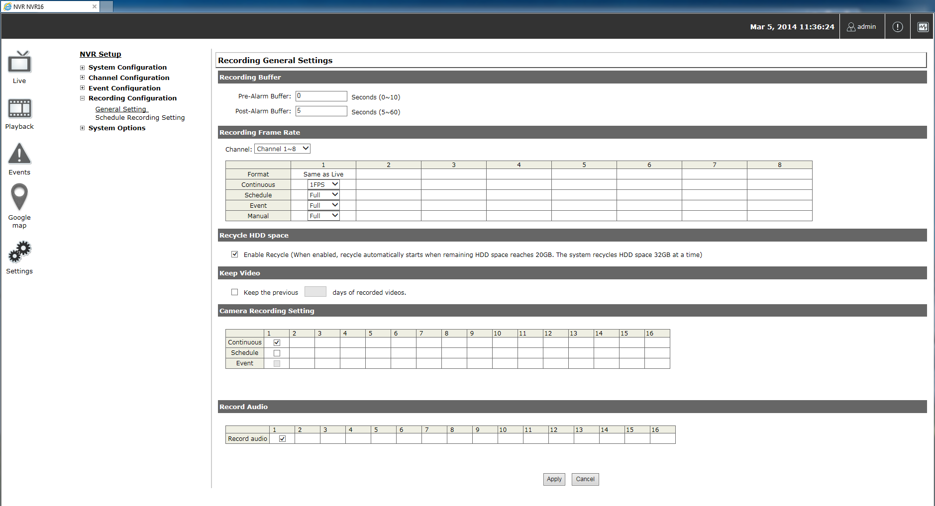
Configuration
SVR800
Recording Configuration
General Settings

Slide 44
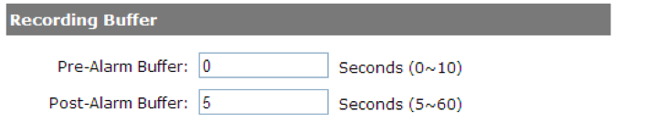
Configuration
SVR800
Recording Configuration
General Settings
“ Pre-Alarm” time sets the NVR to record in advance when an event is triggered.
“Post-Alarm” time sets the NVR to continue recording for a period of time after an event trigger is finished.

Slide 45
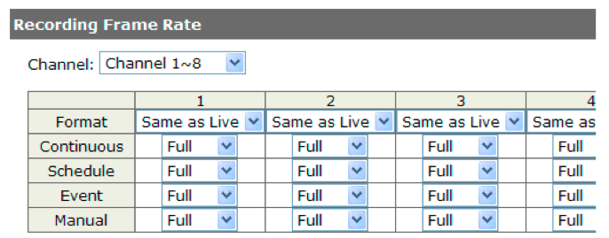
Configuration
SVR800
Recording Configuration
General Settings
Set different frame rate for different types of recording instead of recording at one frame rate only.

Slide 46
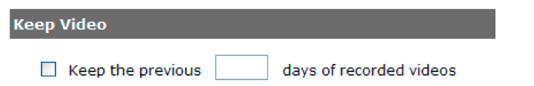
Configuration
SVR800
Recording Configuration
General Settings
Keep the previous recording for a number of days.
If this option is enabled, once the hard drive is full, the recycle function will then start but it will ensure that the number of days of recording data defined here will stay in hard drive instead of wiping out 20GB of data at a time.

Slide 47
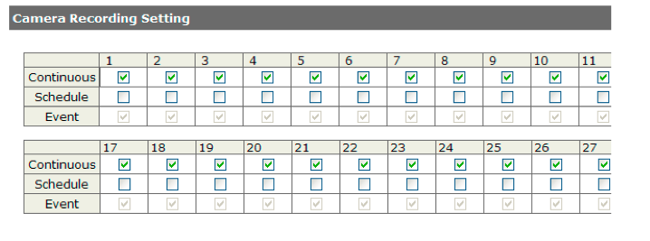
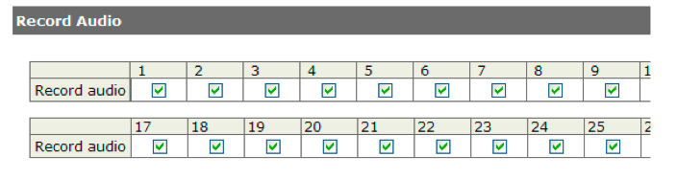
Configuration
SVR800
Recording Configuration
General Settings
Define the type of recording
Enable/disable audio recording on recorded videos

Slide 48
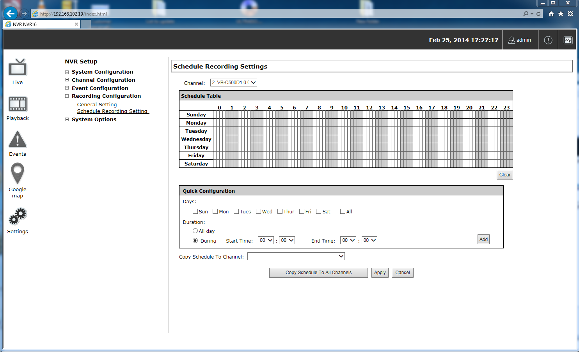
Configuration
SVR800
Recording Configuration
Schedule recording Settings
Define the time range of the schedule recording for each channel
Choose a channel
Configuration a
or
Configuration b

Slide 49
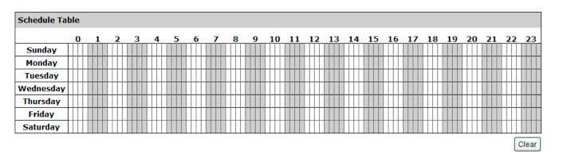
Configuration
SVR800
Recording Configuration
Schedule recording Settings
Define the time range of the schedule recording for each channel
Configuration a: Schedule table
Choose first the channel then select the prefered time slot .
Click on the time slot then slide the cursor :
    Horizontaly to choose the recording hours
    Verticaly to choose the recording days
P.S Each cell box represents 15 minutes of time. Click one or more boxes to omit consecutive recording.

Slide 50
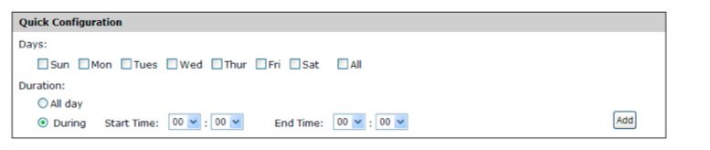

Configuration
SVR800
Recording Configuration
Schedule recording Settings
Define the time range of the schedule recording for each channel
Configuration b: Quick Configuration
Copy the configuration to all the channels or apply it to specific ones

Slide 51
PLAN
Training Course SVR800
SVR800
Installation
Configuration
Live View
Main View
Playback
System Options
Events

Slide 52
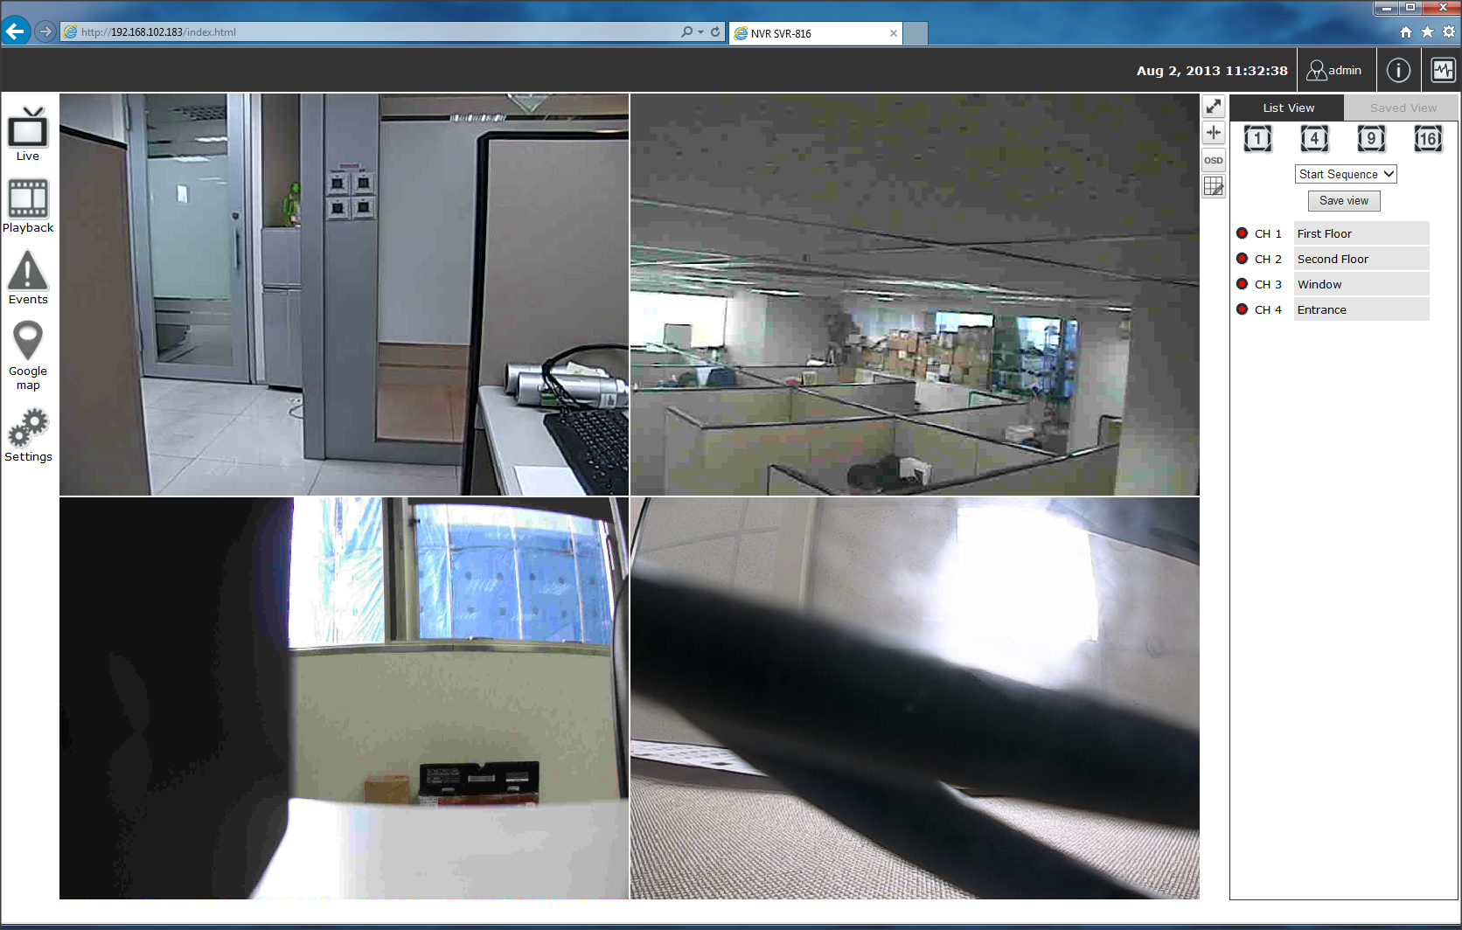
Main view
SVR800
Live view
Main View
The main view provides a live streaming of each channel and several interactive functions
Notes:
The selected functions will be explained in the next slides.

Slide 53


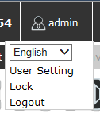

Main view
SVR800
Live view
Main View
Date and Time display
The date and Time are defined by the user on the settings section.
User’s configuration
It displays the name of the current user. If you click on the user’s name, the context menu will display the current functions

Slide 54

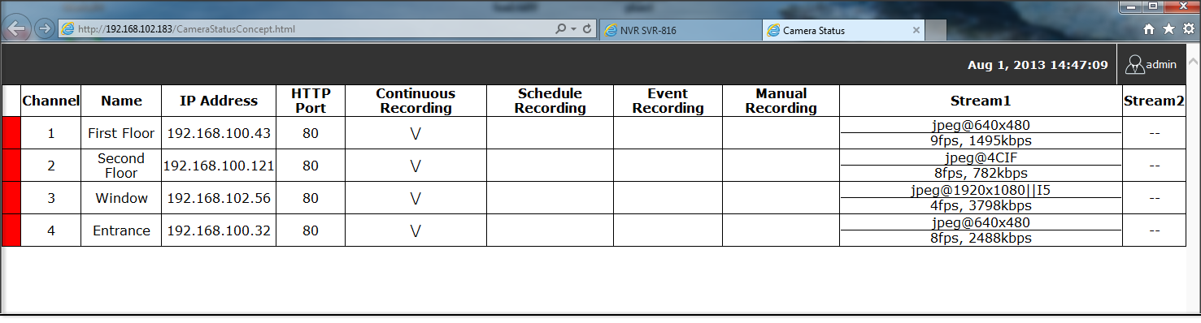
Main view
SVR800
Live view
Main View
Hardware events notification
User receives notifications if a warning sound is triggered or if the hard disk drive of the NVR failed in recording data.
Channel status
Click on the icone, a page tab will display the current status of the channels added to the NVR.
Notes:
It can also display the current configuration used for the event recording or the configuration settled for the scheduled and manual recording.
The channels status page is updated as long as the NVR’s main user interface is open.

Slide 55
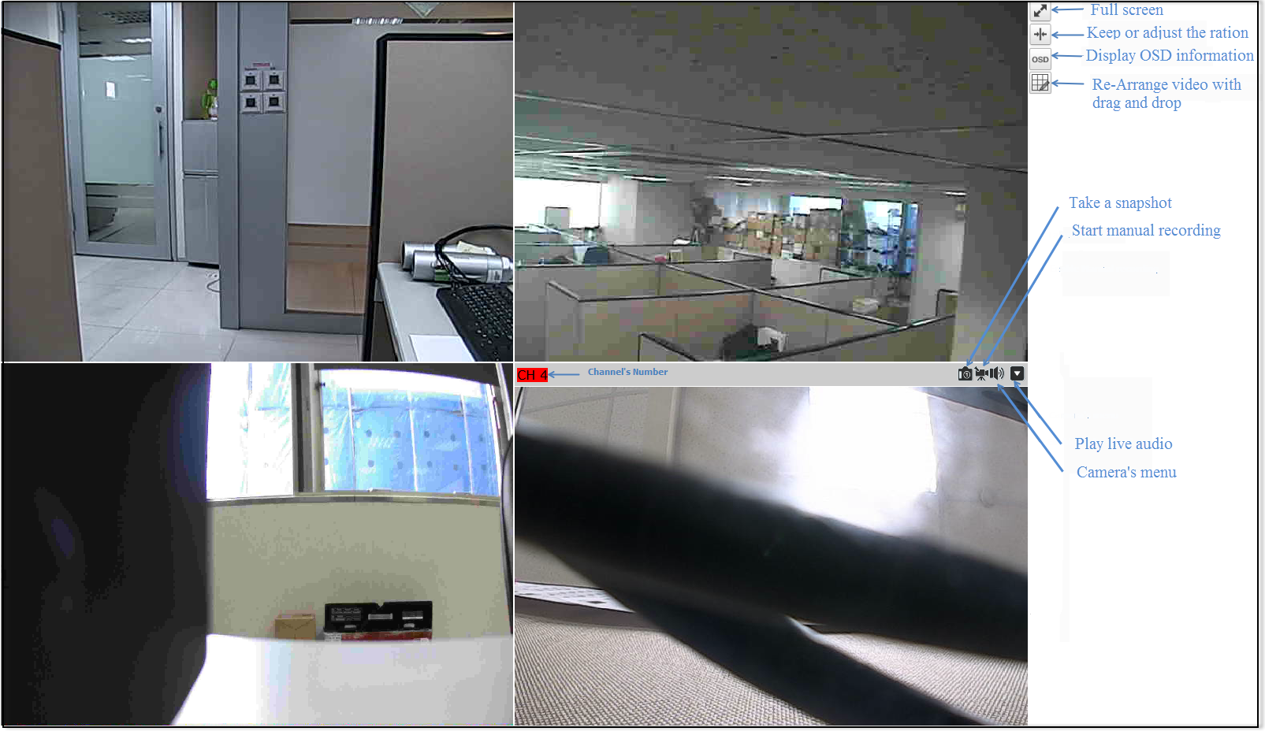
Main view
SVR800
Live view
Video Frame
P.S. - PTZ function is available by clicking on the left button of the mouse at the channel’s live view.
-To enable Zoom function, double click on the left button of the mouse.
Notes:
If the cursor points on one of the channels, it will show a bar on the top.
The bar displays the channel’s number and several functions.

Slide 56

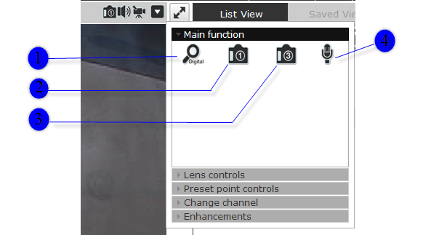



Main view
SVR800
Live view
Camera’s Menu
Enable digital zoom function on the video
Snapshot function
Three continuous snapshots. Each snapshot represents a frame. 1Snapshot/Frame
Send audio sound from the microphone to the audio output of the camera.
P.SThis function can only work if the camera supports audio input/ouput function.

Slide 57


Main view
SVR800
Live view
Camera’s Menu
Lens Control
Preset Point Controls
Change the Focus and Iris settings of the camera.
Save the current position of the camera and its preset point. It helps to avoid moving manually the camera to each desired points.
The function is only enabled if the camera supports the function .

Slide 58


Main view
SVR800
Live view
Camera’s Menu
Change Channel
Enhancements
It is a shortcut to configure the channel but more advanced functions are available at the NVR settings page.
Set the brightness and contrast on the live view of the channel .

Slide 59


Main view
SVR800
Live view
List View
Channels list
The channel’s status is defined by 3 colours:
Red: The channel is recording and the live view is available
Blue: The channel is connected and live view is available
Grey: The camera is disconnected
Displays the list of channels added to the camera
Notes:
List view is devided in two sections:
Channels list
Sequence function

Slide 60




Main view
SVR800
Live view
List View
Sequence functions
It can display 1, 4, 9, or 16 cameras at once.
Every time you click on an “ n” pattern icon, the live video of the next “n” cameras will be displayed.
To save a name the current view.
The sequence mode will automatically switch between a single or a group of cameras every a certain period of time. The period is defined by user.
Display the views already saved.
Notes:
You are also able to switch between saved views every certain period of time by clicking on the “start sequence function”.
If you check the box beside the name of the view, you can edit or delete the view

Slide 61

Main view
SVR800
Live view
Local UI
Notes:
The Local User Interface is very similar to Web User Interface.
Unified design is made for easy user interaction

Slide 62
PLAN
Training Course SVR800
SVR800
Installation
Configuration
Live View
Main View
Playback
System Options
Events

Slide 63

Main view
SVR800
PlayBack
Select the channels
Display playback by time chart or event
Select the day
Move the playback bar to the recorded field
Notes:
The playback view displays all the videos recorded by the NVR.
You can choose the channels and display the videos by time or events.
The functions are available as long as you have configured them before on the NVR settings.

Slide 64

Main view
SVR800
PlayBack
Zoom on a range of time
Zoom on range of time and get more details on the playback bar.
Minimize the bar of the playback
Minimize the playback range frame

Slide 65

Main view
SVR800
PlayBack
Local UI
Notes:
The Local User Interface is very similar to Web User Interface.
Unified design is made for easy user interaction

Slide 66
PLAN
Training Course SVR800
SVR800
Installation
Configuration
Live View
Main View
Playback
System Options
Events

Slide 67

Main view
SVR800
Event view
Select the channel or display all of them.
Motion detection triggered on CH3
Click on the picture to display the event video
Or
Click on event from the list
Notes:
The events can only be detected and displayed if you have configured it on the NVR’s settings.
You can display the event of all the channels at once or by each channel.

Slide 68

Main view
SVR800
Event view
Playbar for video display
Notes:
Each event can be displayed.

Slide 69

Main view
SVR800
Event view
Local UI
Notes:
The Local User Interface is very similar to Web User Interface.
Unified design is made for user’s convenience.

Slide 70
Training Course SVR800
SVR800
PLAN
Installation
Configuration
General Information
System Logs
Main View
Maintenance
System Options
Disk Status

Slide 71

System Options
SVR800
Device Information
General information
NVR’s status
Firmware version and system time
Network settings

Slide 72

System Options
SVR800
System Logs
Posts events that are logged and recorded by the NVR’s OS.
Basic information for troubleshooting
System Logs contains events that are logged by the NVR’s system.
It provides basic information for troubleshooting.

Slide 73

System Options
SVR800
Maintenance

Slide 74

System Options
SVR800
Maintenance

Slide 75
System Options
SVR800
Maintenance
Several functions available on maintenance page
Restart the NVR
Restart a camera by selecting a channel
Upgrade NVR’s Firware
Backup NVR’s Setting
Restore NVR’s Setting
Reset the NVR to Factory default
Replace NVR web UI Logo

Slide 76

System Options
SVR800
Maintenance
Firmware Upgrade
The firmware can be upgraded through web UI .
The firmware’s file extension is “tar.gz”.
Please use the file as it is. Don’t unzip it.
P.S. Before upgrading firmware, please backup configuration in advance.
Step2
Step 1

Slide 77

System Options
SVR800
Disk Status
It displays detailed information about the HDD which is currently installed in the NVR.

Slide 78
PLAN Review
Training Course SVR800
SVR800
Installation
Configuration
Main View
System Options
Notes:
We have completed the training

Slide 79
Thank you for your attention !
We welcome your questions and comments.

