Slide 1
2013 Product Roadmap

Slide 2
2013.Q2/Q3
Existing product line
 | Product | Changes
2013.Q2 | SVR-500 Pi-Vu Central Basic | Multi-stream support with dynamic display Camera Setup Wizard Camera AutoSetup
2013.Q3 | SVR-632 SVR-632U | Upgraded CPU & memory

Slide 3

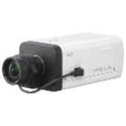

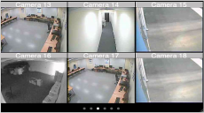
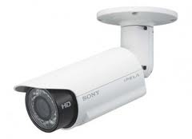
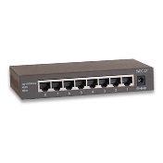
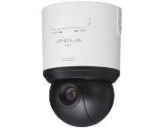

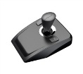
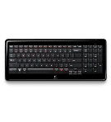
2013.Q3
SVR-800 series
Full HD
Monitor
Hub
SVR-800
NVR
    Redesigned unified UI
Recording performance
1080p x 16 or 96Mbps
Configuration: web, local
Live/playback: web, local
Camera Auto setup
Client software
-ipad/iphone/android
-256CH CMS software
    Multi-stream with dynamic display
    DSP platform
USB2.0 for external device
  Mouse, keyboard, Joystick
Network: RJ 45 (Giga LAN)
IO: 8DI/4 DO
Video: VGA/HDMI
Audio: MIC-in, line-in and line-out
2-4 bays (Hardware RAID),4TB/bay
E-SATA: Max. 8TB
•Local Video Display
-Compression MJPEG/MPEG-4 Part 2/H.264 baseline,
main, high profile
-Resolution 5Mp/3Mp/ Full HD/MegaPixel/FD1/CIF/QCIF
-Max. decoder Frame Rate D1:480fps, 720p:360fps, 1080p:150fps
-Split window 1x1,2x2,3x3,4x4(SVR-816)
-Max. resolution limitation: 5Mp x1
-Dual monitor (HDMI+VGA)
    -Live:20CH (Live 16CH+SEQ 4CH), Live 16CH+playback 4CH

Slide 4
2013.Q3
SVR-800 series
Model | Channel | HDD | RAID | Housing | DI/DO
SVR-808 | 8CH 5Mpx1+2Mpx7 | 2 | X | Desktop | X
SVR-816 | 16CH 5Mpx1+2Mpx15 | 2 | X | Desktop | X
SVR-816 plus | 16CH 5Mpx1+2Mpx15 | 2 | HW 0/1 | Desktop | X
SVR-816U | 16CH 5Mpx1+2Mpx15 | 4 + e-SATAx1 | HW 0/1/5/10 | 1U | O

Slide 5
SVR-800 Series
Performance
Models | Local display performance
SVR-808 | 240fps@720p30 120fps@1080p30 80fps@3MP 50fps@5MP Support 1080p60
SVR-816 series | 480fps@D1 30 360fps@720p30 150fps@1080p30 50fps@5MP Support 1080p60

Slide 6
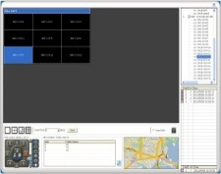
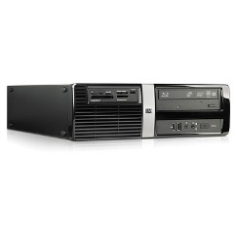


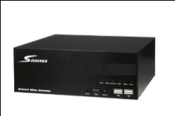
2013.Q4
SVD-832
    DSP platform
    Redesigned unified UI
    32CH (management), Live:16CH, playback:4CH
    Support network camera and SEEnergy NVR
    Video wall mode (controlled by 1024CH CMS)
    Media player mode (Display NVR video)
    Multi-stream with dynamic display
USB2.0 for external device, Mouse, keyboard, Joystick
Network: RJ 45 (Giga LAN)
Video: VGA/HDMI
Audio: MIC-in, line-in and line-out
Video format :MJPEG/MPEG-4 Part 2/H.264 baseline, main, high profile
Resolution 5Mp/3Mp/ Full HD/MegaPixel/ FD1/CIF/QCIF
Max. decoder Frame Rate D1:480fps, 720p:360fps, 1080p:150fps
Split window 1x1,2x2,3x3,4x4
Max. resolution limitation: 5Mp x1
SVD-832
CMS software
control
Video stream
Network camera
NVR

Slide 7

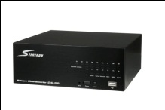

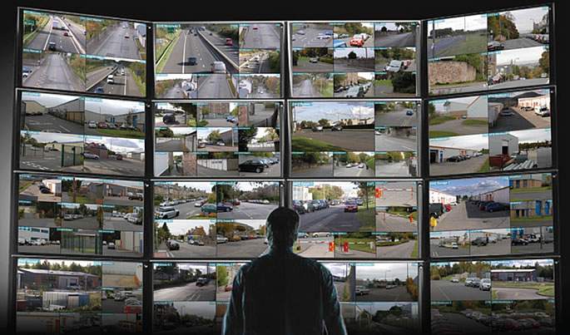

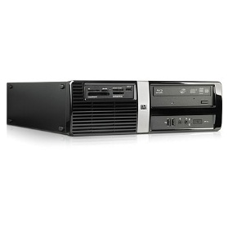

2013.Q4
SVD-832
Audio/Video stream
SVD-832
Network camera
NVR
SVD-832
Control
Audio/Video stream
SVD-832
SVD-832
Network camera
    Controlled by 1024CH CMS software
    Display live video stream from NVR & camera
CMS
Manage NVR & Video decoder

Slide 8





2013.Q4
SVD-832
    Control NVR remotely
    Display live & playback
    Operated by mouse, keyboard, remote controller and joystick
NVR
SVD-832
Audio/Video stream
Media player Mode
Network camera

Slide 9

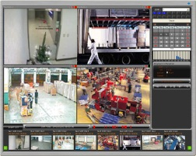

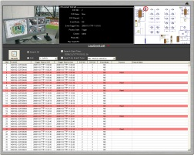
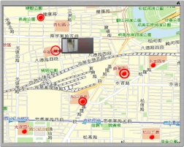
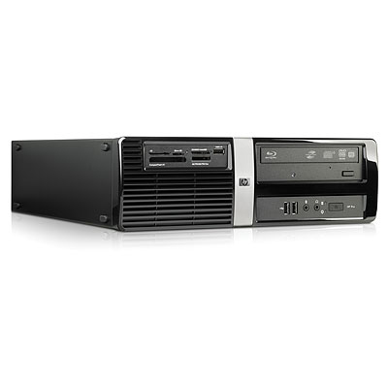
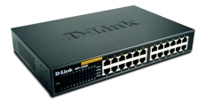

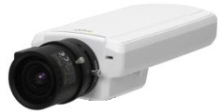
2013.Q4
Pi-Vu Central 2.0
CMS software Pi-Vu Central 2.0
PC
Hub
Hub
NVR
SVD-832
Network camera
    Central control NVR & SVD
    Max.1024CH
    Support Google Map

Slide 10
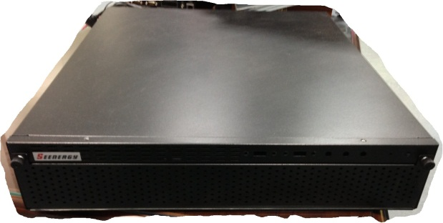
2013.Q4
SVR-632S
Recording performance
  32CH,1280x1024, 2Mbps
8 bays: 2U housing
  4TB x 8
Video output: VGA
Audio IO: Microphone, line in & line out
USB x4
E-SATA x 1 (Max. 8TB)
RAID 0/1/5/10
8DI/4DO

Slide 11
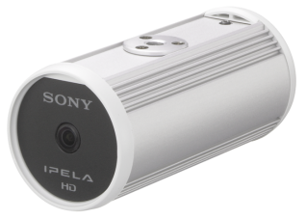
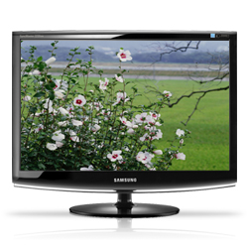
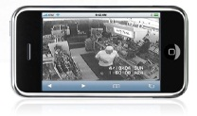
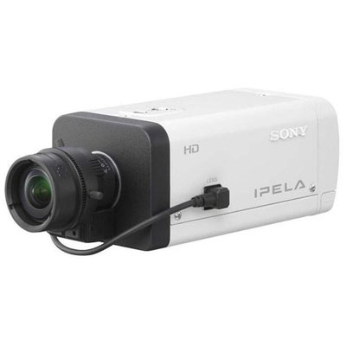
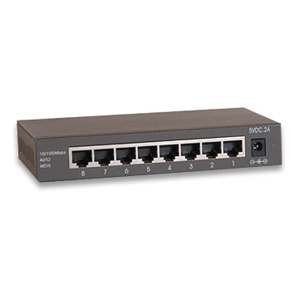

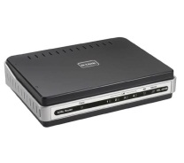


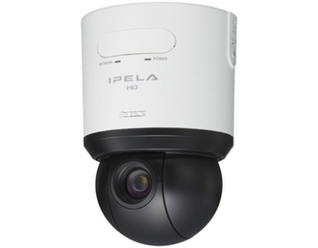
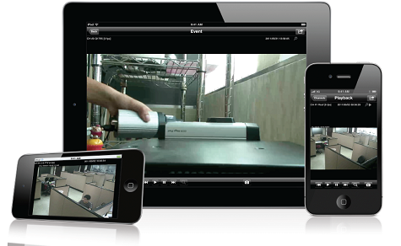
Multi-Stream
SVR-800
NVR
Smart Phone
Live video (JPEG)
Remote access
Live view
320x240
Recording
1920x1080
Live view
640x480
1920x1080
640x480
320x240
Hub
Router
Internet
Internet Explorer
Live, Playback (video streaming)
Camera setup
Resolution
Function
Strream1
1920x1080
Live/Rec
Stream 2
1280x720
Live/Rec
Stream 3
640x480
Live/Rec
iPhone/iPad client software
Live, Playback (video streaming)
Stream 4
320x240
Remote
Network camera

Slide 12

Dynamic Display
640x480
Display real-time video on split screen
640x480
1280x1024
1280x1024
SVR-800
NVR
1920x1080
Network camera
Get video steam with different resolution from network camera
1920x1080
* Works with compatible multi-stream cameras only

Slide 13
2012-2013 Product Roadmap
SVR-632S
8 bay
High
End
Channel/storage performance
SVR-632U
4 bay
SVR-808
SVR-816
SVR-816+
2 bay
SVR-816U
4 bay
Middle
End
Channel /video performance
Display performance
SVR-500
2 bay
SVD-832
Low
End
SVR-204
2 bay
Display performance
2012.Q1
2013.Q1

Slide 14
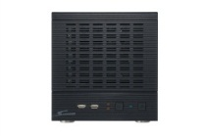
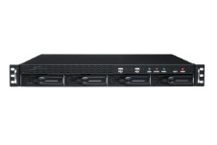
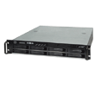
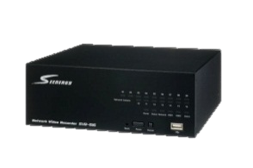
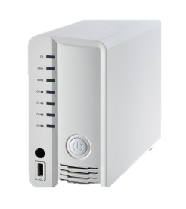
Product Profile
CMS Software-Pi-Vu central
Video Decoder SVD-832
NVR server
NVR with local display
SVR-632
SVR-632U
SVR-632S
Enterprise
SVR-504
SVR-508
SVR-516
SVR-516+
SVR-808
SVR-816
SVR-816+
SVR-816U
Small office
Entry
level
SVR-204

