Slide 1
QNAP VioStor CMS
V.1.0

Slide 2
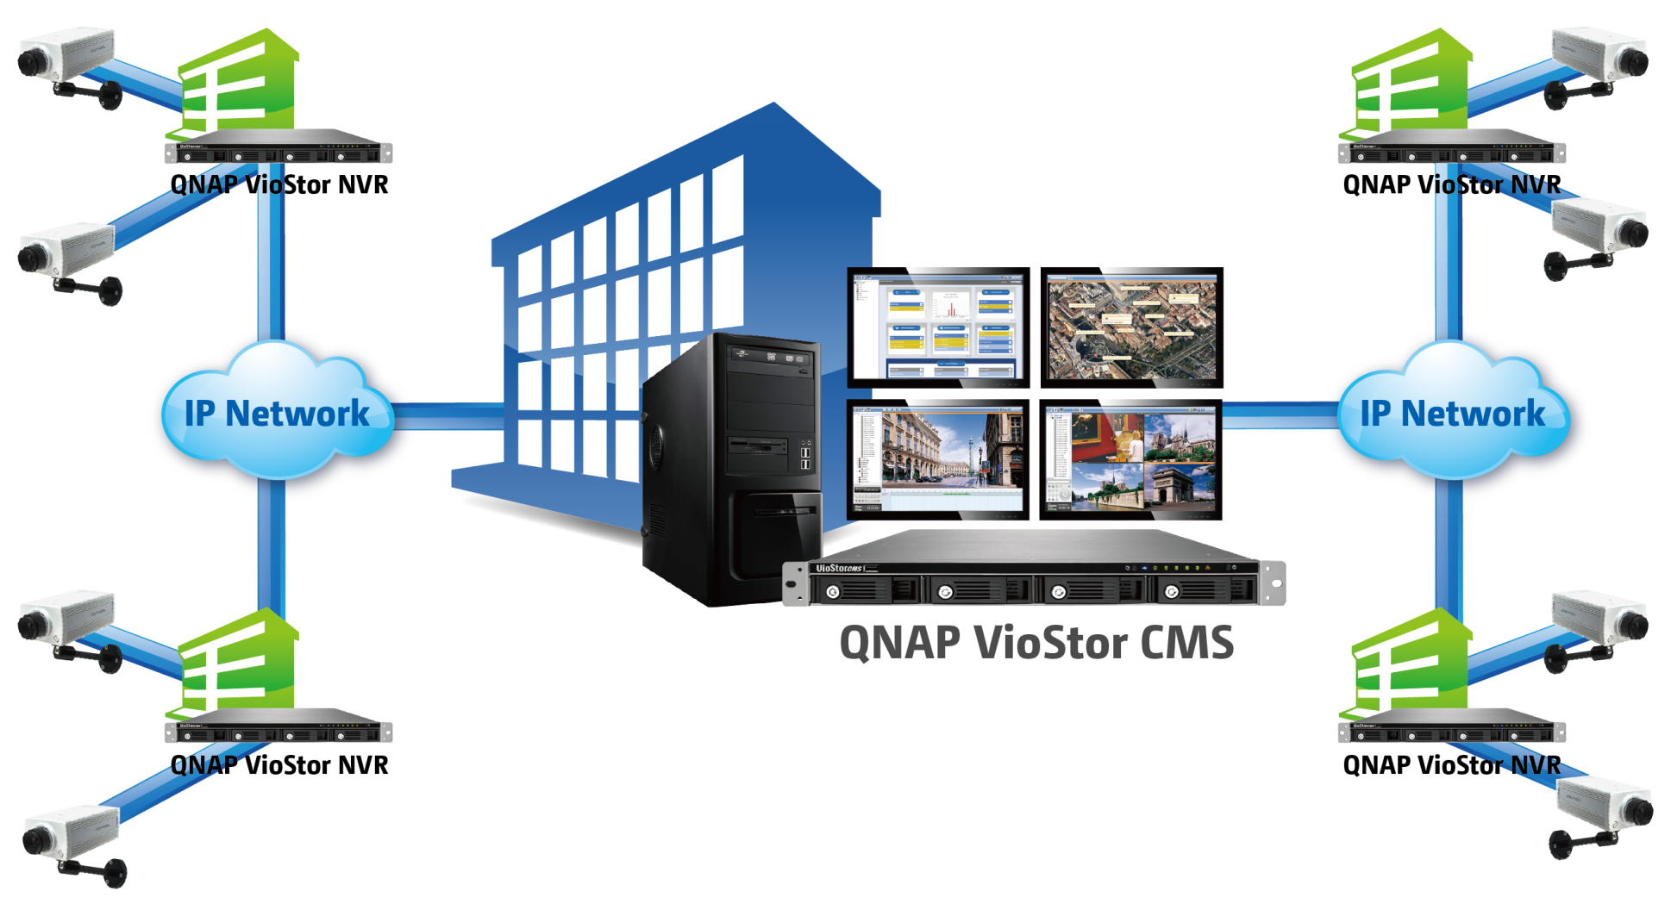
VioStor CMS Structure
Notes:
centrally monitor and manage multiple NVRs at distributed sites

Slide 3
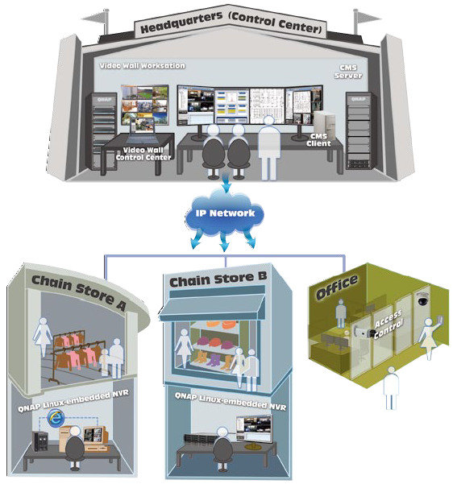
VioStor CMS Application
Notes:
Ideal to manage distributed sites, ex: retail store, offices, etc.

Slide 4

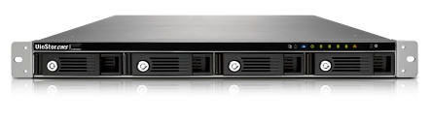
Server - Turnkey Solution
Easy Setup
Turnkey Solution
RAID Data Protection
Stable Hardware
Linux
Notes:
Easy setup: 快速六步驟 人員訓練容易 相容性問題(PC規格, OS, database(SQL), .net) 發生問題時容易解決
RAID 資料備援 data protection
Linux 減少病毒入侵機會

Slide 5
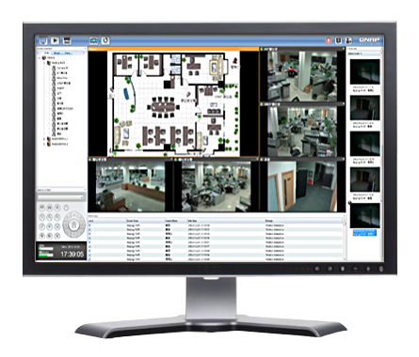
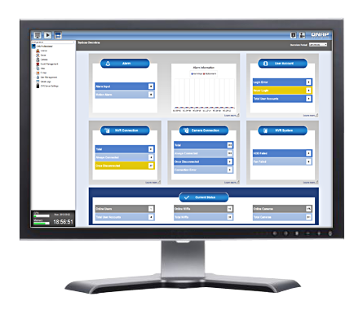
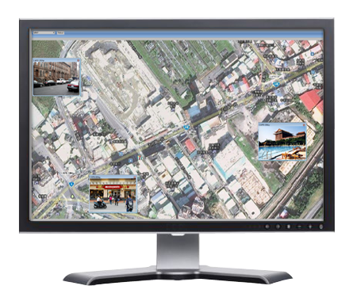

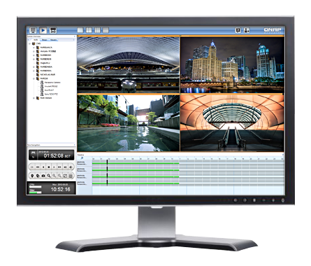
Client – Easy Central Monitoring
Live View
CMS Client Software
Configuration
E-map
Playback
Notes:
只需灌一種sw就可提供四大功能於一台電腦中 (可接四台螢幕)
(解釋主螢幕和副螢幕)

Slide 6
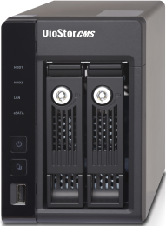

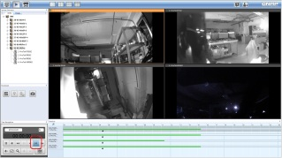
Easy Setup
Easy system setup in 6 steps
  Install the hard disks
  Connect the network cable and power on the CMS server
  Using QNAP Finder to detect CMS server IP add
  Run the Quick Configuration
  Install CMS client software on a PC
  Log into CMS server from CMS client
TCP/IP
CMS Server
(VSM-2000)
CMS Client
Notes:
QNAP CMS server is a Linux-embedded turnkey solution - a hardware with all the needed services built-in. This design eliminates the hassles of surveying and installing the suitable hardware, OS, and the database SQL server. The installation of the QNAP VioStor CMS therefore becomes easy and efficient than ever.

Slide 7
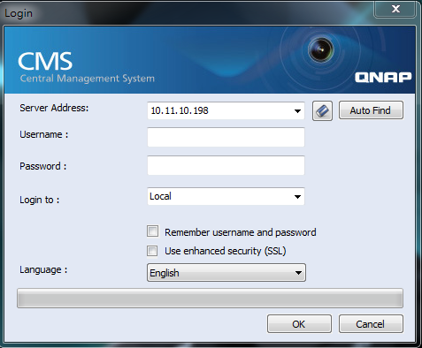
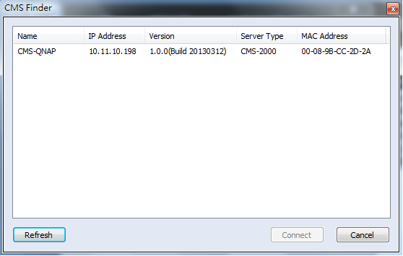
Convenient Login Page
Auto find CMS server
Able to select the preferred language
Notes:
Some CMS manufactures design the language selection on the “CMS installation” stage.
Once English is selected, the language can’t be changed, unless de-install and re-install the CMS, which isn’t practical.
It becomes a problem if there’re different users preferring using different language. Ex: security guard prefers using the local language, while the manager may prefer using English.

Slide 8
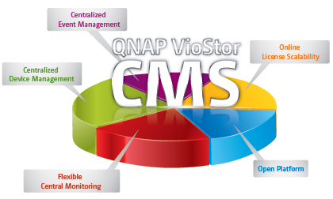
VioStor CMS 5 Main Purposes
Centralizing Sites with Ease
Centralized Event Management
Centralized Device Management
Flexible Central Monitoring
Open Platform
Online License Scalability
Notes:
All the features are surrounded around these 5 main purposes.

Slide 9
VioStor CMS 5 Main Purposes
Centralized Event Management
Centralized Device Management
Flexible Central Monitoring
Open Platform
Online License Scalability

Slide 10
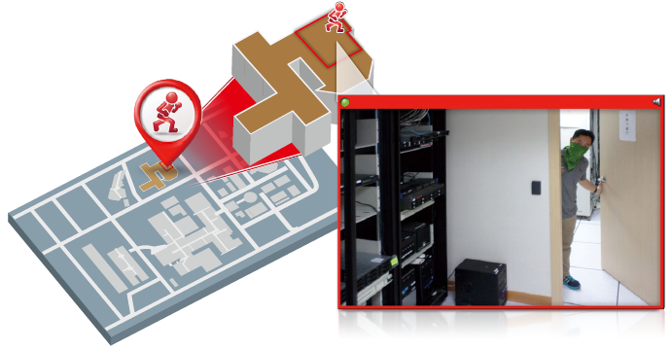
E-map Based Event Alert
When event occurs, camera icons turns into red indicators to show the event location
Double-click the camera icon to get the live view video of the event status
Event source:
  Edge motion
  Camera I/O

Slide 11
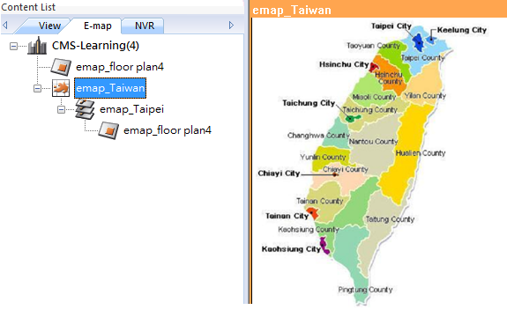
Unlimited E-map Layers
Tree-structure E-map management

Slide 12
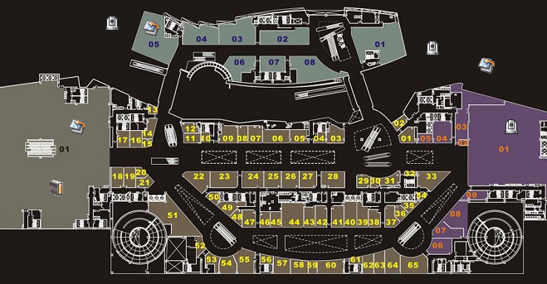
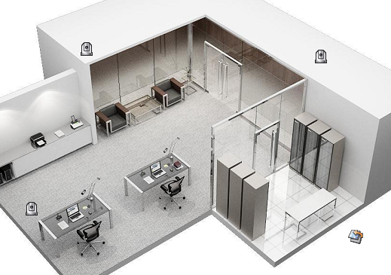
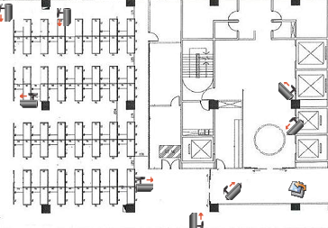
Multi-directional E-map links
Map icon as hyperlink for multi-directional E-map links
Customizable structure E-map management
Notes:
Each emap can contain multiple emap link icon

Slide 13
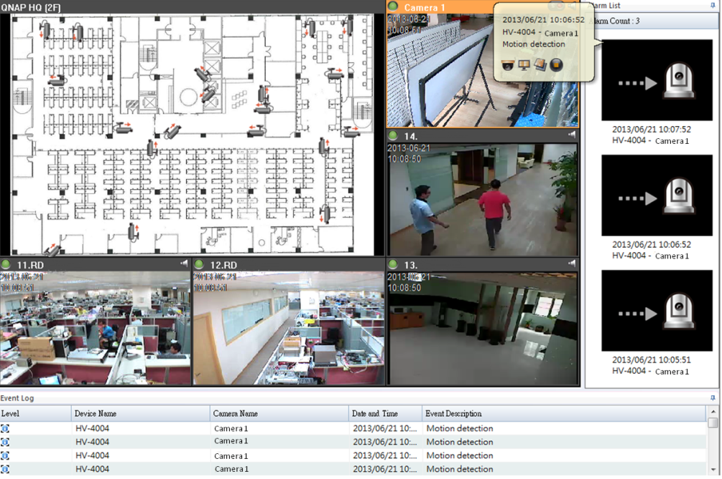
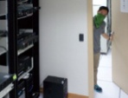


Event Notification & Instant Handling
Event Notification (on client PC)
  Red indicator on e-map
  Show on snapshot
  List on event log
Event Notification
  Send e-mail
  Send SMS
Instant Handling
In each snapshot or event log:
  Open live view
  Open event playback
  Go to live view layout
  Go to e-map layer
Notes:
Event playback window: instant playback v.s. event playback
Sent email & sms 是從NVR

Slide 14
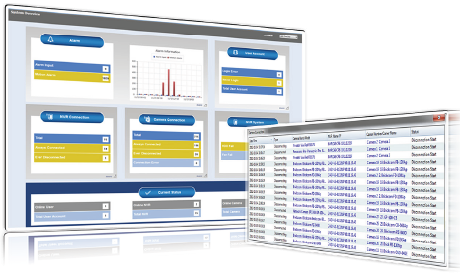
Dashboard Event Overview
Abnormal event marked in yellow
Click “learn more” for detailed info
Event source:
  Edge motion
  Camera I/O
  System Malfunction
    NVR disconnection
    Camera disconnection
    NVR HDD failure
    NVR Fan failure
Notes:
Edge motion = motion from camera

Slide 15
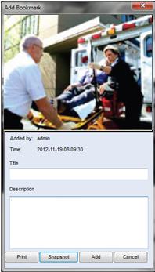
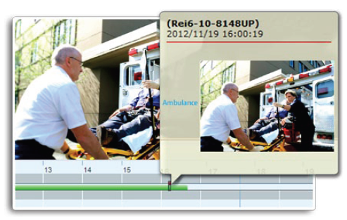
Bookmark for Unexpected Event Management
Flexible for unexpected event management
Available in both live view & playback
Quick & detailed bookmark
Easy for event evidence search

Slide 16
VioStor CMS 5 Main Purposes
Centralized Event Management
Centralized Device Management
Flexible Central Monitoring
Open Platform
Online License Scalability

Slide 17
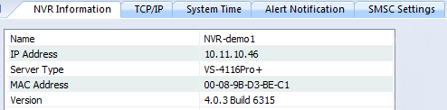

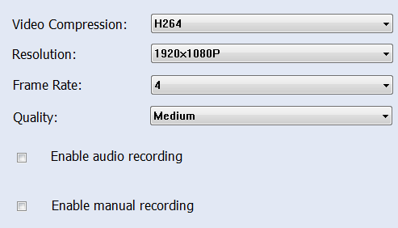
Centrally Configure Remote Devices
NVR
  IP address
  Time
  E-mail notification
  SMS notification
  Update firmware
  Shutdown
  Reboot
Camera
  Recording parameter settings
  Recording schedule settings
  Audio recording
  Manual recording

Slide 18
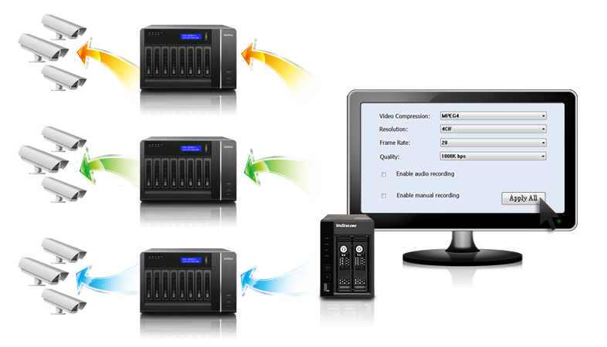
“Apply All” Configuration
Settings can be synchronized by grouping devices of the same model, saving configuration time.
Sync
Sync
Sync
Sync
one click
Sync
Sync

Slide 19
Device Status Overview
Overview in dashboard:
  NVR connection status
  Camera connection status
  NVR HDD status
  NVR fan status
Abnormal event marked in yellow
Click “learn more” for detailed info
Notes:
Edge motion = motion from camera

Slide 20
VioStor CMS 5 Main Purposes
Centralized Event Management
Centralized Device Management
Flexible Central Monitoring
Open Platform
Online License Scalability

Slide 21
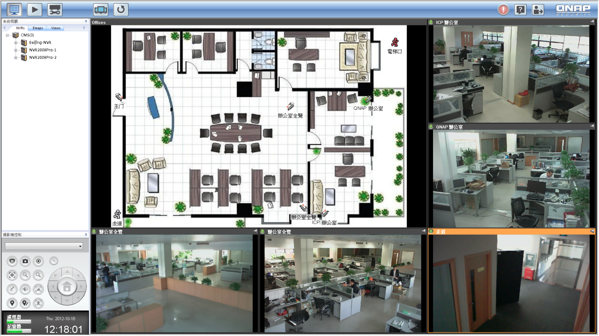
Flexible View Content
Mix and match E-map & camera video in one view
  easier floor plan management

Slide 22
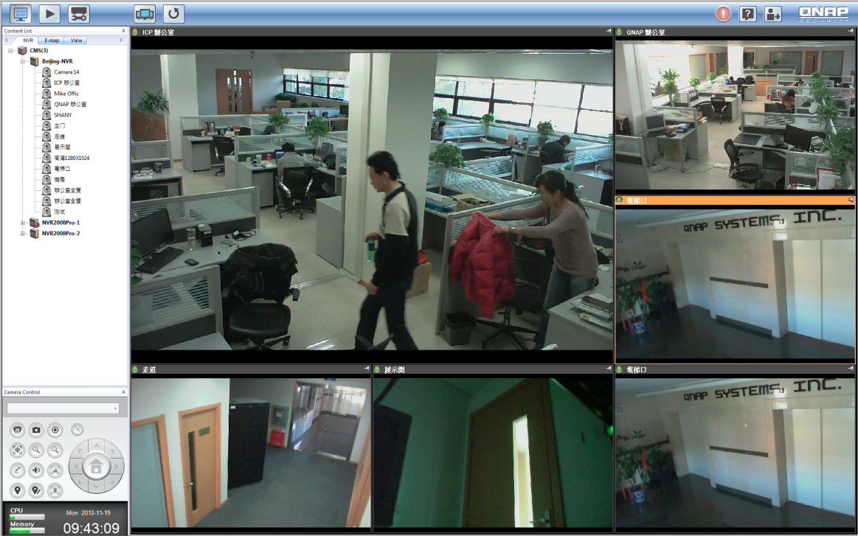
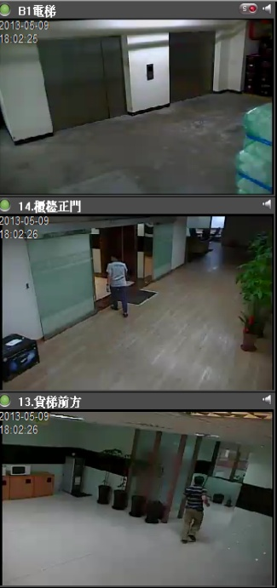
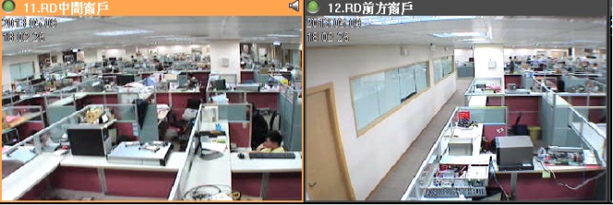
Flexible Sequential Mode
Mix static & sequential camera video in one view
  Always display the critical areas
  Sequential display the general areas
Optimize the number of displaying channel per monitor

Slide 23
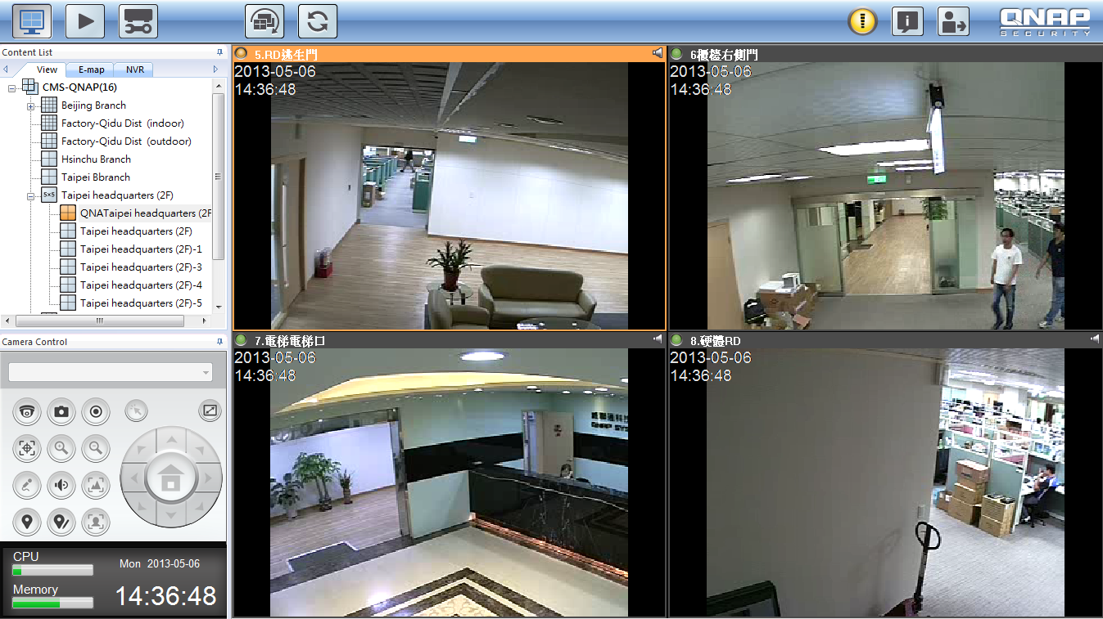
Easy CPU Status Check
Users can easily notice if should adjust video display arrangement due to CPU status
Notes:
eliminate the misevaluation of CMS performance

Slide 24

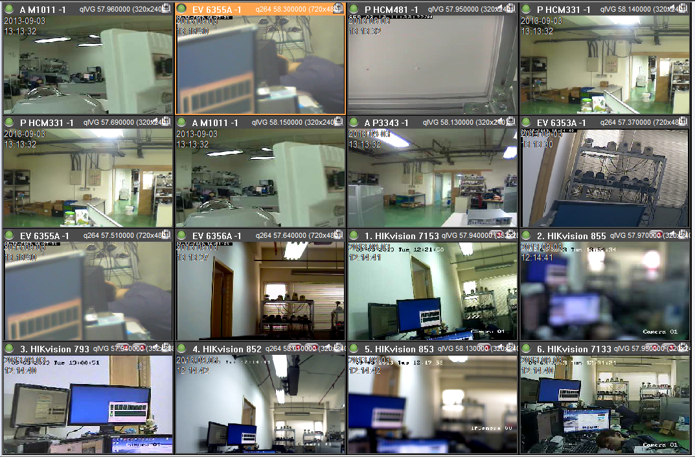
View Layout/E-map Shortcut
Drag-and-drop the most frequently used view layout or E-map onto the toolbar as shortcut

Slide 25
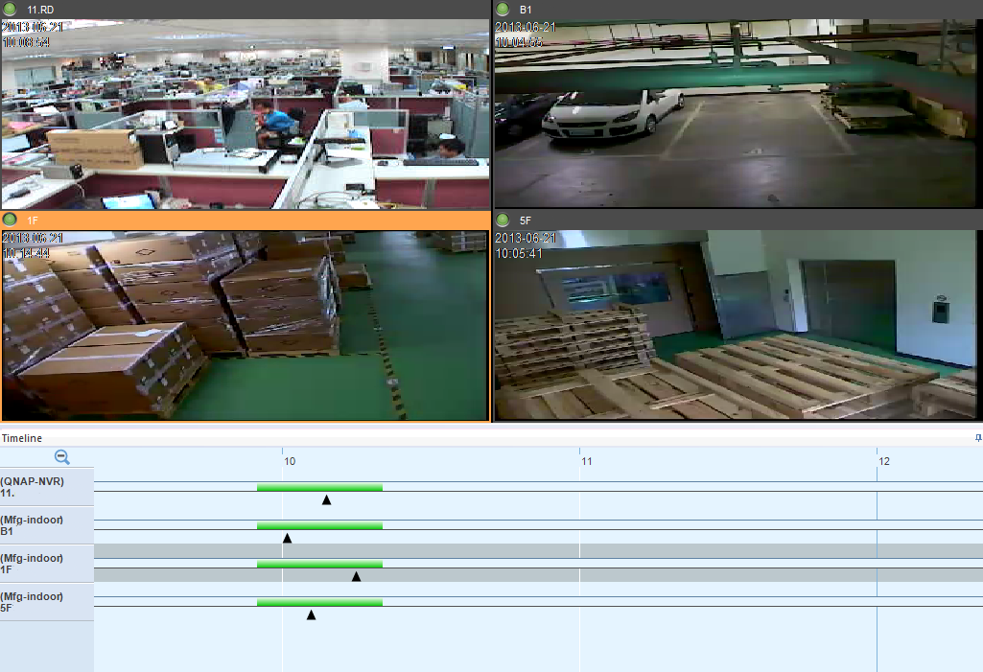
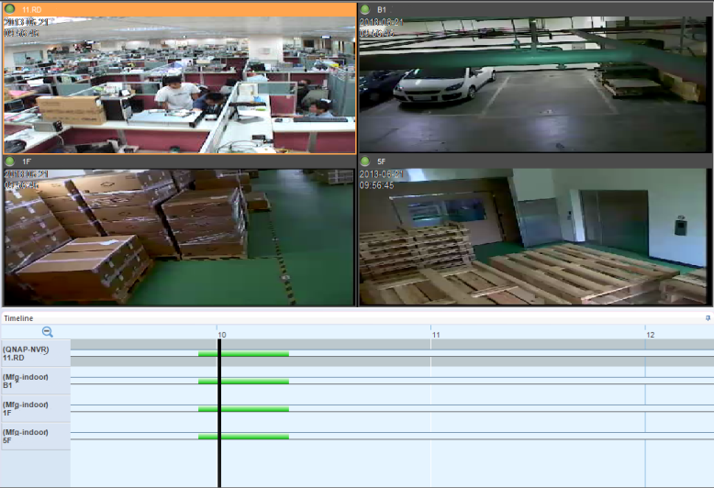
Centralized Playback
Centralized playback up to 16 channels from 16 NVRs
Playback Non-sync & Sync Mode

Slide 26
Easy Central Monitoring
Live View
CMS Client Software
Configuration
E-map
Playback

Slide 27
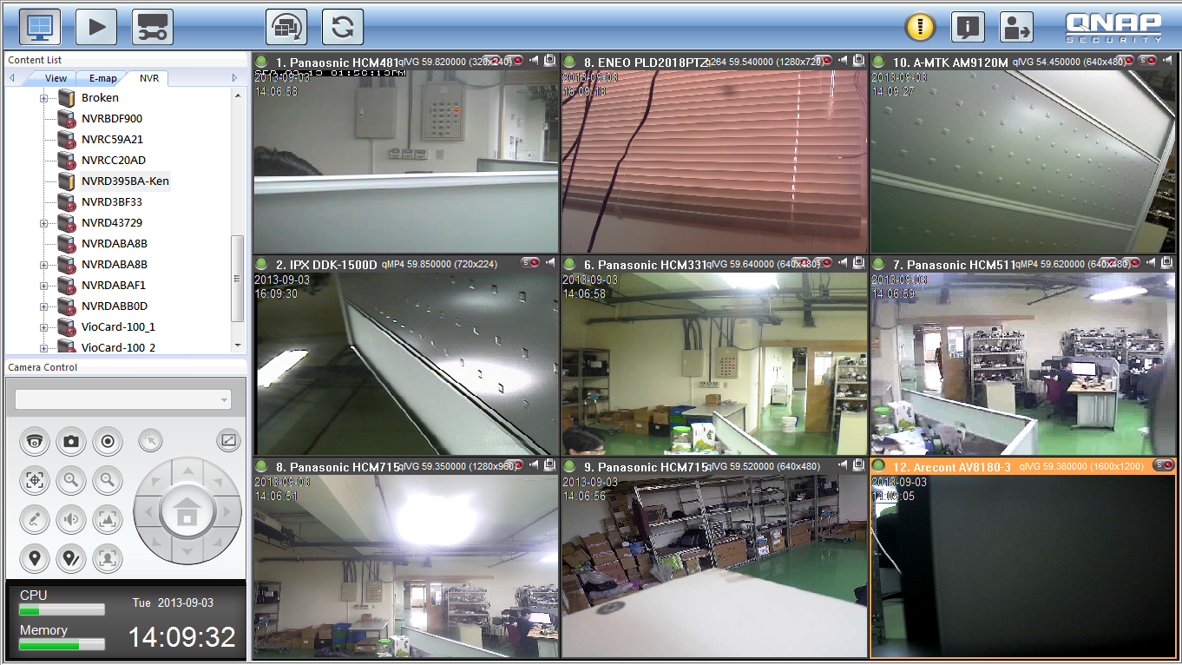
Live View
Enable alarm mode
back

Slide 28
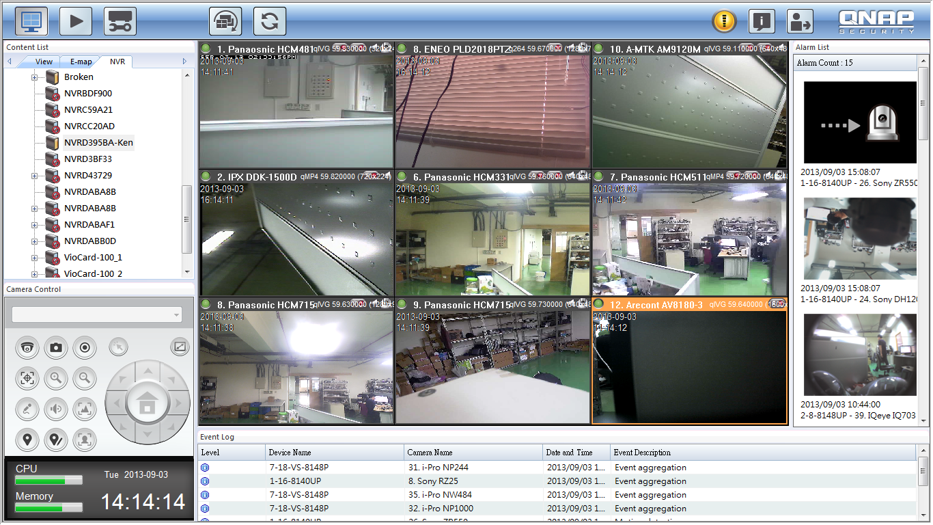
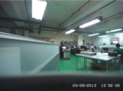
Live View
Alarm mode
back

Slide 29
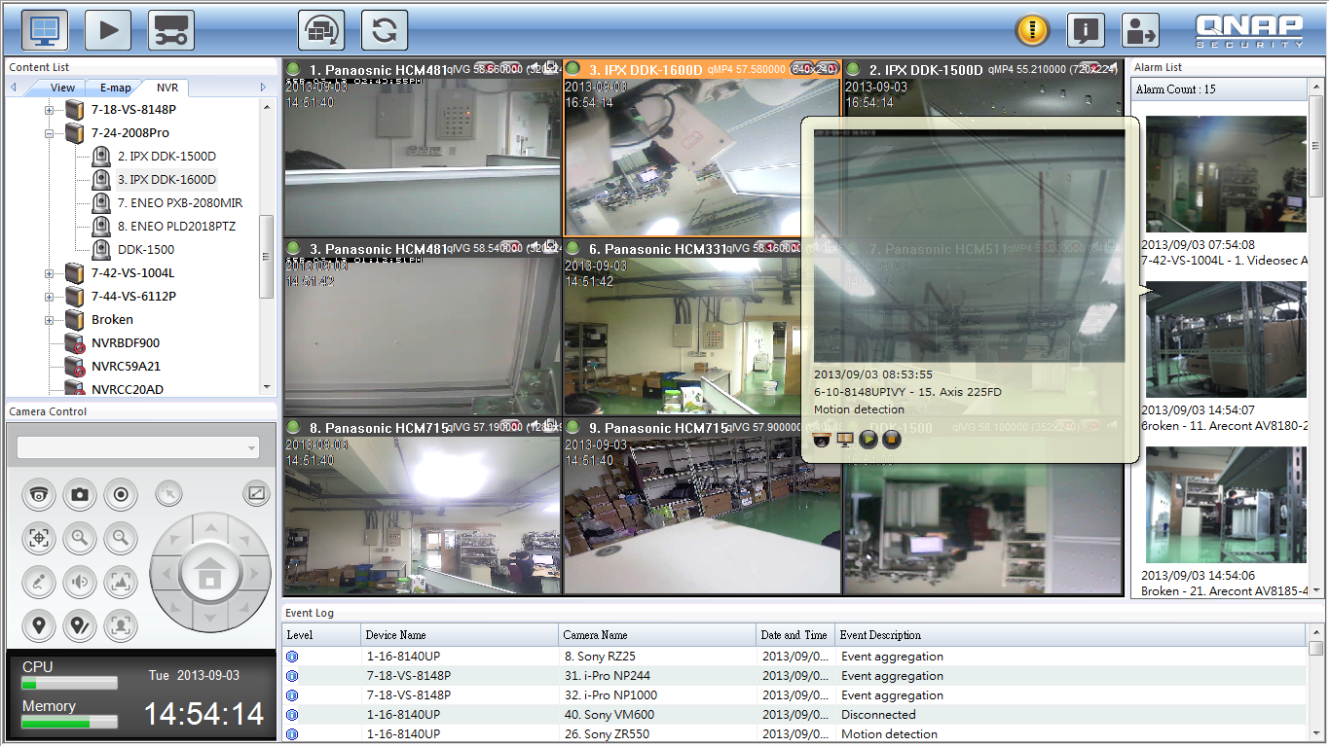
Live View
Instant event handling
back

Slide 30
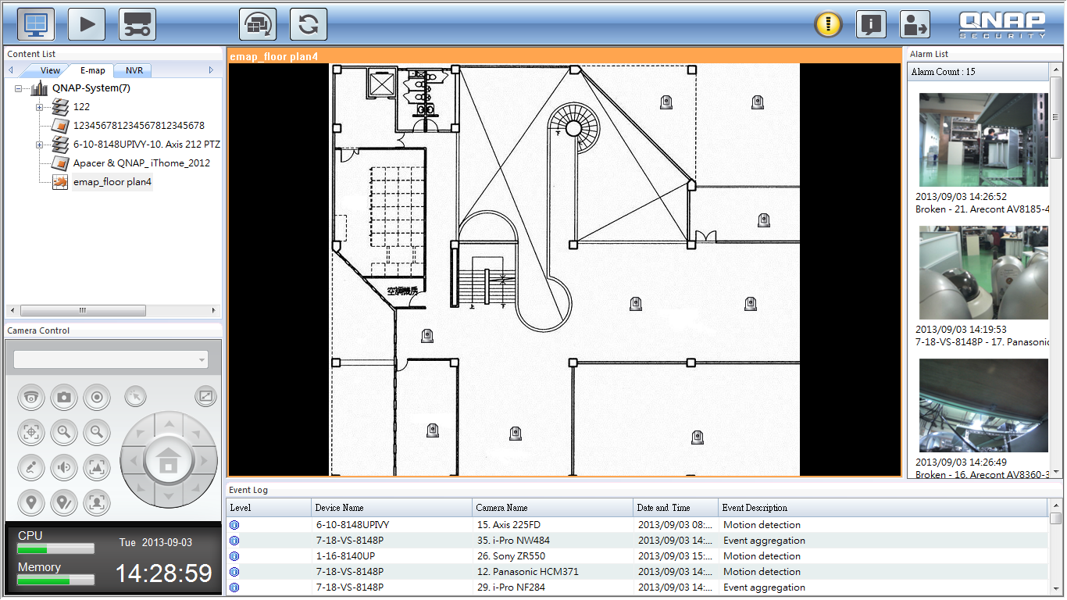
E-map
Device icon on E-map to indicate its location
back

Slide 31
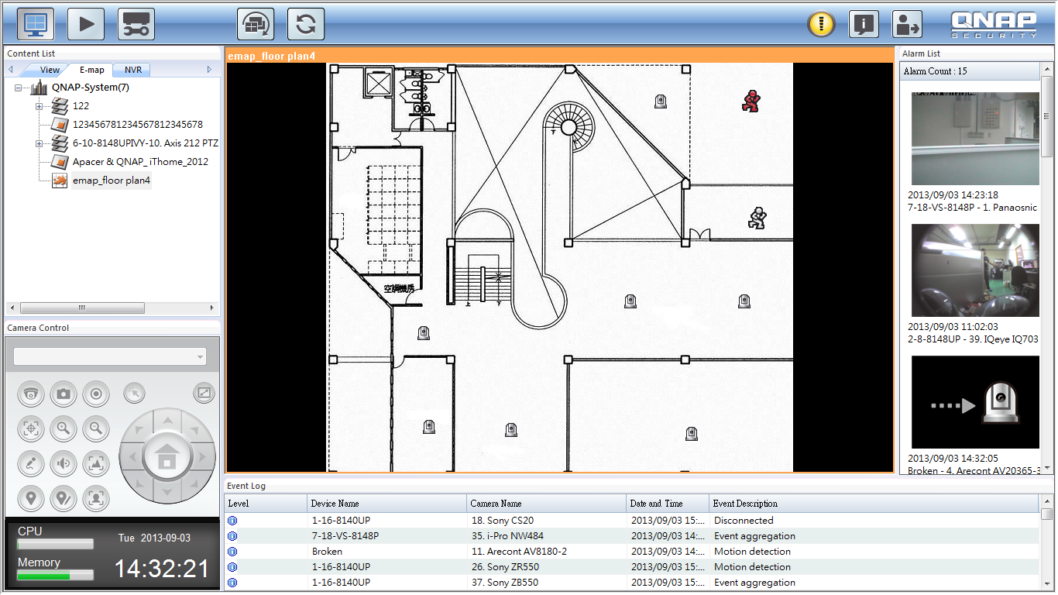
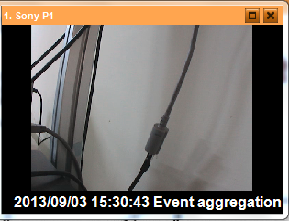
E-map
1. Red icon to show event location
2. Double click to check event live view
back

Slide 32
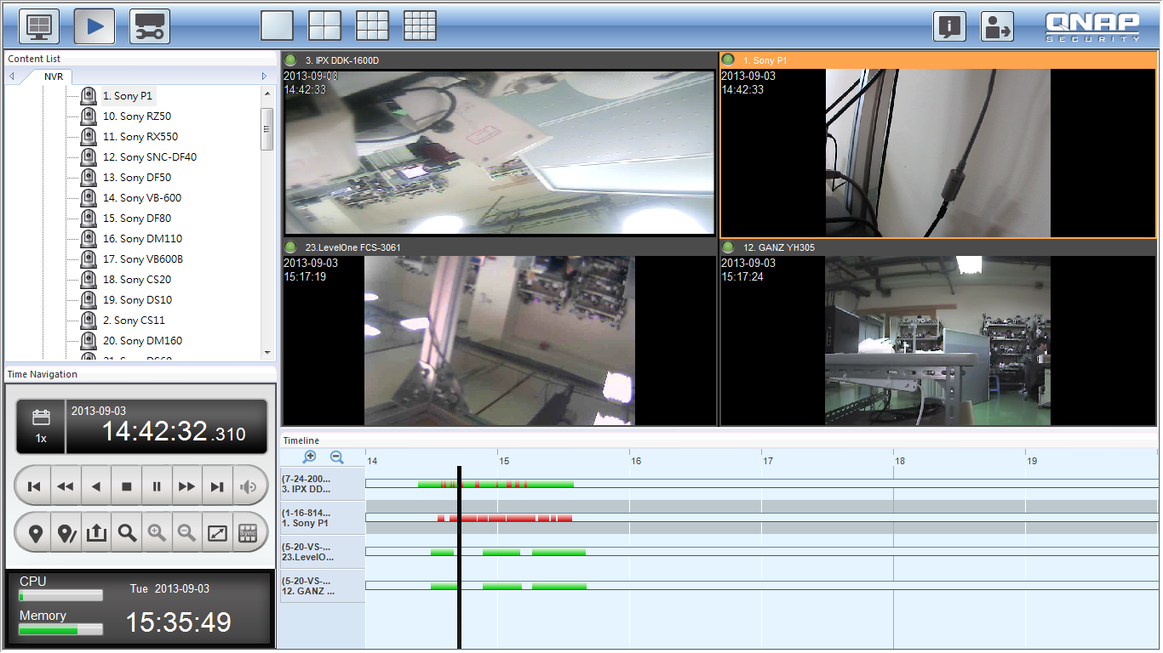
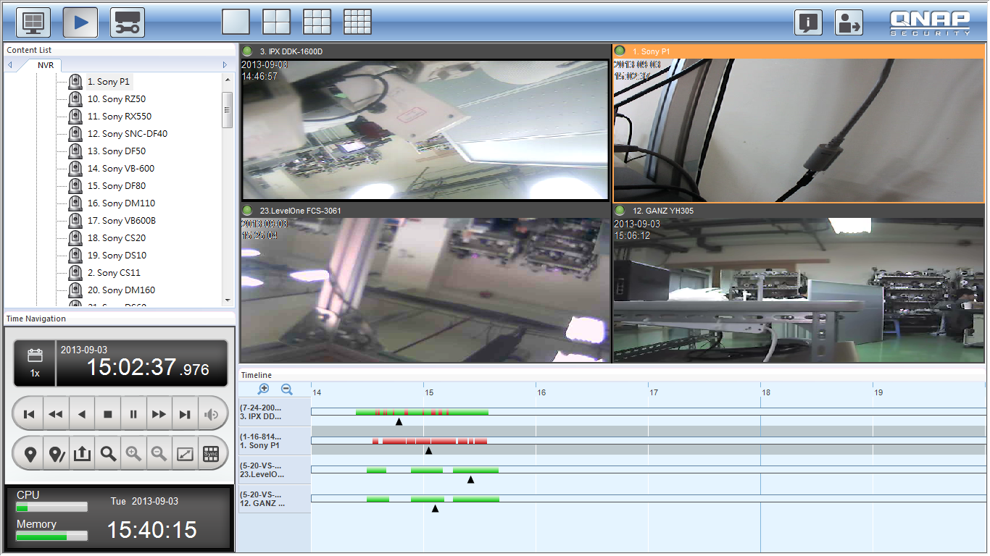
Playback
Centralized playback up to 16 channels from 16 NVRs
Playback Non-sync & Sync Mode
back

Slide 33
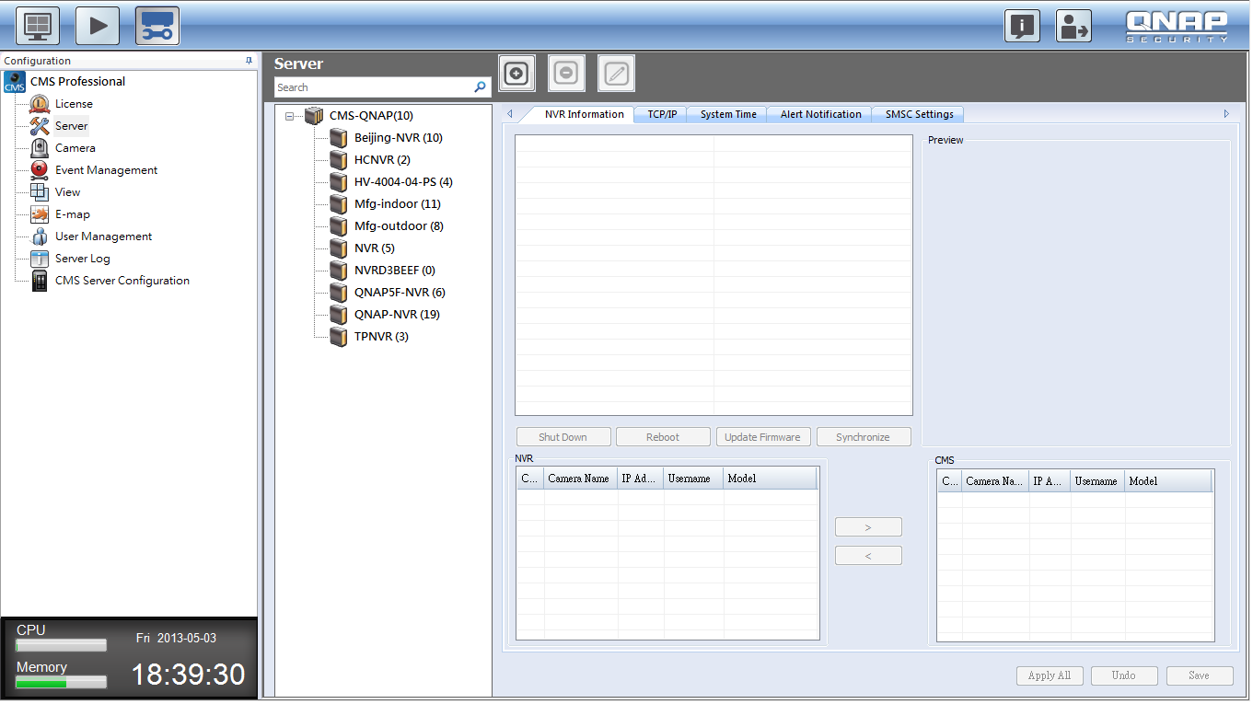
Configuration
configuration
License:
back
Notes:
License放大

Slide 34
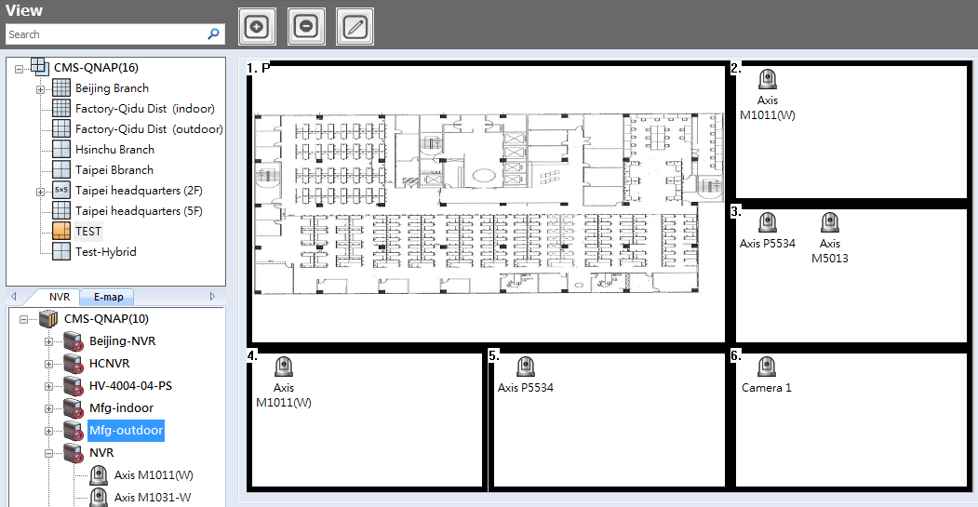
Configuration
configuration
back
Notes:
License放大

Slide 35
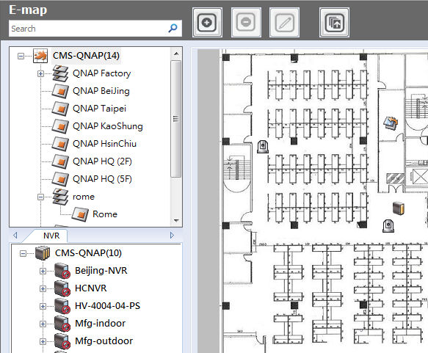
Configuration
configuration
back
Notes:
License放大

Slide 36
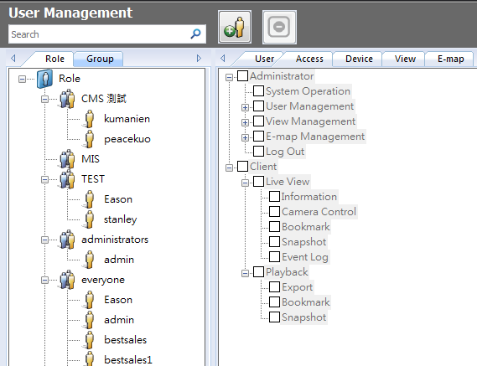
Configuration
configuration
back
Notes:
License放大

Slide 37
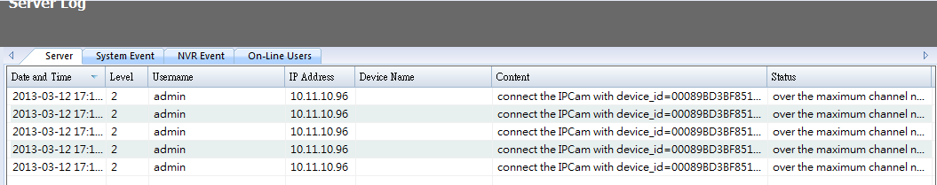
Configuration
configuration
back
Notes:
License放大

Slide 38
VioStor CMS 5 Main Purposes
Centralized Event Management
Centralized Device Management
Flexible Central Monitoring
Open Platform
Online License Scalability

Slide 39
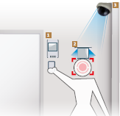
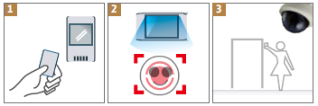
Open Platform *
An open platform for 3rd party integration
  Access control
  POS
  LPR
  IVA
  Face Detection
The 3rd party information can be recognized as the event source to trigger the pre-configured actions automatically.
The integration is applicable upon project
* Available in VioStor CMS v. 1.2
Notes:
Sales: Please refer the 3rd party integration application guide.
Qnap is open to integrate 3rd party devices by project request.
How PM choose the 3rd party integration partners? 1. big players in each local market 2. request by key customers with evaluated ROI
Sales must get the info to apply the 3rd party integration: 1. contact window of the 3rd party company 2. ensure to get the SDK if the application is approved. 3. number of the to-be-integrated 3rd party devices & camera channel

Slide 40
VioStor CMS 5 Main Purposes
Centralized Event Management
Centralized Device Management
Flexible Central Monitoring
Open Platform
Online License Scalability

Slide 41
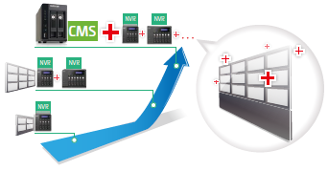
Online Project Scalability
‧ VioStor CMS is compatible with QNAP VioStor NVR with firmware v. 4.1.0 or above
‧The number of channel license can be expanded online upon project expansion.

Slide 42
QNAP Scalable Solution
Comparing Items | Local Display | Multi-Server View (Free VMS) | Central Management System (CMS)
Number of NVRs supported | 1 | 30 | 128
Number of channels supported | 64 | 128 | 1,024
Number of monitors supported | 1 | 2 | 4
Concurrent user connections | 1 | 32 | Unlimited
Applicable site size | Small Scale Sites (1-64 CH) | Medium Scale Sites (64-128 CH) | Large Multi-Site (64-1,024 CH)
Key Feature | Flexibility of Deployment | Remote Monitoring | Centralized Monitoring and Management

Slide 43
Conclusion
Centralizing Sites with Ease

Slide 44

Thank you for participating
Question & Discussion

