Slide 1
QNAP Surveillance Solution
Innovative Surveillance

Slide 2
Agenda
About QNAP Security
Why standalone NVR
What's new?
VioStor NVR is…
What’s next?

Slide 3
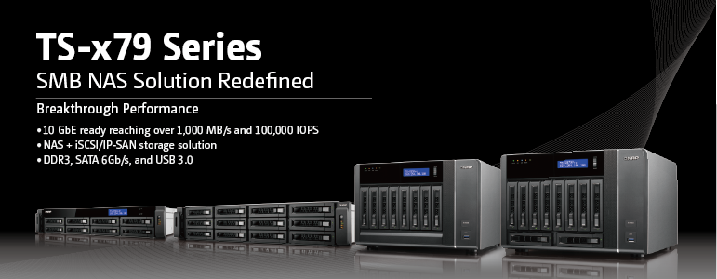


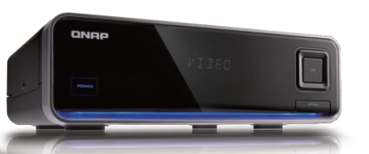
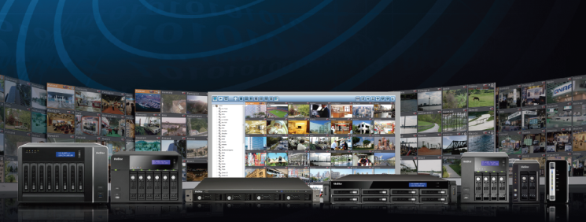

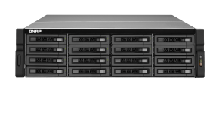

Core Technology
NAS
Network
Attached
Storage
Viostor NVR Series
NMP
Network
Multimedia Player
NVR
Network
Surveillance
System
iNDS
Digital Signage
System
Based on solid QNAP NAS, QNAP Security provides full spectrum VioStor NVR series

Slide 4




































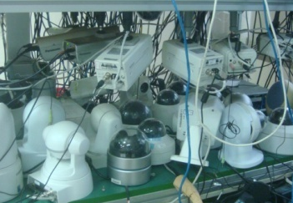
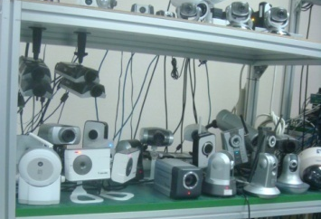
Solid Development Power
Hardware
Top notch E/E and ME design engineer team
Partner with major chipset vendors
ID/ME/Thermal in house design & simulation capability
Testing: Stress, reliability, performance, functional, compatibility, EMI...
Facility: SMT/DIP & Assembly
Software
Pioneers in embedded
Linux technology
High performance and high reliability server & video technology
Extensive experience in RISC I/O processor
Experts in TCP/IP offload engine technology
Most complete self-developed management software
Advanced network distributed management technology
Integration
Camera integration
Long-term testing
Notes:
stardot

Slide 5
QNAP Global Market Position
Gartner (March 2012)
  QNAP is top 8 world NAS
Gartner (March 2011)
  QNAP is the global top 3 SMB NAS brand (MSRP below $24,999)
  QNAP is the fastest growing business NAS brand
IMS Research (2010)
  QNAP is Top 10 Embedded NVRs supplier in the world
Recognition from Media around the World
Notes:
5

Slide 6
Top 10 Worldwide NAS Brand
Year Ranking | Company Name | Current Year Revenue ($M) | Current Year Market Share (%)
1 | EMC | 2,834 | 41.7
2 | NetApp | 2,446 | 36.0
3 | IBM | 341 | 5.0
4 | HP | 116 | 1.7
5 | Oracle | 94 | 1.4
6 | Netgear | 85 | 1.2
7 | Dell | 82 | 1.2
8 | QNAP | 79 | 1.2
9 | Synology | 57 | 0.8
10 | Buffalo Technology | 46 | 0.7
 | Others | 620 | 9.2
 | Total | 6,801 | 100.0
Vendor Revenue Market Share of Worldwide NAS and Unified Storage, 2011
Gartner (March 2012)

Slide 7
Proven Hardware Reliability
By Raw Terabytes Shipped (NAS System Price Band: Sub-$5,000 & $5,000-$24,999)
 | 2009 | 2010
NetApp | 228,108 | 475,259
Market Share (%) | 12.2 | 14.8
Growth Rate (%) | 43.9 | 108.3
Buffalo Technology | 235,662 | 395,000
Market Share (%) | 12.6 | 12.3
Growth Rate (%) | 72.4 | 67.6
QNAP | 177,743 | 371,291
Market Share (%) | 9.5 | 11.6
Growth Rate (%) | 212.5 | 108.9
Netgear | 189,076 | 235,961
Market Share (%) | 10.1 | 7.9
Growth Rate (%) | 43.8 | 34.0
Low-end Standalone NAS/Unified Storage Vendor Market Share by Unit Shipments - Tool
Gartner (March 2011)

Slide 8
Top 3 Suppliers of SMB NAS
By Unit Shipments (NAS System Price Band: Sub-$5,000 & $5,000-$24,999)
 | 2009 | 2010
Buffalo Technology | 72,750 | 98,705
Market Share (%) | 14.4 | 14.2
Growth Rate (%) | 15.6 | 35.7
QNAP | 56,719 | 80,797
Market Share (%) | 11.2 | 11.7
Growth Rate (%) | 72.4 | 42.5
NETGEAR | 62,812 | 69,294
Market Share (%) | 12.4 | 10.0
Growth Rate (%) | 20.2 | 10.3
EMC | 46,550 | 67,205
Market Share (%) | 9.2 | 9.7
Growth Rate (%) | 110.2 | 44.4
Low-end Standalone NAS/Unified Storage Vendor Market Share by Unit Shipments – Total
Gartner (March 2011)

Slide 9
Top 10 Players of Embedded NVR
Company Name | 2009 Market Share
1. GEUTEBRÜCK | 14.0%
2. NICE Systems | 13.0%
3. Panasonic System Solutions (PSS) | 8.3%
. . .
10. QNAP | 2.7%
Others | 34.1%
World in 2009 - Revenues = $167.8 million
QNAP is one of the top 10 embedded NVR suppliers in the world
Market Shares for Embedded NVR
© IMS Research
Notes:
According to IMS Research, QNAP is one of the top 10 embedded NVR supplier in the world. And we are the top three embedded NVR supplier in Japan. And you may be curious about how we start surveillance business. We enter Japan market in 2007. From that time on we have co-worked with Japanese customers very closely. After years of hard work, VioStor NVR is approved by Japan market. It’s a simple sentence, but we spend many time overcoming the difficulties and moving ahead. I trust the table is just the beginning. I believe that from A to A+ is a very difficult process. We will continue to invest in surveillance products to further develop compatibility, stability, and simplicity to bring our users an unbeatable surveillance experience.

Slide 10


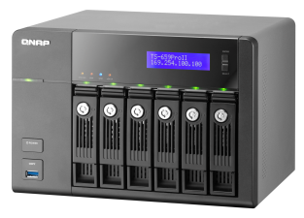
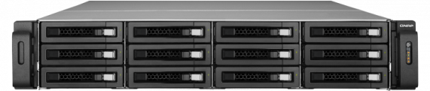

















Recognition around the World
NVR Excellence Awards
in 2012 Secutech Awards Contest
InfoWorld's 2012 Technology of the Year Award winners
VS-12164URP Pro
TS-659 Pro II

Slide 11
Agenda
About QNAP Security
Why standalone NVR
What's new?
VioStor NVR is…
What’s next?

Slide 12
Advantages of Standalone NVR
 | Standalone NVR | PC-based Solution
OS | Linux Embedded | Windows
Stability | High | Low
Setup cost | Low | High (+ PC)
Ease of setup & management | Easy, only simple steps | Difficult (Software required)
System temperature | Low | High
Maintenance (frequency) | Low (easy-to-maintain) | High
System crash risk | Low | High
Problem analysis | Easy (by event logs) | Difficult
Auto power on when power recovery | Yes | No, manual reboot required
Virus attack/Trojan threaten | None | Sometimes
Power consumption and noise level | Low | High
Total maintenance cost | Low | High

Slide 13
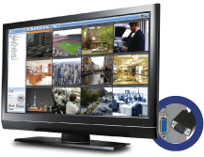
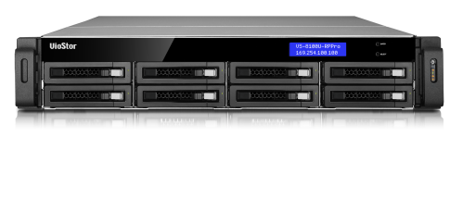




Innovative NVR Solutions
Remote Replication
Surveillance Storage Expansion
HD Local Display
Turbo NAS
Multi-site VioStor NVR
Remote Monitoring/ playback
Mobile Surveillance

Slide 14
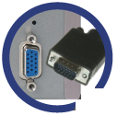
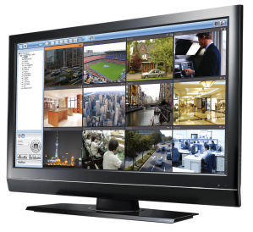
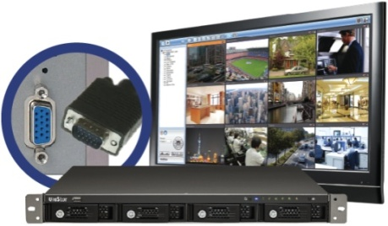
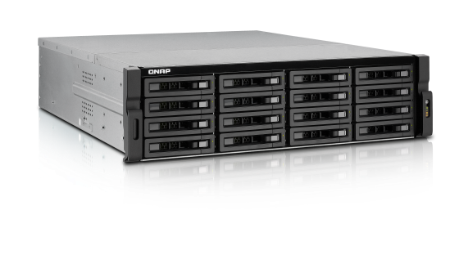
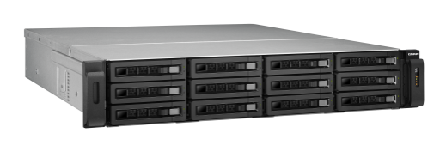
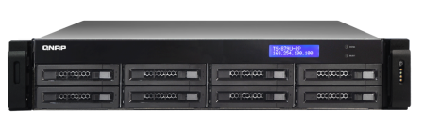

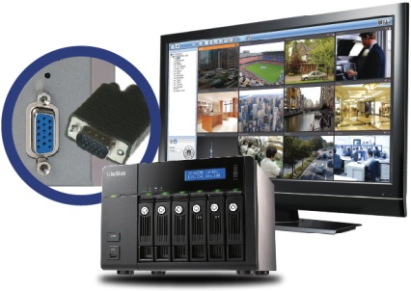
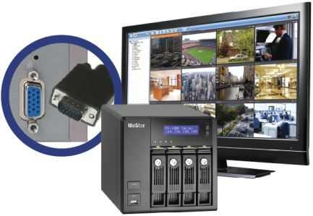
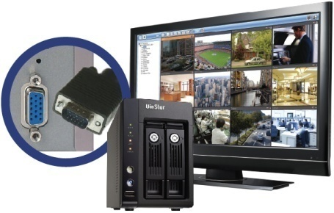
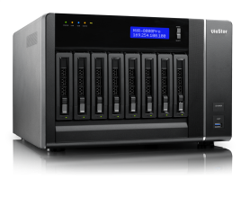
Full Spectrum NVR Series
QNAP has developed a series of NVR which supports high performance and remarkable local display (HDMI output).
Enterprise
Enterprise
Enterprise
Enterprise
VS-16100U-RP Pro+ series
VS-12164/12156/12148/12140U-RP Pro
Up to 64/56/48/40 channels
VS-8148/8140/ 8132/8124U-RP Pro
Up to 48/40/32/24 channels
VS-4016/4012/4008U-RP Pro
Up to 16/12/8 channels
Enterprise & SMB
Enterprise & SMB
SMB & SOHO
SMB & SOHO
VS-8148/8140/8132/8124 Pro+
Up to 48/40/32/24 channels
VS-6020/6016/6012 Pro
Up to 20/16/12 channels
VS-4016/4012/4008 Pro
Up to 16/12/8 channels
VS-2012/2008/2004 Pro
Up to 12/8/4 channels

Slide 15
NVR + CMS Roadmap
CMS
CMS-2000
NVR
(Dec 2012)
VS-16100U-RP Pro+
Enterprise
VS-12100U-RP Pro
VS-12100U-RP Pro+
VS-8100U-RP Pro
VS-8100U-RP Pro+
VS-8100 Pro+
VS-6000Pro
VS-6100 Pro+
SMB/
SOHO
(Nov 2012)
VS-4000U-RP Pro
VS-4100U-RP Pro+
(Q1 2013)
VS-4000 Pro
VS-4100 Pro+
■ Intel® Core™ E3 processor, 8GB DDR3 ECC RAM
■ Intel® Core™ i3 processor, 4GB DDR3 RAM
■ Dual-core Intel 2.5GHz processor, 4GB DDR3 RAM
■ Dual-core Intel Atom 1.8 GHz processor
■ Marvell 2.0 GHz CPU, 1GB DDR3 RAM
■ Marvell 1.2 GHz CPU, 256MB DDR2 RAM
(Nov 2012)
VS-2000 Pro
VS-2100 Pro+
(Dec 2012)
Home
VS-2008L/2004L
VS-2100L
(Q1 2013)
VS-1004L
Project only
Now
Oct.
Nov.
Dec.
Jan.
Feb.
Mar.
Future
2012

Slide 16


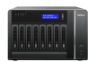






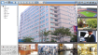
Future NVR Product Line
 | 2-bay | 4-bay | 6-bay | 8-bay | 12-bay | 16-bay
64ch
56ch
48ch
40ch
32ch
24ch
20ch
16ch
12ch
8ch
4ch
VS-12164U-RP Pro+
VS-16100U-RP Pro+
VS-12156U-RP Pro+
VS-8148 Pro+
VS-8148U-RP Pro+
VS-12148U-RP Pro+
VS-8140 Pro+
VS-8140U-RP Pro+
VS-12140U-RP Pro+
VS-8132 Pro+
VS-8132U-RP Pro+
VS-8124 Pro+
VS-8124U-RP Pro+
VS-6120 Pro+
VS-4116 Pro+
VS-4116U-RP Pro+
VS-6116 Pro+
■ Intel® Core™ E3 processor, 8GB DDR3 ECC RAM
■ Intel® Core™ i3 processor, 4GB DDR3 RAM
■ Dual-core Intel 2.5GHz processor
■ Marvell 1.2 GHz CPU, 256MB DDR2 RAM
VS-2112 Pro+
VS-4112 Pro+
VS-4112U-RP Pro+
VS-6112 Pro+
VS-2108L
VS-2108 Pro+
VS-4108 Pro+
VS-4108U-RP Pro+
VS-2008L
VS-2104 Pro+

Slide 17
QNAP Surveillance Features Roadmap
CMS-2000
CMS-2000
V1.2
CMS-2000
V1.1
(Q2 2013)
V1.0
(Q1 2013)
Access control, real-time IVA
CMS
(Dec 2012)
Video wall, event management
Up to 1024 cameras, centralized monitor, quad-monitor, role-based, dash board
V4.2.0
V4.1.0
V4.0.0
(Q1 2013)
(Dec 2012)
Real-time IVA (HH 5 features), edge recording, enhanced two-way audio support, virtual channel on Windows Client, hardware decode on Windows Client, NVR fail over
(Nov 2012)
Hardware decoding support (VS-12100U-RP Pro, 8100U-RP Pro, 8100 Pro+), HTTPS, surveillance storage expansion, multi-stream enhancement (dual recording, smart recording), ONVIF enhancement
NVR
V3.6.1
Hardware decoding support (new Intel G540 platform), cross-browser (Chrome, Firefox on Windows), new monitor/playback UI, ImmerVision Enables
New camera support
QNAP Surveillance Client for MAC
APP/ Feature
Beta
Surveillance Storage Expansion
Surveillance Storage Expansion
Now
Oct.
Nov.
Dec.
Jan.
Feb.
17
Mar.
Future
2012

Slide 18
Agenda
About QNAP Security
Why standalone NVR
What's new?
VioStor NVR is…
What’s next?

Slide 19
VioStor NVR FW v4.0.0

Slide 20

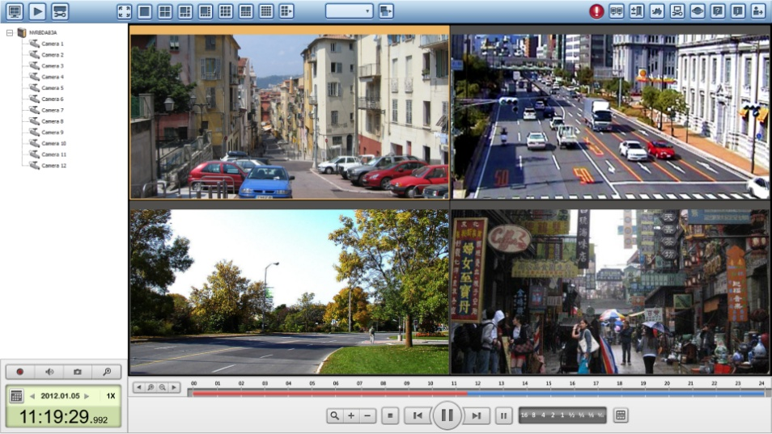



Cross Browsers Enhancement
On Windows PC

Slide 21
New Remote Monitoring/Playback Interface
Intuitive monitoring interface
New device/camera tree for clear system overview
Flexible drag & drop of control panel
Max 64-channel display mode
Alert for disk error and warning
Intuitive playback interface
New device/camera tree for clear system overview
Flexible drag & drop of control panel
Timeline of recording status
Notes:
彈性拖拉要秀圖
From 42 to 64 channel
秀disk error 視窗
project-option => 64 channel

Slide 22
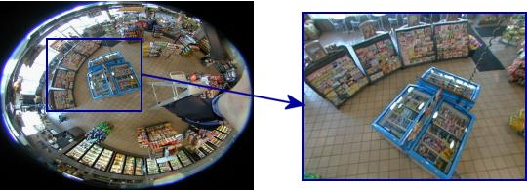
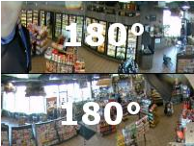

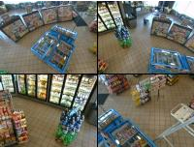
ImmerVision 360° Panomorph Ready
Single PTZ window
Complete perimeter view in one window (2 x 180°)
Four PTZ view in one window
Note: The feature will be supported at official NVR FW v4.0.0.

Slide 23
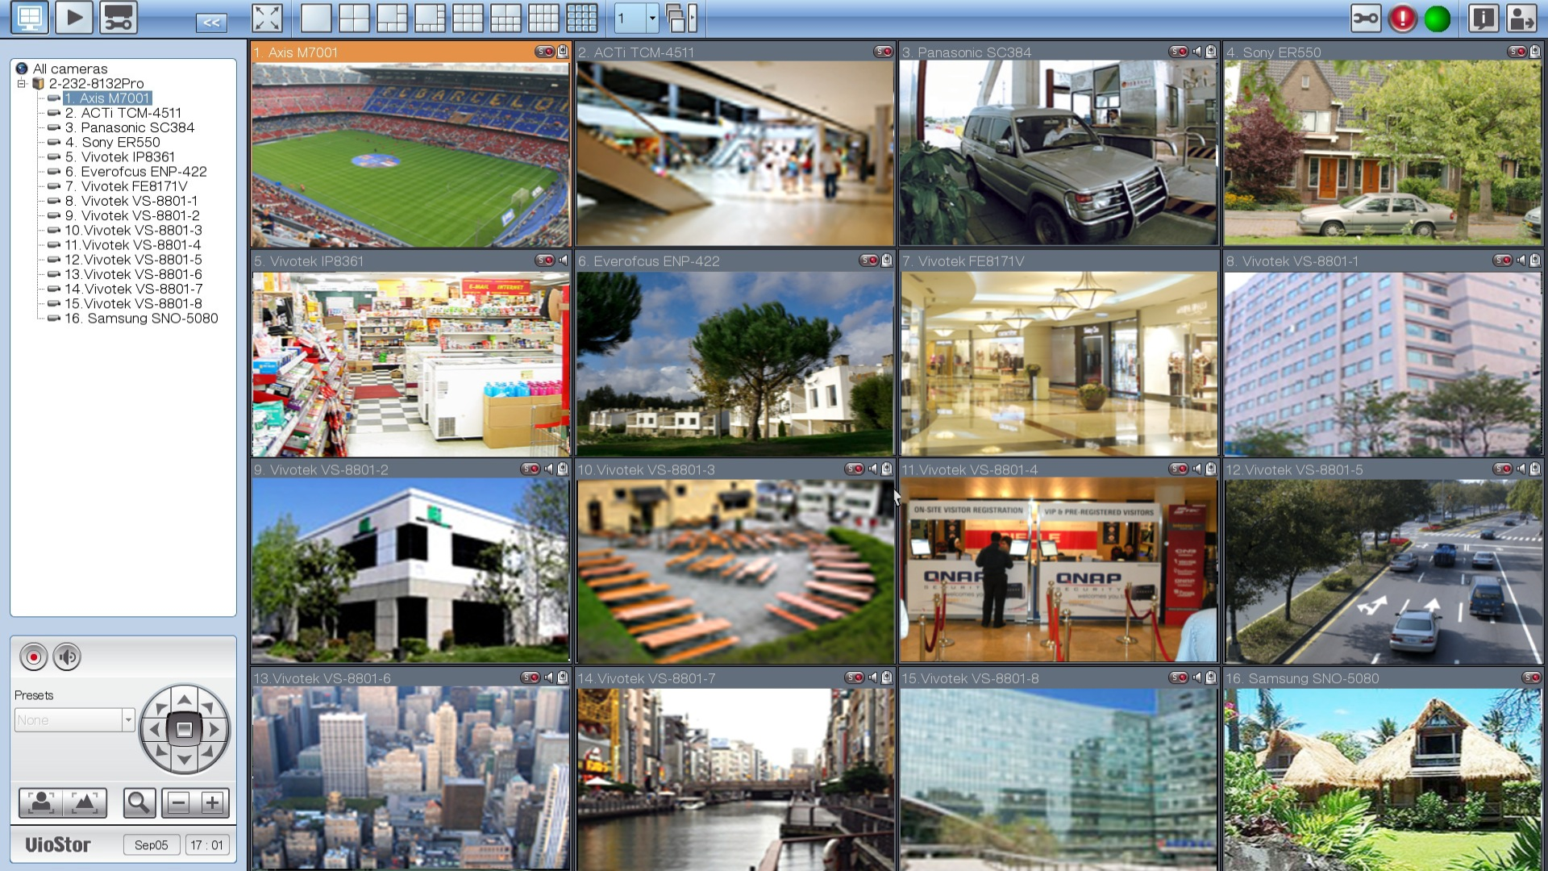
Hardware Decode Support
H.264, Full HD, 150fps on local display interface

Slide 24































More Network Camera Support
is a member of

Slide 25
Agenda
About QNAP Security
Why standalone NVR
What's new?
VioStor NVR is…
What’s next?

Slide 26
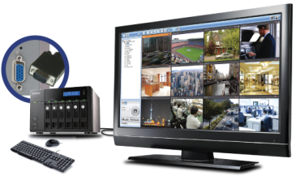

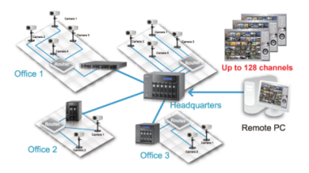
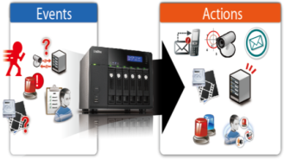


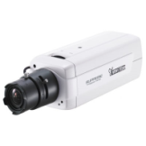
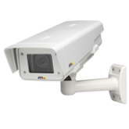
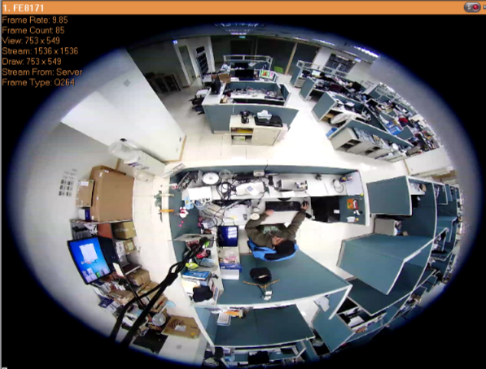
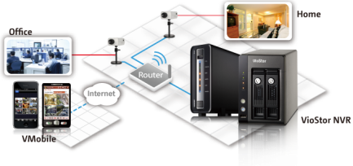

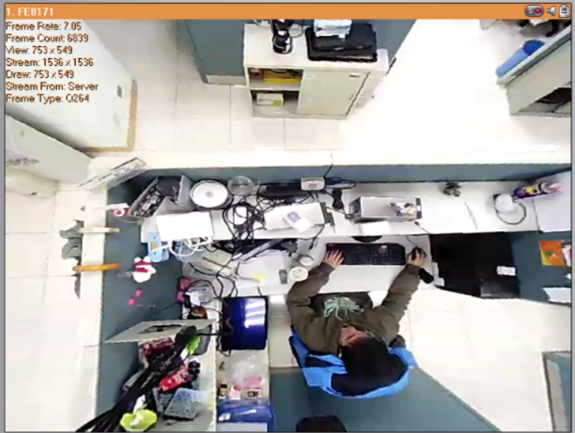
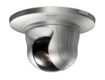
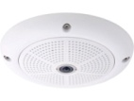
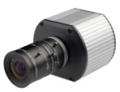
VioStor NVR is…
Compatible with a broad range of IP cameras
World’s first Linux-based NVR with HD local display
(VioStor Pro series)
QNAP Surveillance Client for Windows and Mac
Intelligent Video Analytics (IVA) for fast video search
Live view on mobile devices by VMobile
Green NVR solution
Advanced event management for event handling
128-channel monitoring from multiple VioStor NVR servers
Megapixel recording
(up to 10-megapixel camera)
Fisheye dewarping support
Windows and Mac-compatible
Multi-server
Monitoring
is a member of
HD Local Display
Event Management
Motion Detection
Foreign Object
Missing Object
Out of Focus
Camera Occlusion
Megapixel Recording
Dewarp function
IVA
Mobile Surveillance
Green NVR solution

Slide 27
Supports a Broad Range of IP Cameras
Compatible with 67 camera brands, over 1,600 camera models
is a member of

Slide 28
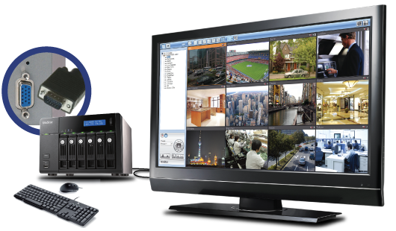
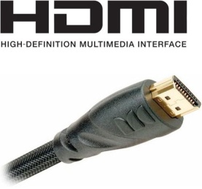
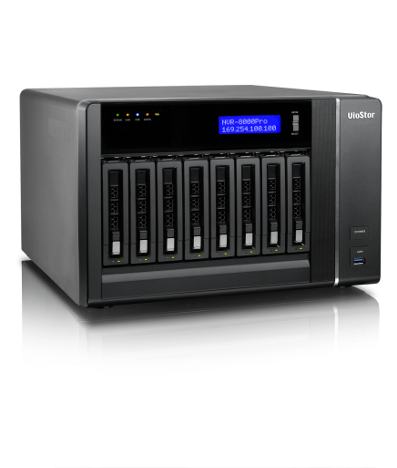
First Linux-based Standalone NVR with HD Local Display
The Linux-based standalone NVR* supports PC-less quick configuration, monitoring of IP cameras on the network, video playback and system administration by local display via a VGA monitor, a USB mouse and a USB joystick (optional). The administrator can manage the surveillance system with the least hardware required.
VGA connector
*1 For VioStor Pro series only
*2 VS-8100 Pro+ support HDMI local display.

Slide 29
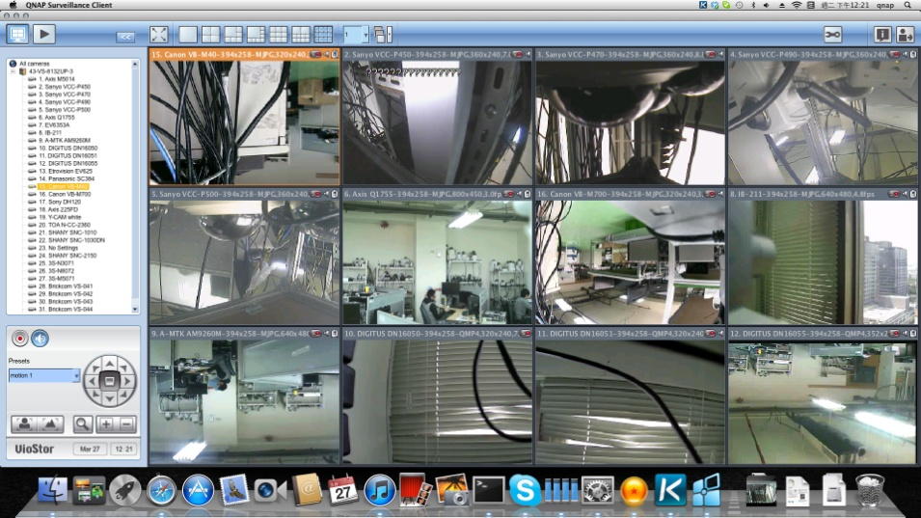
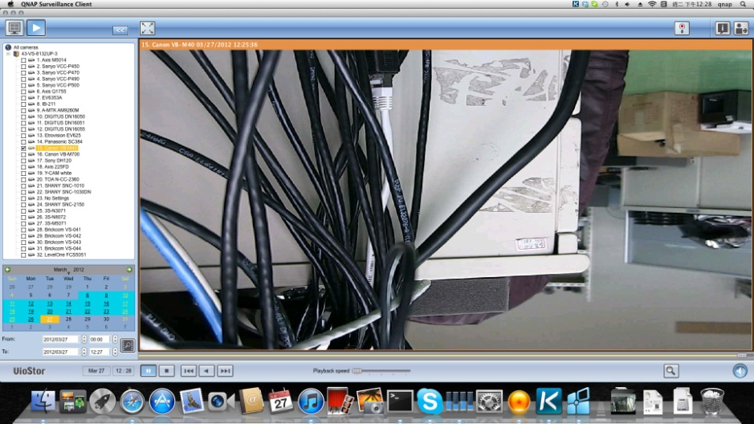
QNAP Surveillance Client for Mac
Monitoring page
Playback page
Only live view and playback are supported on QNAP Surveillance Client.
Note: To use QNAP Surveillance Client for Mac, your Mac should be running OS X Lion 10.7.x.
Mac and Mac OS are trademarks of Apple Inc., registered in the U.S. and other countries.
Notes:
PC & Mac 比較表
準備上市

Slide 30
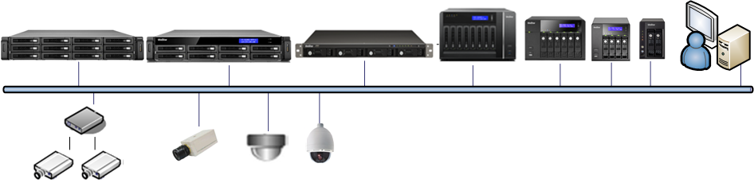
128-channel Monitoring from Multiple VioStor NVR Servers
Free embedded VMS
Up to 128 Channel
HD local display
Video Server
PC Client
IP Camera
Analog Camera
No additional software required!

Slide 31

Advanced Event Management for Event Handling
Events
Camera Event: Motion detection, alarm input, connection failure
NVR Event: Recording failure
Actions
External Event: User-defined event
User-defined action
SMS and email alert
PTZ camera control, alarm output
Multi-channel recording, NVR buzzer

Slide 32
Megapixel Recording
High Performance Megapixel Recording
NVR Model | Network Throughput
VS-12164U-RP/12156U-RP/12148U-RP/12140U-RP Pro | 450 Mbps
VS-8148U-RP/8140U-RP/8132U-RP/8124U-RP Pro | 400 Mbps
VS-8148/8140/8132/8124 Pro+ | 400 Mbps
VS-6020 Pro/6016 Pro/6012 Pro | 176 Mbps
VS-4016U-RP Pro/4012U-RP Pro/4008U-RP Pro | 176 Mbps
VS-4016 Pro/4012 Pro/4008 Pro | 176 Mbps
VS-2012 Pro/2008 Pro/2004 Pro | 176 Mbps
Software Performance
* Actual performance may vary in different environment.
VS-12100U-RP Pro series
  Supports live view and real-time recording from maximum 64 cameras
  High quality H.264, MPEG-4, and M-JPEG recording
  64-channel H.264 + 30fps + HD recording and live view
  64-channel H.264 + 15fps + Full HD recording and live view

Slide 33
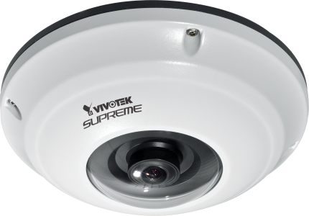
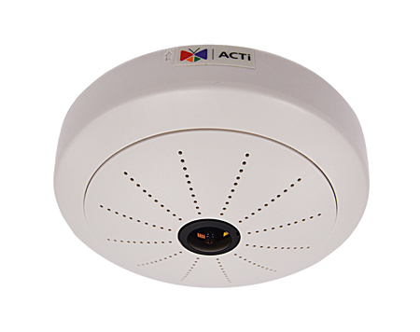
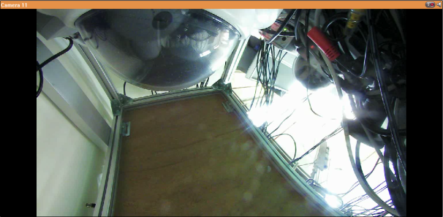
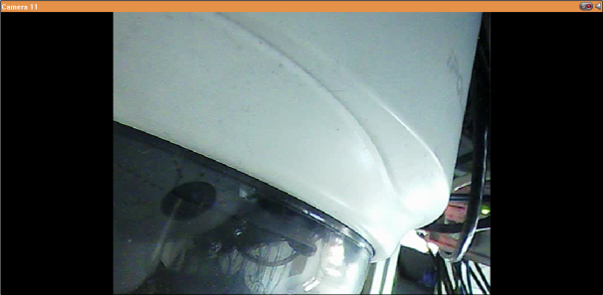
Fisheye dewarping Support
Vivotek FE8171V
Dewarp function for FE8171V is supported on live view and playback of remote PC and local display interface.
ACTi KCM-3911
Single stream, dual stream and 6 streams mode are supported for KCM-3911 .

Slide 34
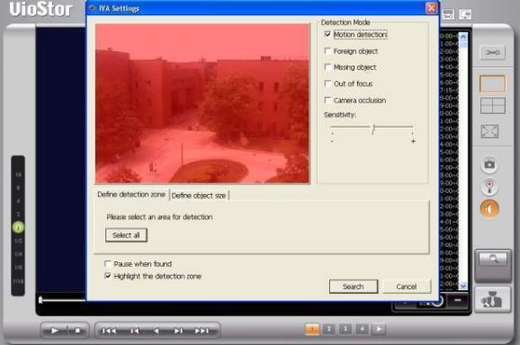

Intelligent Video Analytics for Fast Video Retrieval
Tired of spending hours trying to find the recording files related to specific events? Now there’s no need to browse video files one by one by staring at the monitor looking for what you need. The VioStor NVR provides intelligent video analytics (IVA) function that enable users to retrieve what’s needed quickly.

Slide 35
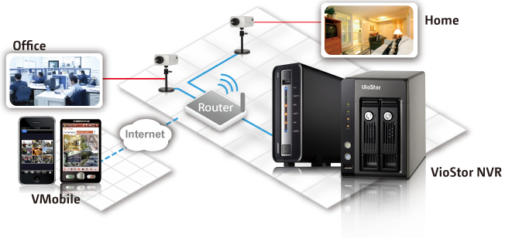
Live View on Mobile Devices
VMobile is a mobile video surveillance utility provided by QNAP for users to monitor the IP cameras on the VioStor NVR. With VMobile installed on your Android phone, iPad, iPhone, iPod Touch, or Windows PDA phone, you can monitor your home and office and receive instant event alert anytime, anywhere.

Slide 36

Green NVR Solution
Green NVR solution: Embedded Linux system with low power consumption
The Linux-based VioStor NVR is more power-saving and quiet, and less vulnerable to virus attacks compared to PC-based surveillance solutions.
The VioStor NVR helps you save more $$$ with lower power consumption.

Slide 37
Agenda
About QNAP Security
Why standalone NVR
What's new?
VioStor NVR is…
What’s next?

Slide 38



Storage Expansion Solutions
Turbo NAS
VioStor NVR
Surveillance Storage Expansion

Slide 39



Surveillance Storage Expansion
For Camera N₁, Camera N₂……
Turbo NAS: Up to 48TB
Camera N₁: N₁ can be 1, 2, 3,... 64.
If N₁ is 3, Camera N₂: N₂ can be 1, 2, 4,... 64.
Whooping up to additional 200TB mass storage
+
For Camera N₃, Camera N₄……
VioStor NVR:
Up to 64 channels
Turbo NAS: Up to 48TB
N₃ can only be the number other than N₁ and N₂. N₄ can only be the number other than N₁ N₂, and N₃.
For Camera N₅, Camera N₆……
Turbo NAS: Up to 48TB
* Single NAS can be used for single or multiple channels for storage expansion.
Note: Design and specifications are subject to change without notice.
Notes:
Description of the slide:
-Each channel is allowed to backup to QNAP Turbo NAS (1~ 12-bay).
-The total storage capacity will be up 2,304TB, while QNAP VioStor NVR VS-12164U-RP PRO backup each channel to a 12-bay NAS.
(64 ch x 36TB= 2,304 TB)

Slide 40
Thank you

