Slide 1
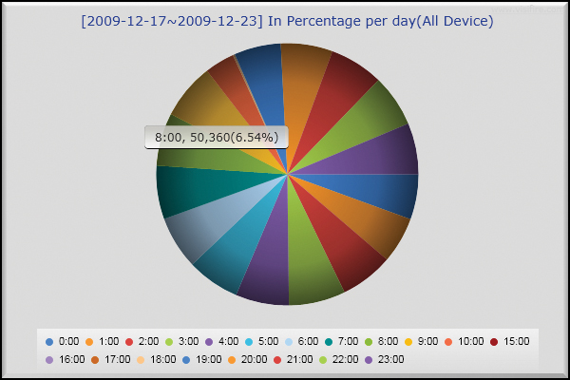


PEOPLE COUNTS
Vision of Security

Slide 2
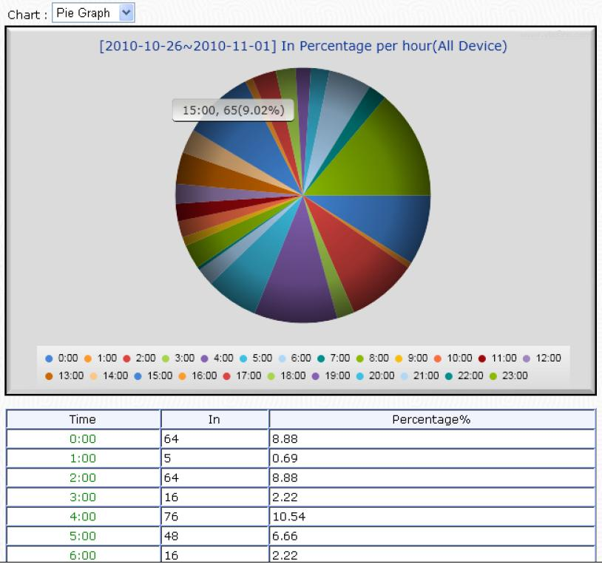

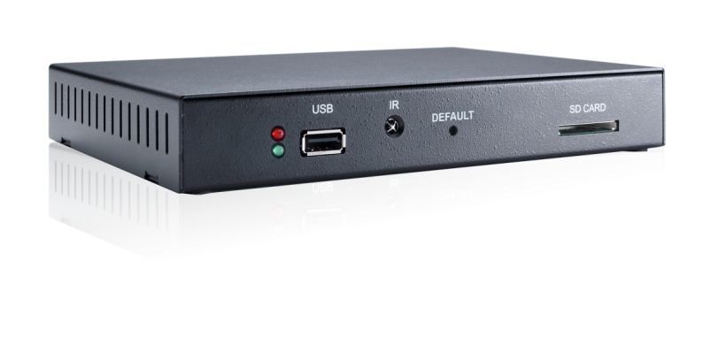
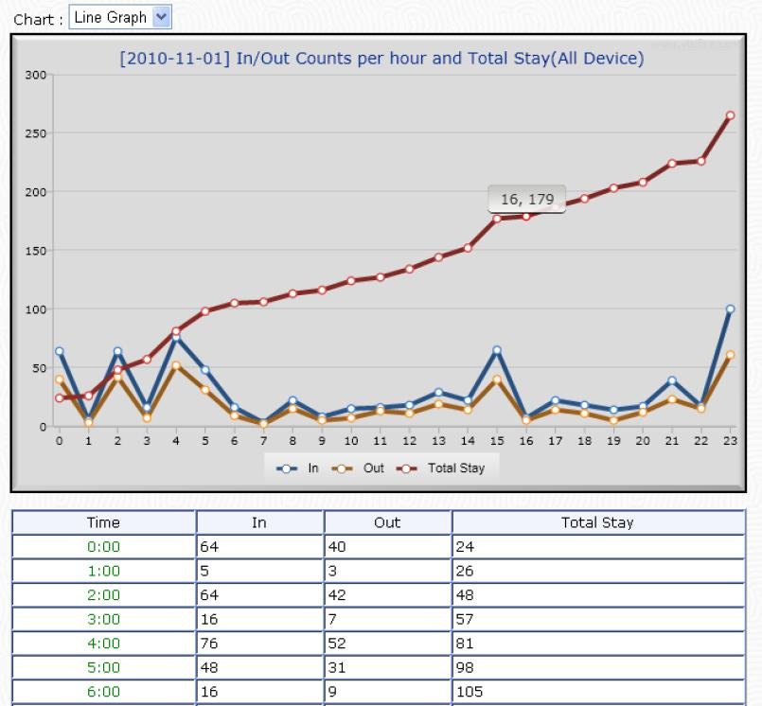

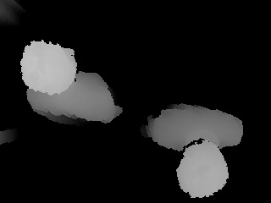
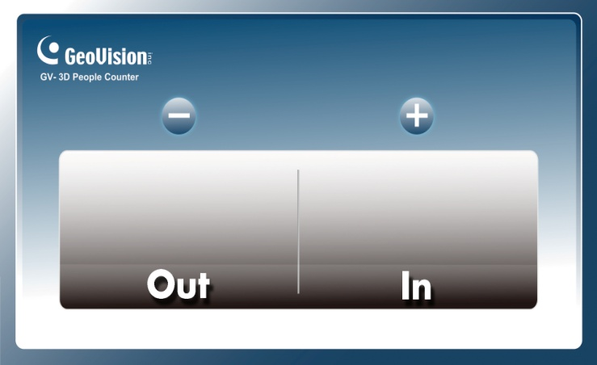
GV-3D People Counter
Network Structure
USB
TCP/IP
HDMI / VGA
Build-in Web Report Lite
10
23

Slide 3
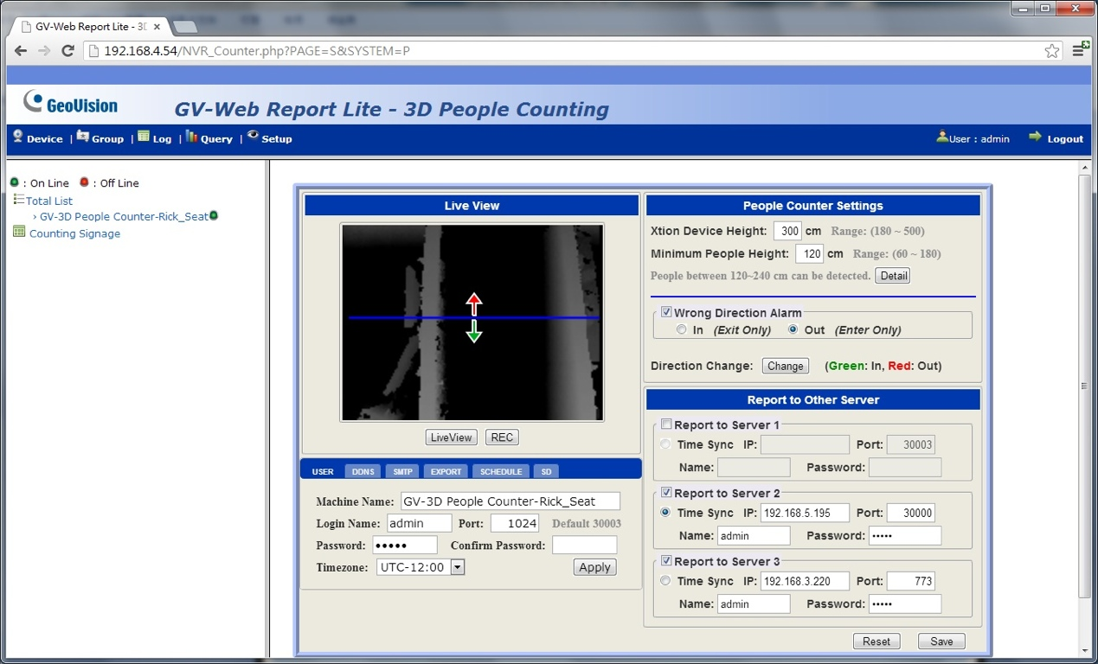
GV-3D People Counter
Easy Setup for People Counting
Simple Setup Steps 1-2-3
1. Insert SD card into Device
2. Draw the Boundary and define IN/OUT in GV-People Counter’s Browser
3. Type-in Xition Device’s Height and Min People’s Height and Click Save

Slide 4
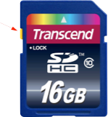
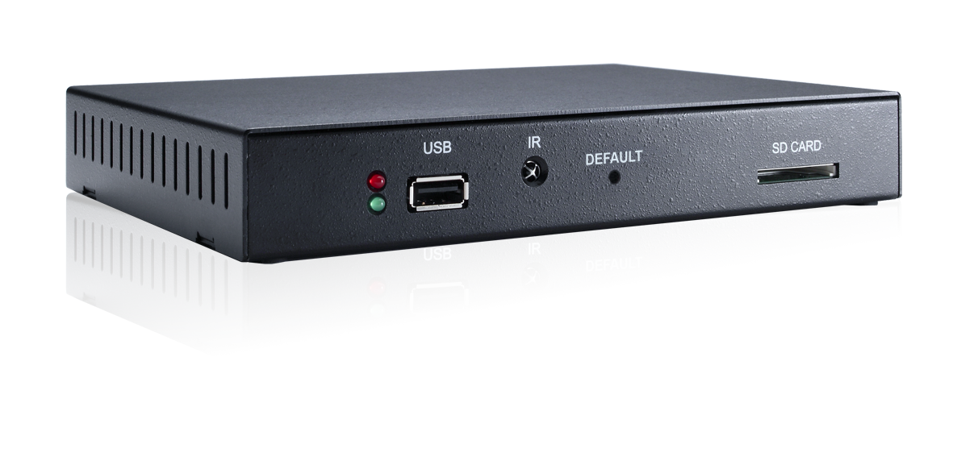
GV-3D People Counter
Step1: Insert SD Card
SD Card Specification
Class 6 or above 4~32 GB with SDHC FAT32 Format
What’s in SD Card ?
Firmware Update
DB for Counter Result
Scenario Folder for Customize Layout on Display Monitor

Slide 5
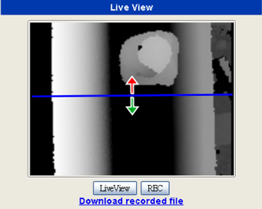
GV-3D People Counter
Step2: Define Boundary and Direction

Slide 6
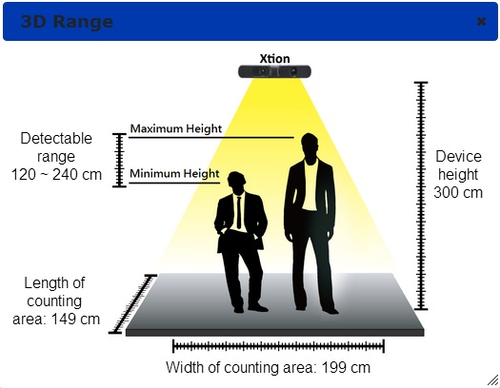
GV-3D People Counter
Step 3: Define Height in Xtion Camera / Min People’s Height

Slide 7
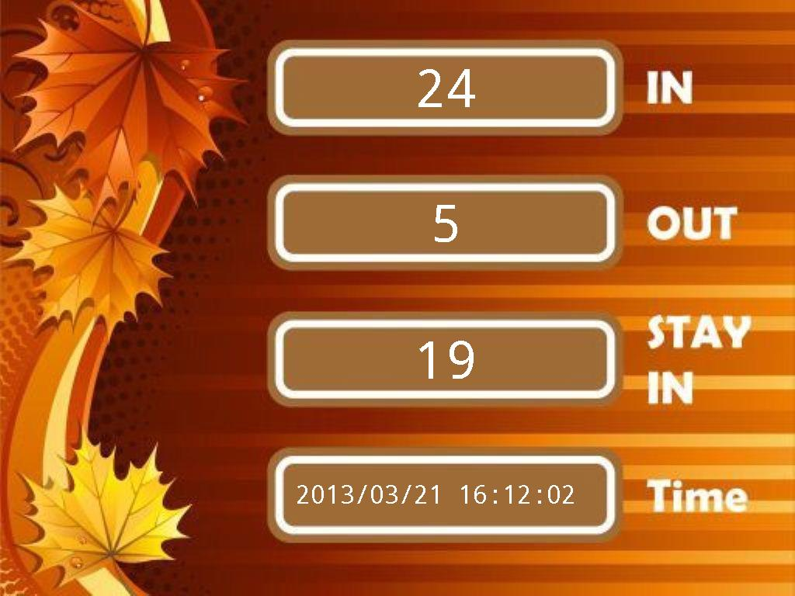
GV-3D People Counter
Result from TV-Out
via VGA / HDMI Output

Slide 8
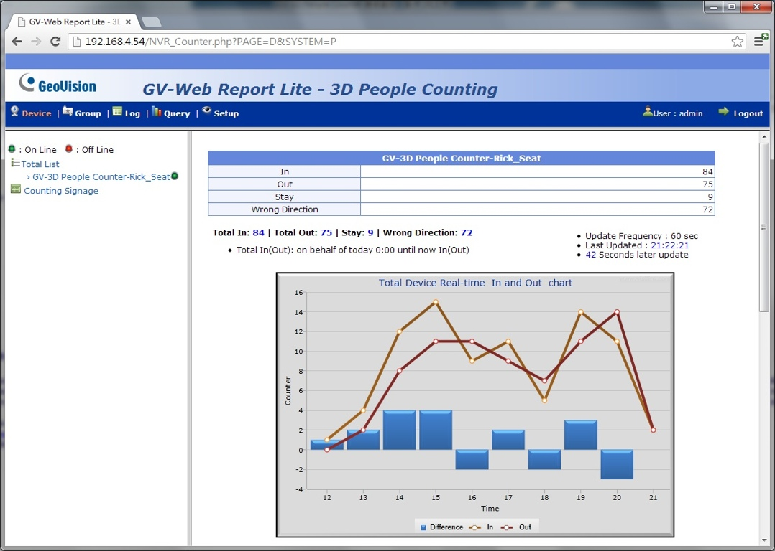
GV-3D People Counter
Result from Build-in Web Report Lite
via Google Chrome

Slide 9
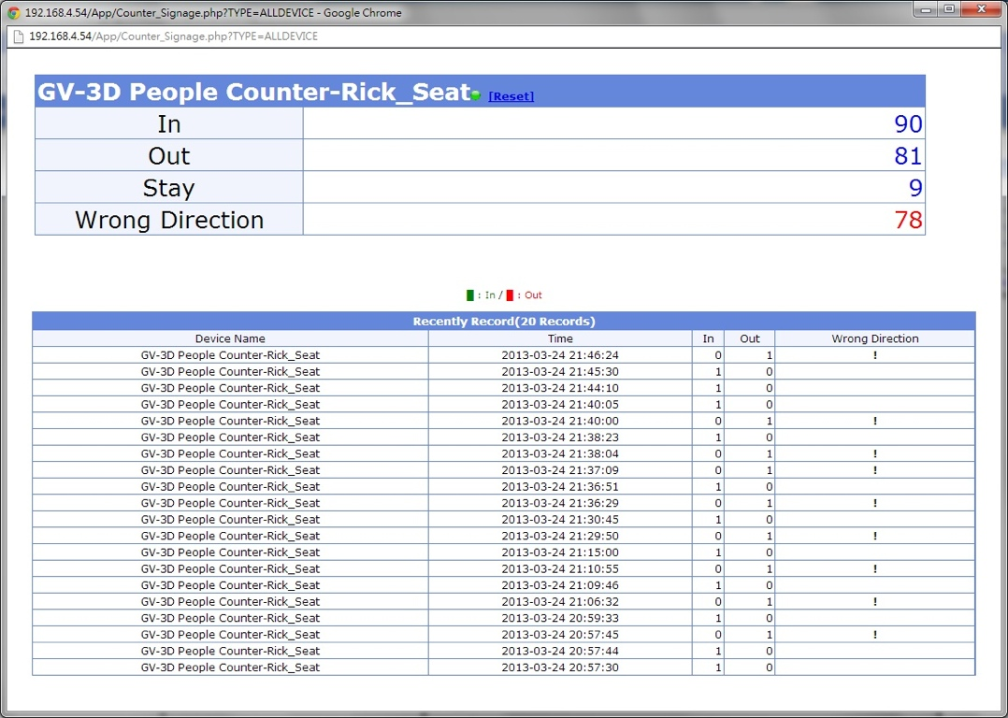
GV-3D People Counter
Features - Instant Counting Result
via Google Chrome

Slide 10
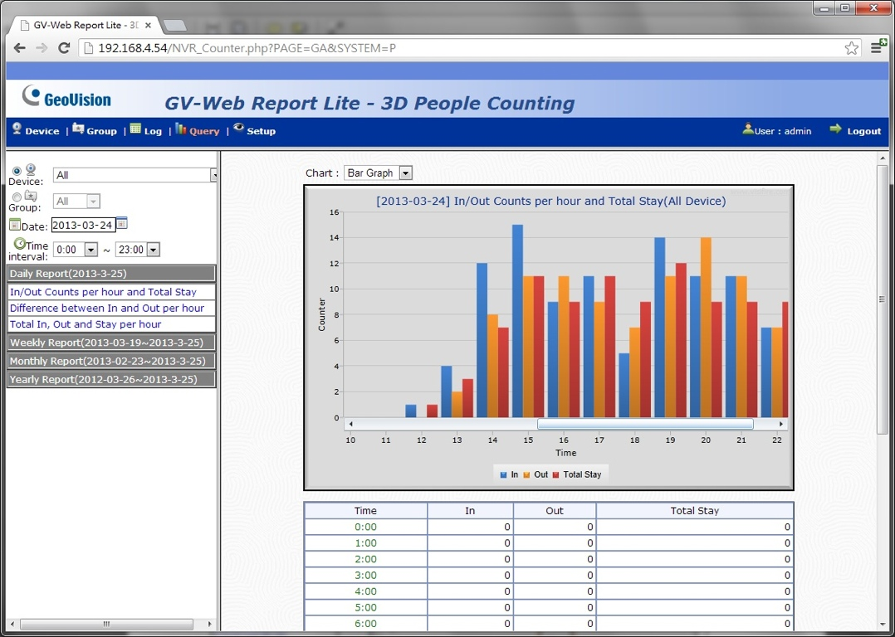
GV-3D People Counter
Features - Daily / Weekly / Monthly / Yearly Report
via Google Chrome

Slide 11

GV-3D People Counter
Features - IN / OUT / STAY-IN Result
Features
In / Out / Stay-In Result
Customize Layout on Display Monitor
View Counting result via HDMI / VGA or via build-in Web Report Lite
Audio Alarm when Wrong Direction
Grouping / Setup Max. In, Out, Stay-in
Create Daily / Weekly / Monthly / Yearly Report for In, Out, Stay-in

Slide 12

GV-3D People Counter
Something you should know.....
Limitation
Xtion Pro Acceptable Range: 180 cm ~ 500 cm
Min People’s Height Setup Range: 100 cm up to 240 cm
Avoid Direct Sunlight or other IR’s interference for better counting result

Slide 13




GV-3D People Counter
Features - Connecting Multiple GV-3D People Counter Device
TCP/IP
TCP/IP
TCP/IP
TCP/IP
Build-in Web Report Lite
Max. 4 device
via Build-in Web Report Lite

Slide 14

GV-3D People Counter
Features - Connecting Multiple GV-3D People Counter Device
1 ~ 1000 device
TCP/IP
Web Report
Max. 1000 device
via Web Report

Slide 15
PEOPLE COUNTS
Up to 1000 units for large scale video surveillance
Collecting counting information from 3D People Counter
Email notification and I/O trigger when the number of people remaining exceeds the specific maximum
Group desired counting channels for data analysis
Competitive Advantages: GV-Web Report

Slide 16
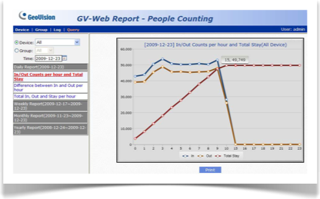

PEOPLE COUNTS
Competitive Advantages: GV-Web Report
Counting result from iPhone / Android Phone
Generate counting results in hourly / monthly/yearly statistic with Pie / Bar / Line charts
Access people counting / see the live view / playback from DVR/NVR via Web Report’s IE interface

Slide 17
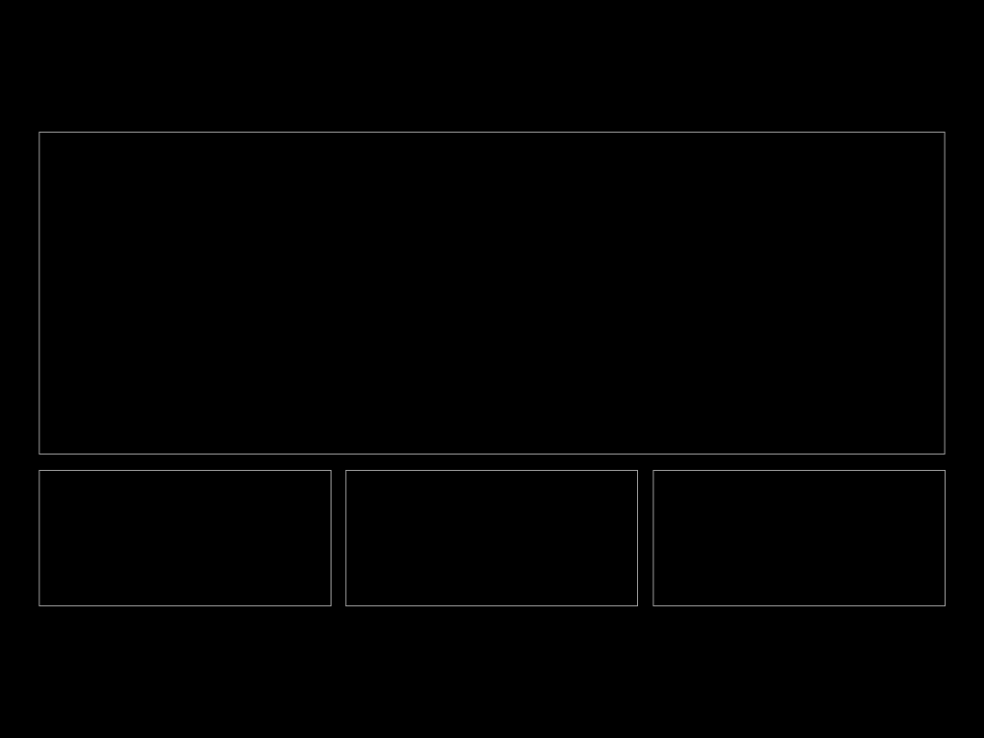
Thank You!
For more information:
Web Site: http://www.geovision.com.tw
E-Mail: support@geovision.com.tw
Phone: +866-2-8797-8376

